Slide 1
Environmental Mapping Strategy
Patxi Escobar
Dpt. of Geology, Geography and Environmental Sciences
University of Alcala
www.geogra.uah.es/patxi
EXPLORERS EUROLAB 2O2O

Slide 2
Environmental Mapping Strategy
A set of mapping tools and methods to communicate information and knowledge about the environment
coding
decoding
Interpretation
Intention
Message
received
Message
sent
Channel (map)
Sender (Map maker)
Receiver (Map user)

Slide 3
The environment…
… is highly complex and varied
… requires special data for its analysis
geospatial data (location, attribute and time). What, where, when
… is multi-scale
from local to global
… is depicted by many and varied data sources
From global to local Spatial Data Infrastructures
… covers many and diverse topics
forestry, agriculture, urban planning, wildlife, public health, infrastructures, facilities, routing, freight management, criminology, climate, migrations, transport, demographics, land management…
... uses multiple representation forms
2D/3D, analogue/digital, online/offline, interactive/non interactive, animated/static, abstract/realistic, point/line/polygon based, global/continental/national/regional/local…

Slide 4
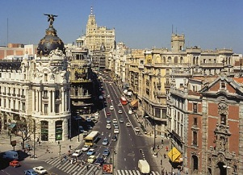
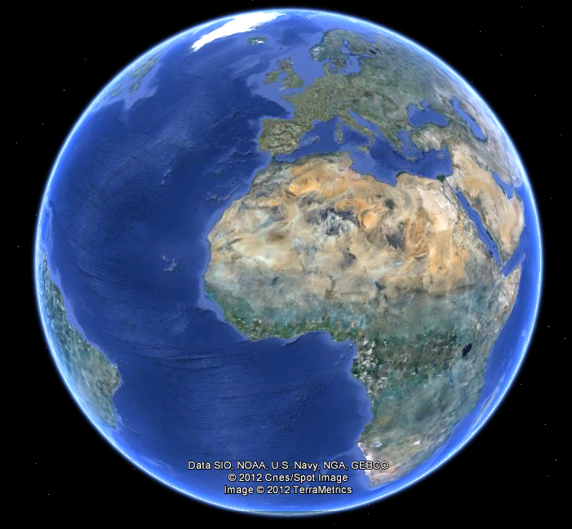
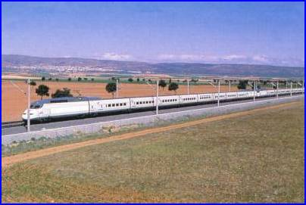
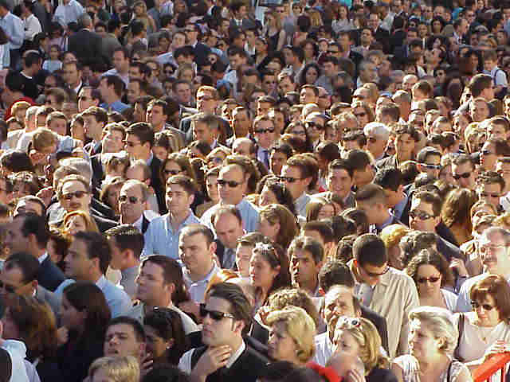
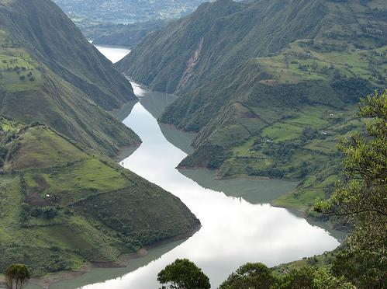
From the real World…

Slide 5
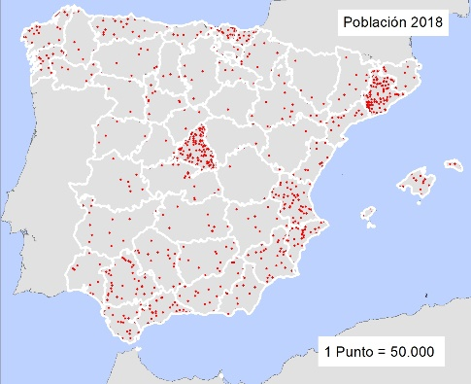
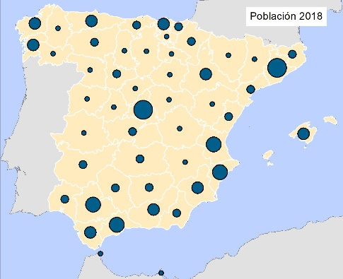
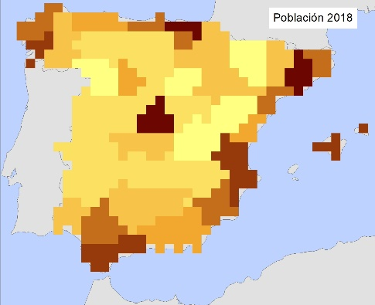
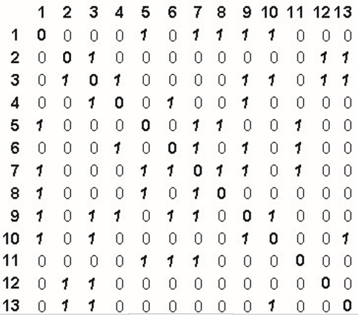
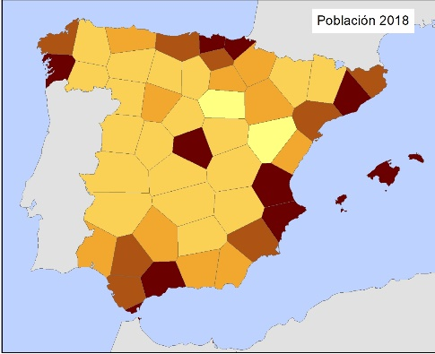
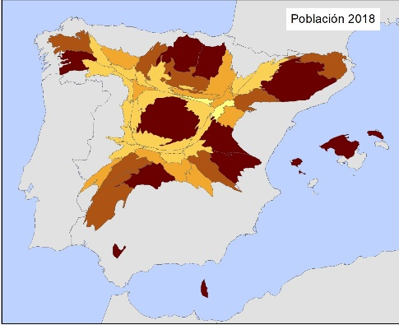
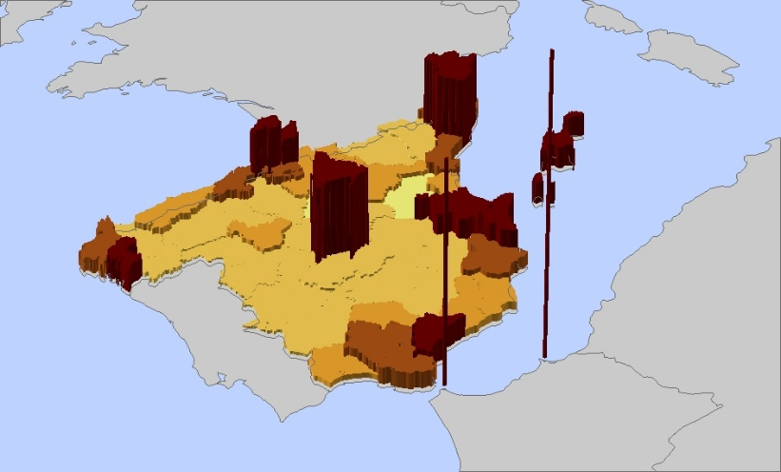
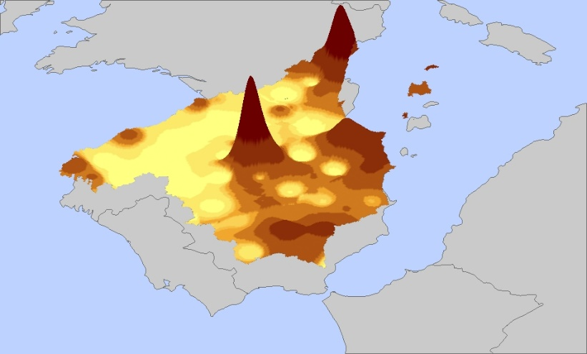
… to the map

Slide 6
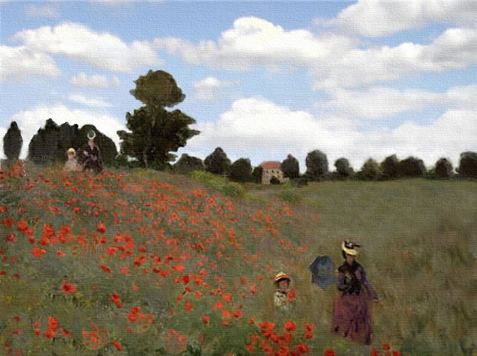
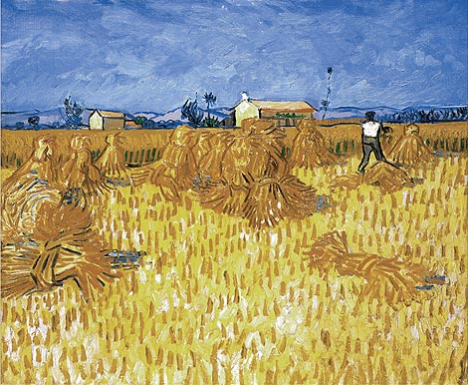
Mapping: representation of the environment
Are these maps?

Slide 7
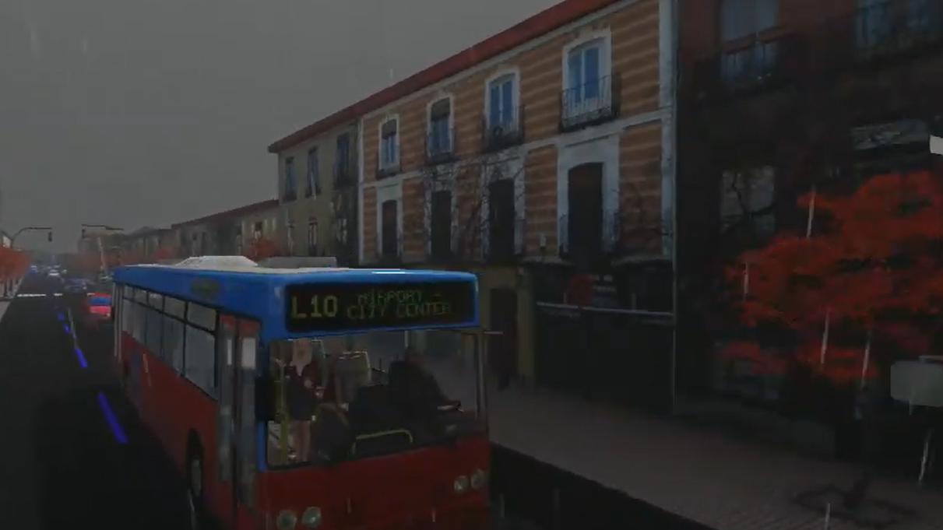
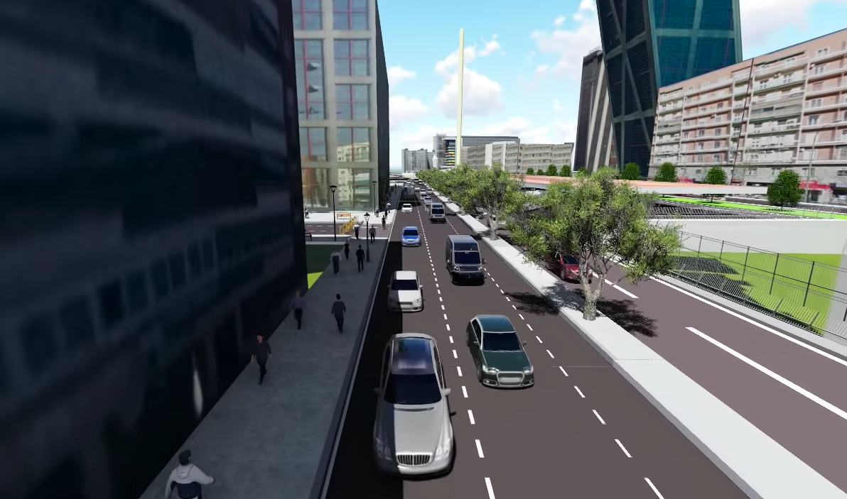
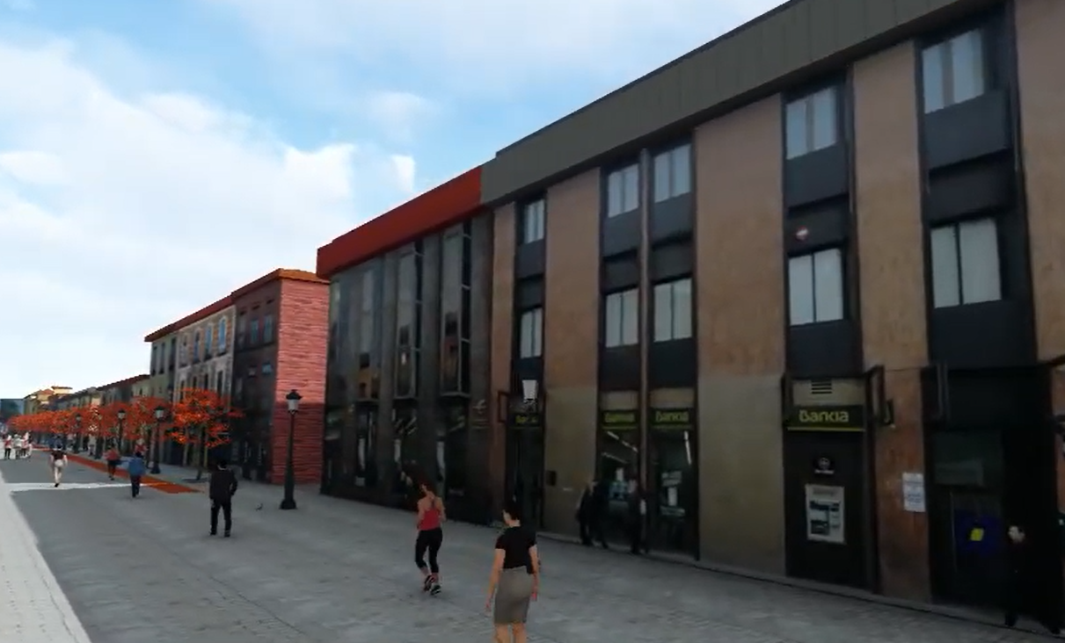
Mapping: representation of the environment
What about these? Are they maps?
Yes as they present mathematically known deformations and distortions throughout the whole area. Measurements are possible
Images: Master in GIT, UAH
Macarena García, Óscar Sánchez and Fabián García

Slide 8
Skills
At completion of the course, you will be able to:
Design and create maps in a variety of formats:
Traditional maps
Flow maps
Distorted maps / Cartograms
3D visualization tools
Animated maps
Practical skills include: ArcGIS; SketchUp, Mapshapper, Darcy, Video editing, Forester, Arboretum and Pov_Ray.

Slide 9
Assessment
Your performance will be assessed throughout the course
You have to complete and to handle 5 assignments
Each of the 5 assignments are considered for the final marking as follows:
Assignment 1: 25%
Assignment 2: 15%
Assignment 3: 15%
Assignment 4: 15%
Assignment 5: 30%

Slide 10
Course structure
Unit | Assignment | Topics
1 | World Population Taiwan Population | Map projections Spatial resolution and scale Map generalization Modifiable Areal Unit Problem MAUP Interval definition Semiotics
2 | Migration flows to US and to Spain | Flows Unimodal vs multimodal Line representation / surface meaning
3 | Foreign born Accessibility by train | Cartograms Weight cartograms Multidimensional scaling Bidimensional regression
4 | Covid-19 expansion | Time mapping Temporal changes
5 | Modelling Madrid | Principles of geovisualization and video editing

