Slide 1
Cartographic Transformation of Position (CTP) - Cartograms
Patxi Escobar
Dpt. of Geology, Geography and Environmental Sciences
University of Alcala
www.geogra.uah.es/patxi
Environmental Mapping Strategy - EXPLORERS EUROLAB 2O2O

Slide 2
Content
Introduction: definition, objective and characteristics
CTP of weight
CTP of distances – Multi Dimensional Scaling - MDS
CTP of comparison –bidimensional regression
Examples – accessibility by train and cognitive distances
Final remarks

Slide 3
1. Introduction
Definition of cartogram - Set of cartographic methods, in which the areas of the spatial objects vary depending on the thematic values of the phenomenon associated with those objects (Cauvin et al 2010)
Cartographic Transformations of Position (CTP) - It is synony-mous with Cartogram - Cartographic Transformation in which the attributes [Z] induce modifications in the variables [X, Y], that is, in the locations.
Other terms
Anamorphosis
Deformed maps
Distorted maps

Slide 4
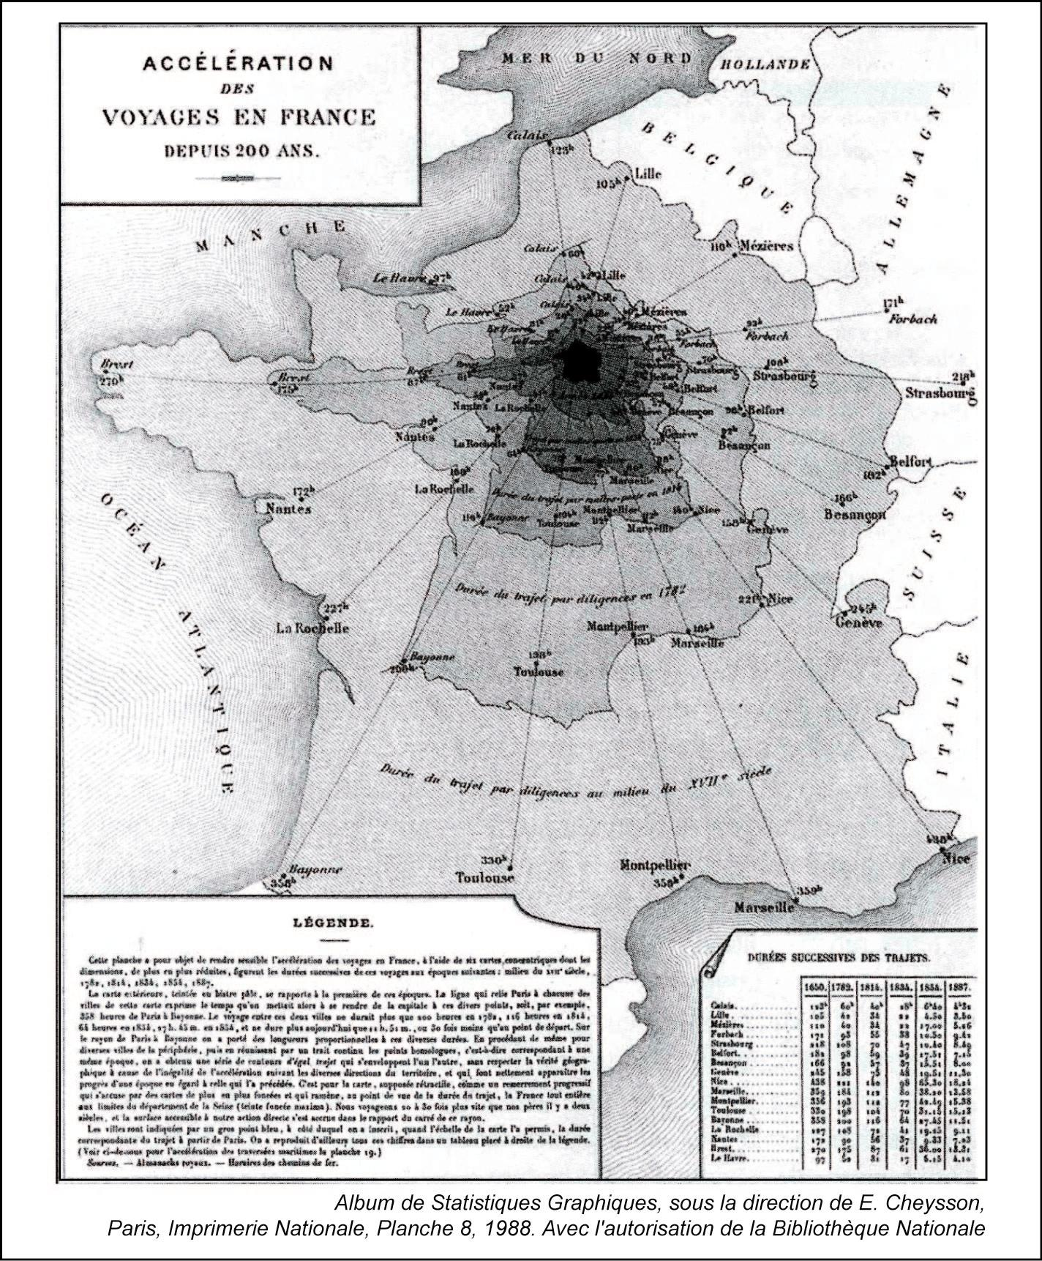
1. Introduction
In CTP, attributes [Z] induce modifications in locations [X, Y]
They express changes in the shape of the map, by displacement of contours, internal limits or places.
They have existed since the mid-19th century
Accelerating travel in France for 200 years (Cheysson, 1888)

Slide 5
1. Introduction
Objective
Communication tool. The easiest-to-read component of the map: surface variation
Exploration and research tool.

Slide 6
1. Introduction
Every 2D map presents deformations in the cartographic base
The characteristics of the cartograms depend on two criteria:
The Topic - Weight CTP, distance CTP, comparison CTP
The principle on which its production is based
Graph / Mathematical
Global (multipolar) / Local (unipolar)
Geometric nature (points, lines or polygons)
Topology
Characteristics
Shape preservation
Topology preservation
Proportionality of the areas

Slide 7
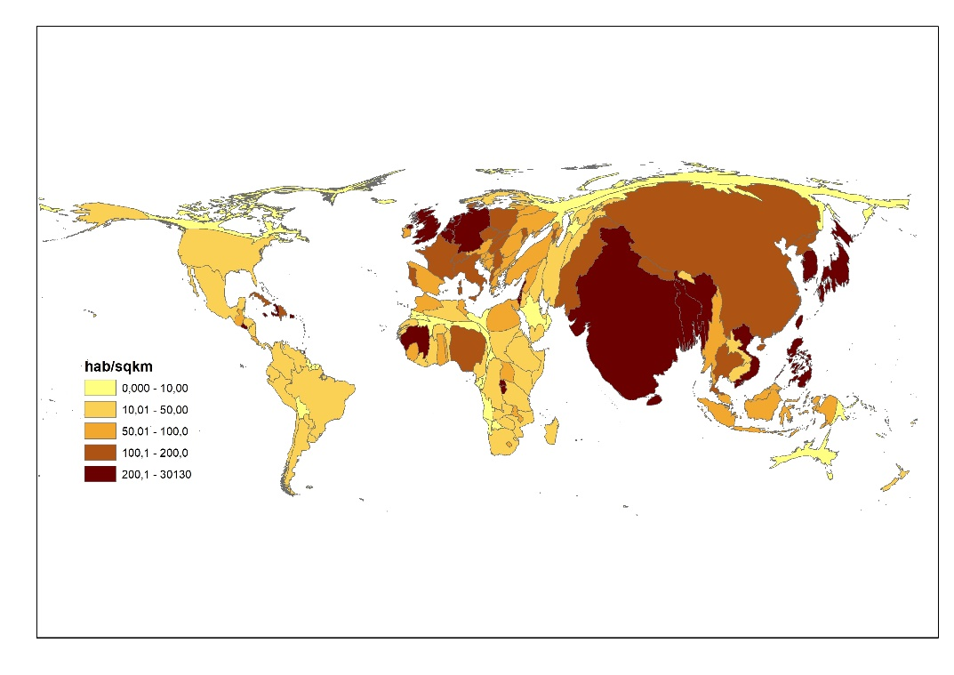
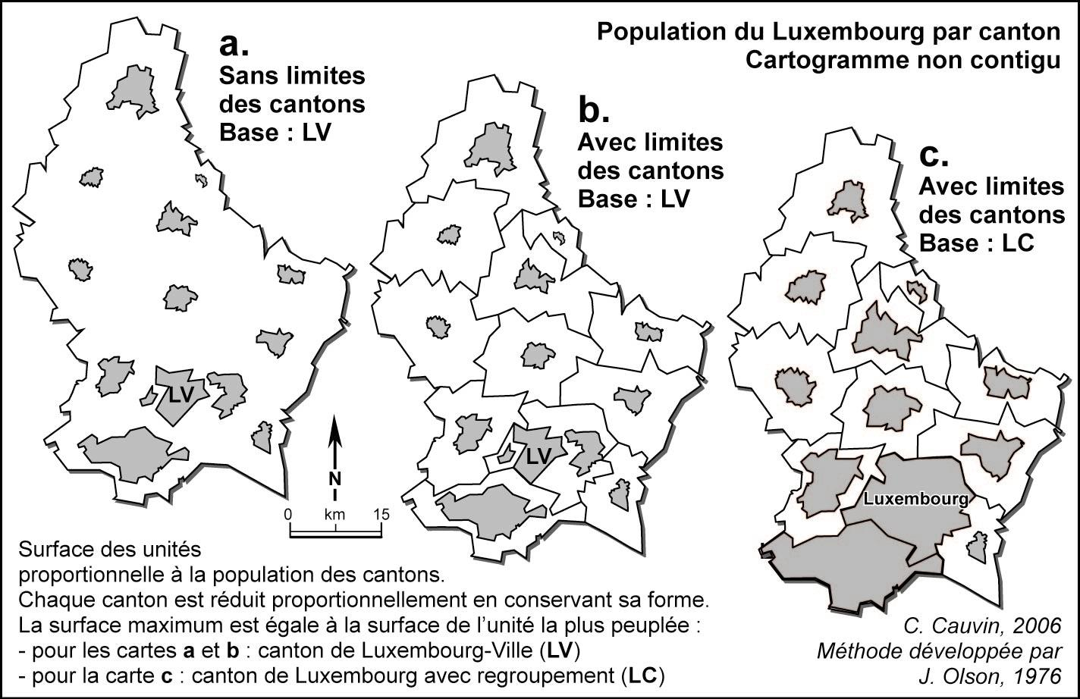
2. Cartographic transformation of weight
They are the most common
The surface is deformed under the effects of a thematic variable
The shapes, which may be of simple geometries, are proportional in size to the thematic values
They can be contiguous or not
contiguous
Non-contiguous
Gastner, M.T. and Newman, M.E.J.. (2004). Diffusion-based method for producing density-equalizing maps. Proceedings of the National Academy of Science, 101(20), 7499-7504

Slide 8
2. Cartographic transformation of weight
World population by country
https://ourworldindata.org/uploads/2018/09/Population-cartogram_World.png

Slide 9
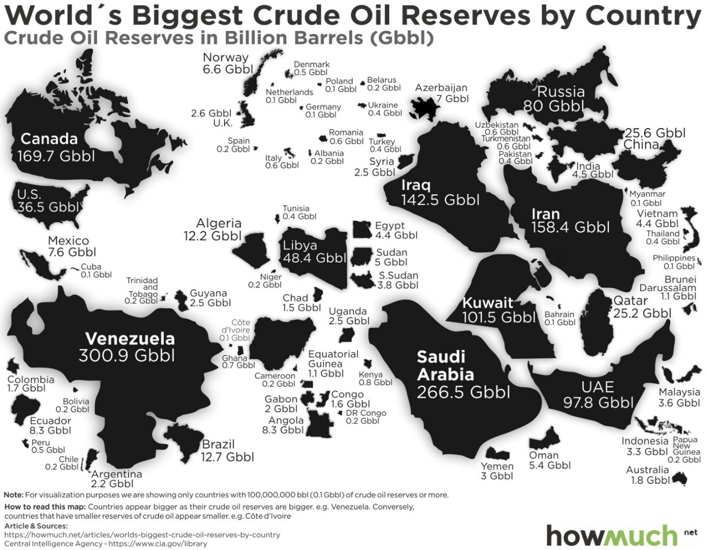
2. Cartographic transformation of weight
Example of non-contiguous cartogram
https://www.reddit.com/r/MapPorn/comments/dijq4j/world_countries_scaled_to_oil_reserves/

Slide 10
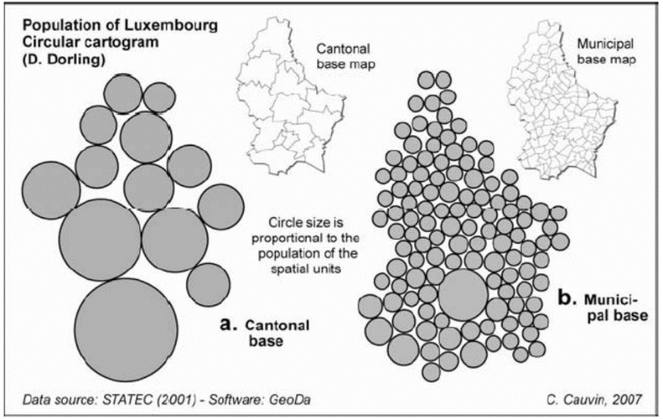
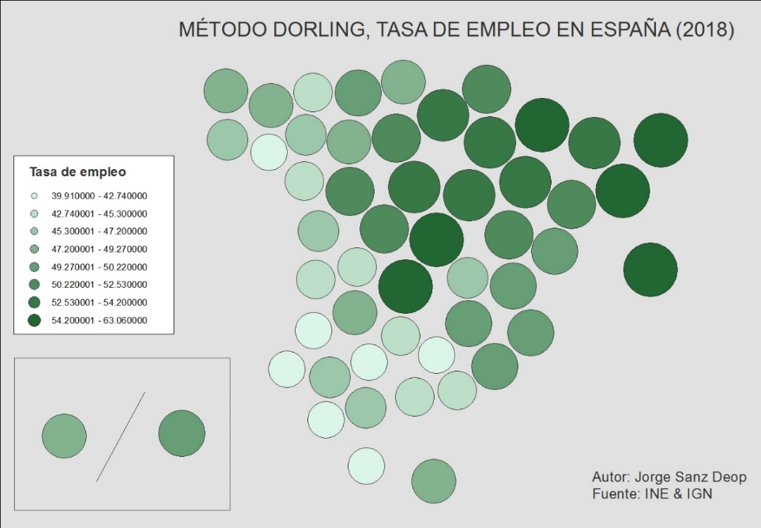
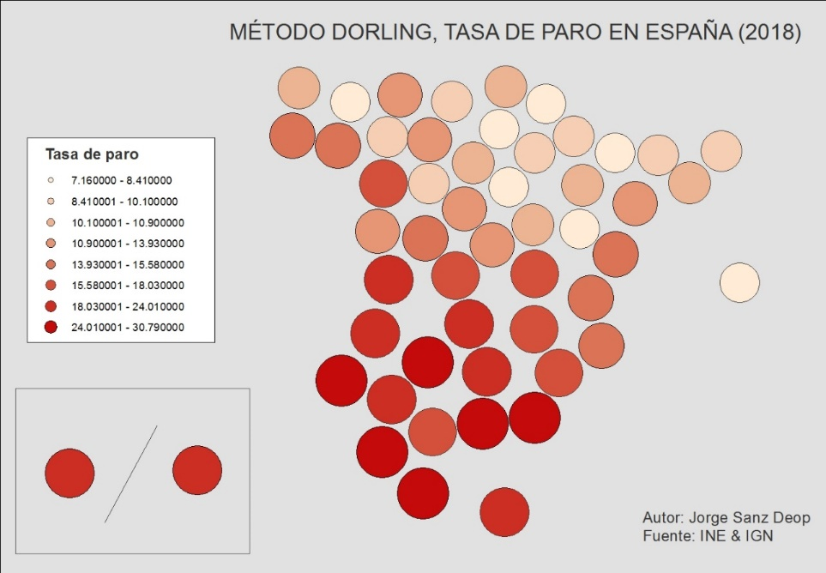
2. Cartographic transformation of weight
Non-contiguous
Dorling’s circle map

Slide 11
3. Cartographic transformation of distances – Multidimensional Scaling (MDS)
It affects all measurable distances between all points on the surface under study
The objective is to find relative positions that meet the distances between the points
It’s been applied in many studies (marketing, psychology, geography, sociology ...)
Principle: Given a configuration of points in a space defined by their x, y coordinates, it is possible to obtain a matrix of distances between them. The MDS performs the process in reverse: given a matrix of distances between points, it is possible to find a spatial configuration of all of them, that is, their x, y coordinates

Slide 12
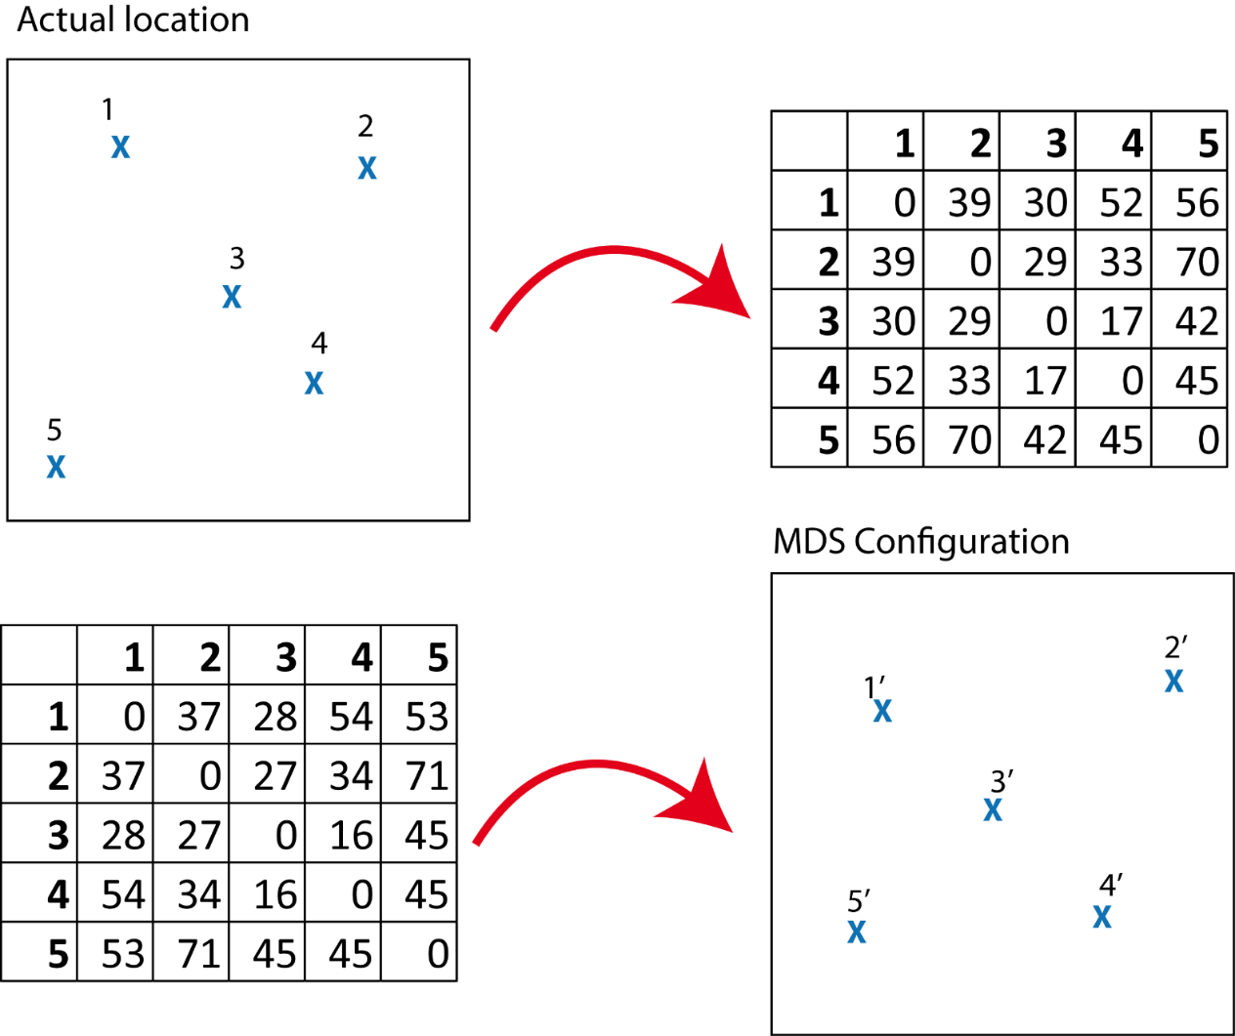
3. Multidimensional Scaling (MDS)
Objective To visualize the level of similarity between individual cases (points) in a dataset. Translates 'distances' between a set of objects, individuals or locations within a cartographic configuration
We usually measure distances between points whose location is known; MDS finds the location of the points from the matrix of distances* between them
* These distances can be travel times, costs or physical or perceived distances

Slide 13
4. CTP of comparison –bidimensional regression
After work developed by D’Arcy Thompson
Developed in cartography by Tobler in the 60s of the 20th century
Thoroughly explored and tested in Strasbourg by Cauvin and collaborators
Updated and programmed at the ThèMa Laboratory in Besançon, France, by Gilles Vuidel
DARCY Software
http://thema.univ-fcomte.fr/production/logiciels/16-categories-en-francais/cat-productions-fr/cat-logiciels-fr/294-art-darcy

Slide 14
4. CTP of comparison –bidimensional regression
The objective is to compare homologous 2D shapes
Shapes to compare can have very different origins:
Old maps
Sketch maps
Configurations obtained after n MDS
They allow to know, quantitatively and graphically, the differences between a reference image and its counterpart

Slide 15
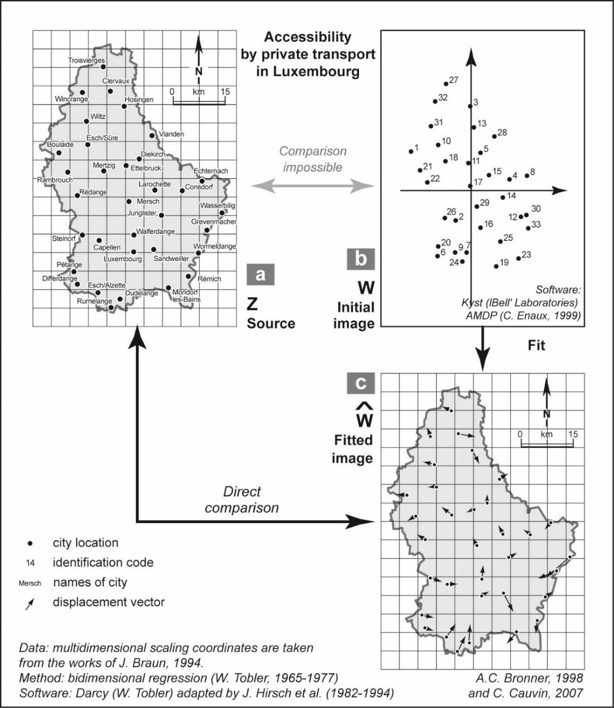
4. CTP of comparison –bidimensional regression
Step 1: fitting
At this stage the method looks for the displacements of the homologous points of the two surfaces.
For example, the displacement of the points obtained by the MDS with the distances by train between cities and the points that represent the real position of those cities As with map projection changes, the fitting involves a rotation (to match the angles of the coordinate axes), a translation (to match the origins of the coordinate axes), and a scale change (to match the measurement units)

Slide 16
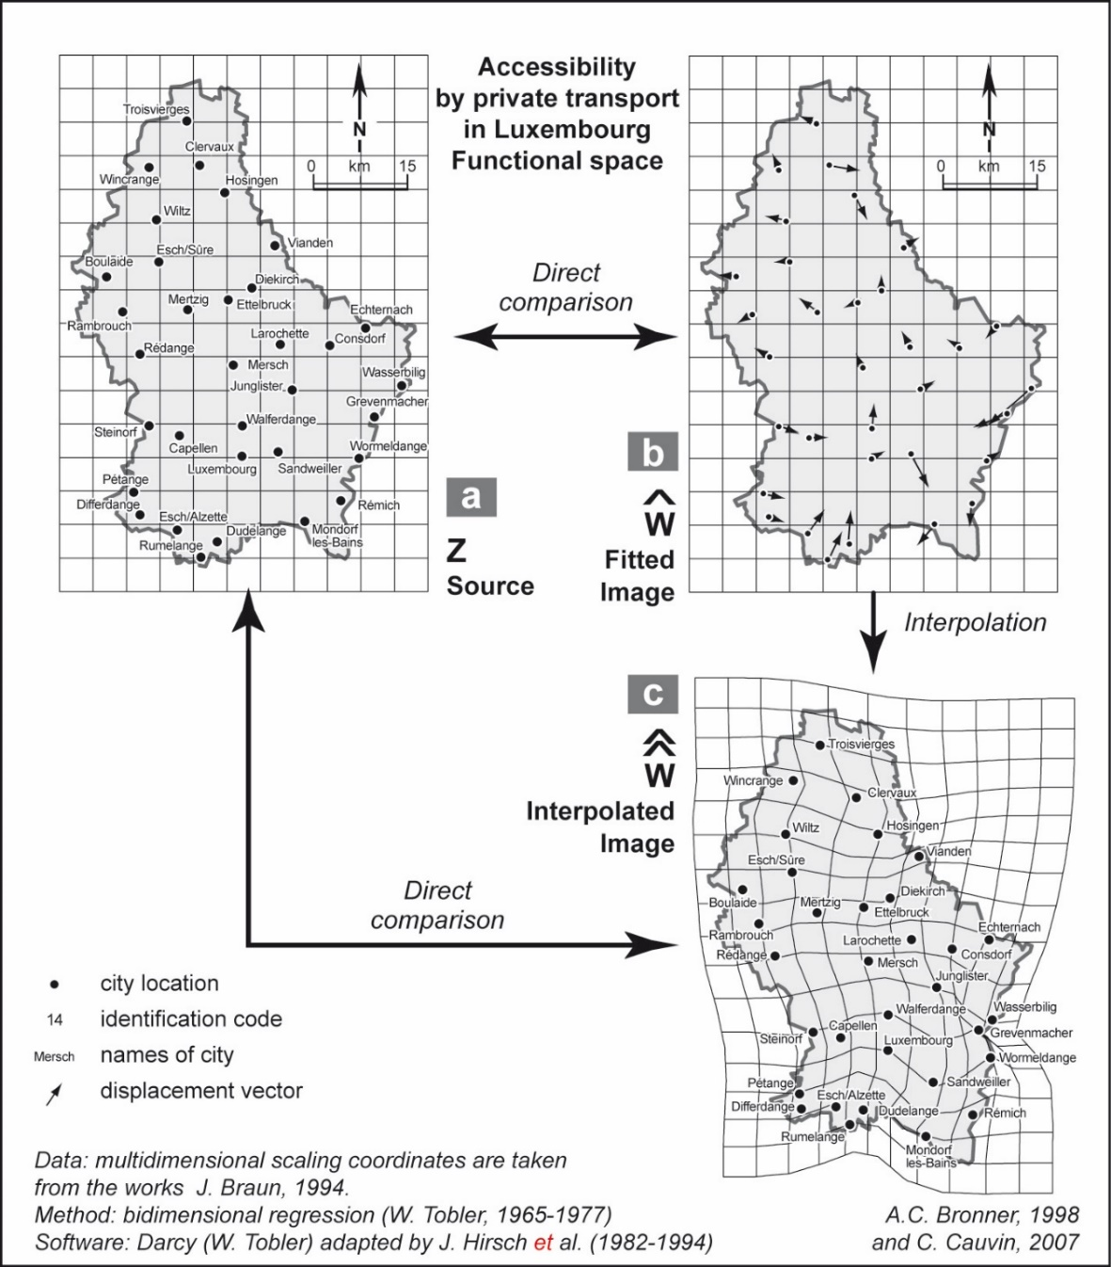
4. CTP of comparison –bidimensional regression
Step 2: interpolation
In this step we extend the results of the previous step (which only affected the points), to the entire set of the analyzed surface.
It produces abundant mapping results

Slide 17
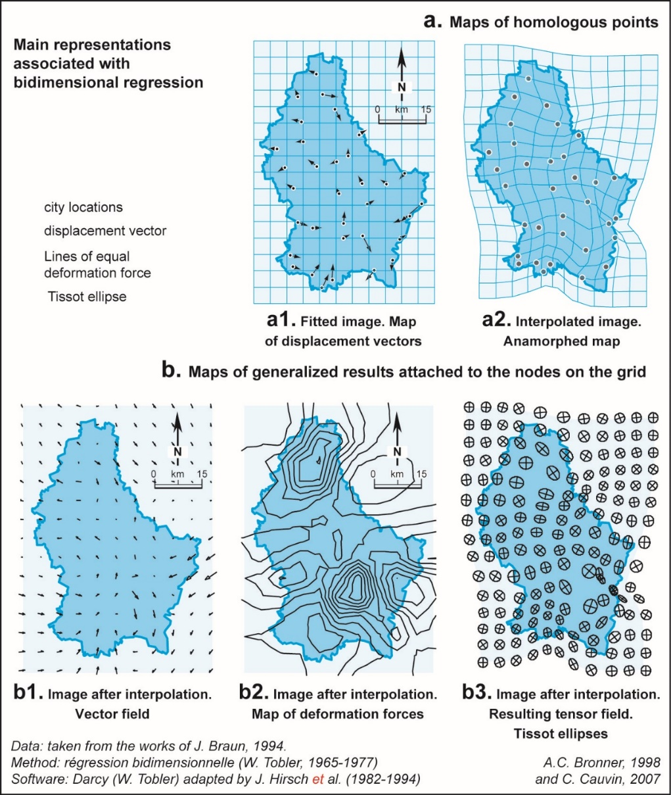
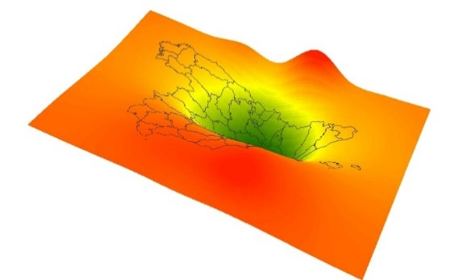
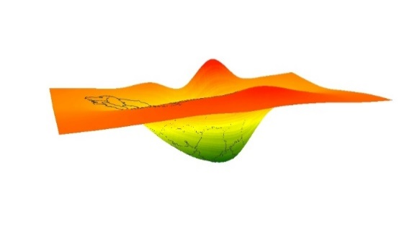
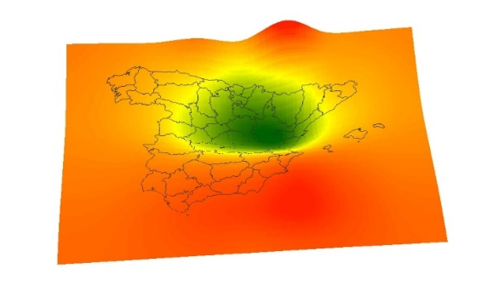
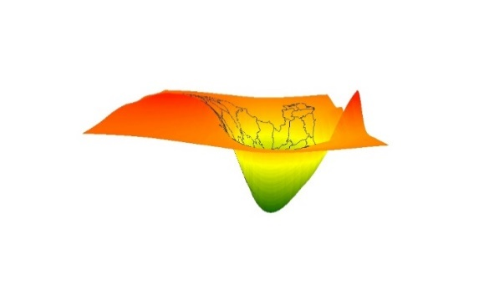
4. CTP of comparison –bidimensional regression
Graphic results

Slide 18
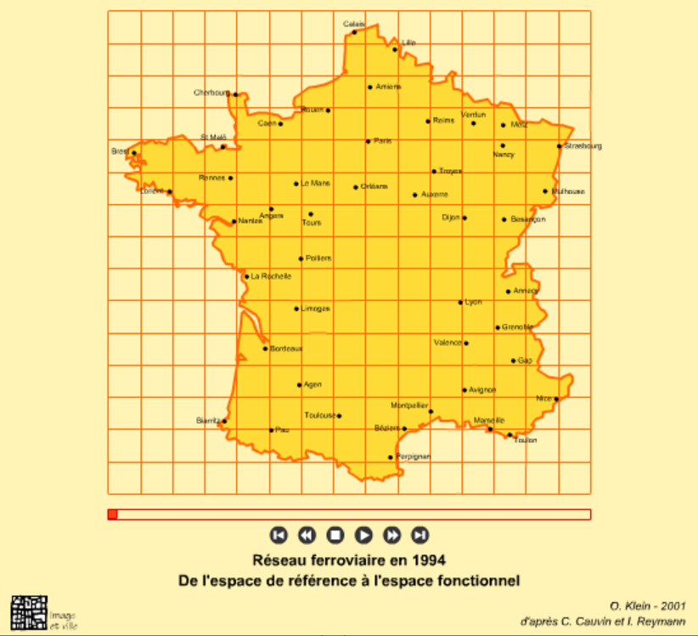
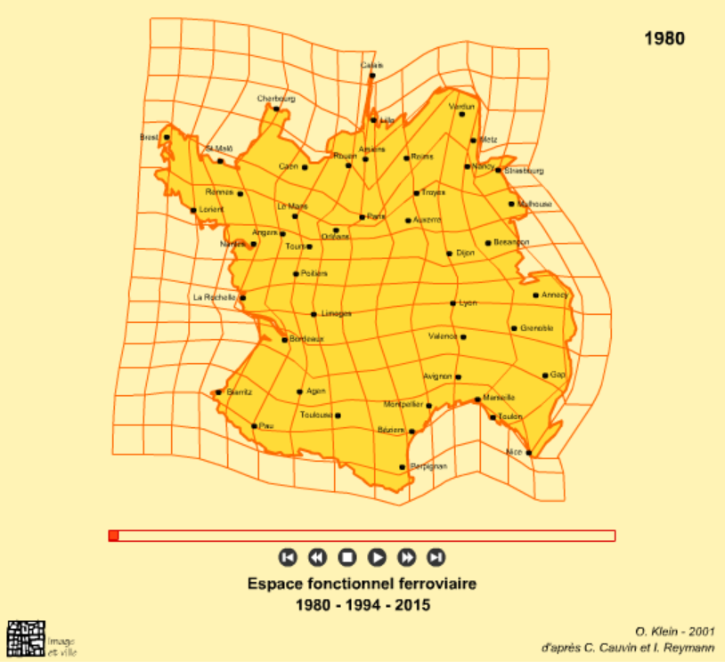
Examples – Accessibility by train in France (Klein 2001)
5. CTP of comparison –bidimensional regression

Slide 19
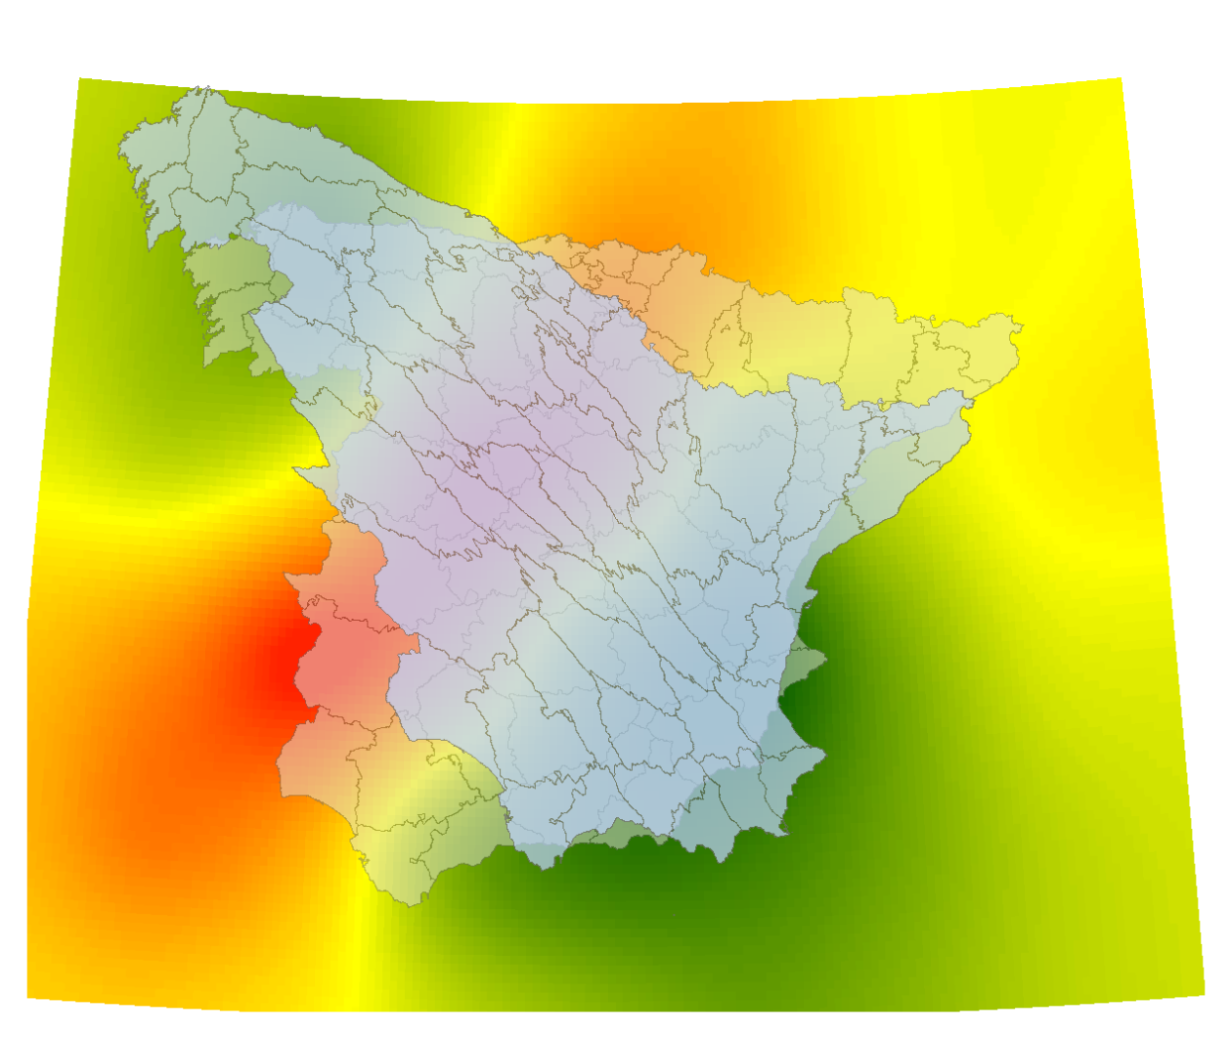
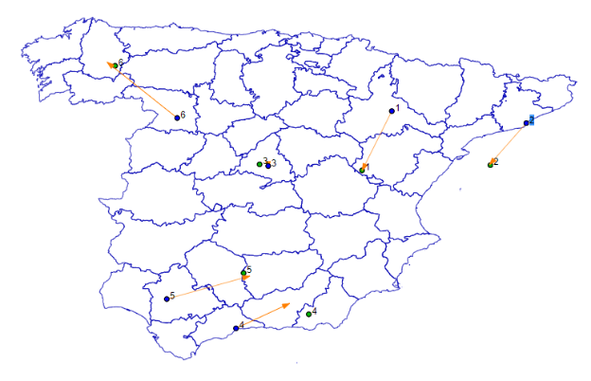
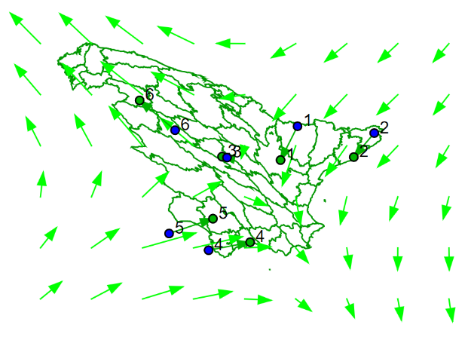
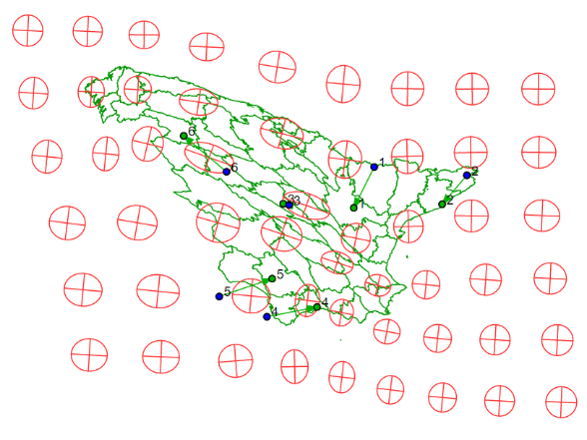
Train accessibility in Spain

Slide 20
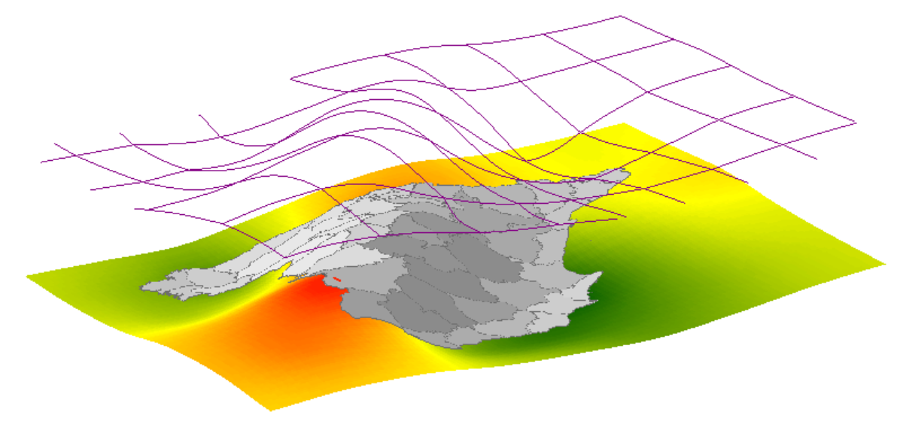

Slide 21
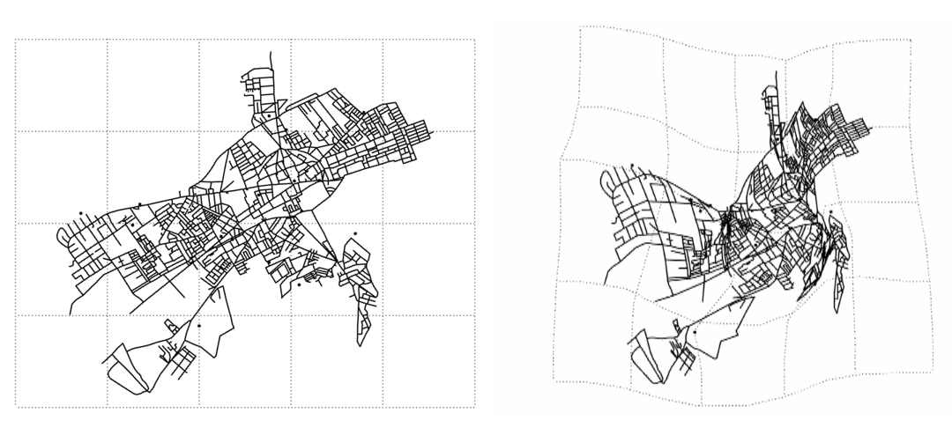
Cognitive distances in Alcalá de Henares, Spain

Slide 22
Cognitive distances in Alcalá de Henares, Spain

Slide 23
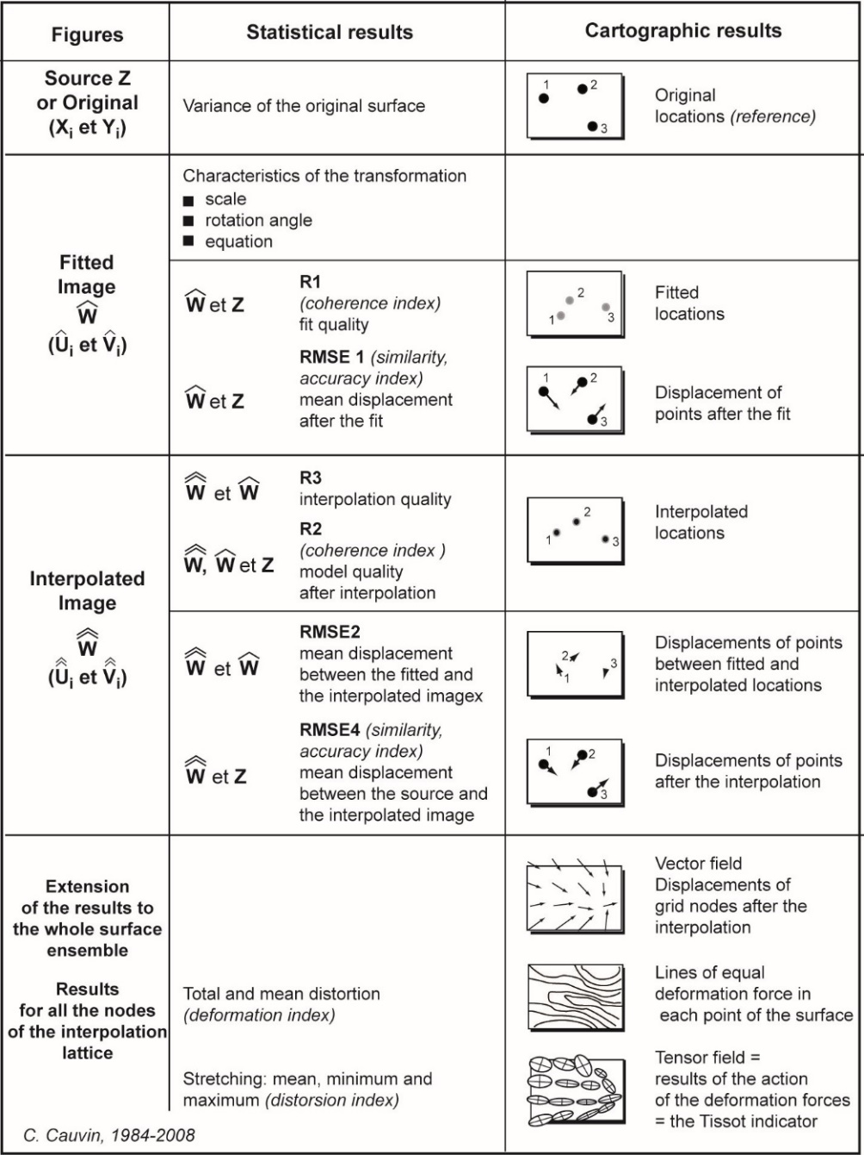
Bidimensional Regression
Graphic and statistical results
Fitting
Scale
Rotation angle
Fitted image coordinates
Fitting index
Mean displacement after fitting
Interpolation
Interpolation quality
Mean displacement between fitted and interpolated images
Mean displacement between original and interpolated images

Slide 24
6. Final remarks
Bidimensional Regression meets the criteria of experimental research: it can be verified and reproduced with identical results
In all cartograms, attention must be paid to familiarity with the represented area
As in traditional maps, the same principles of graphic semiology must be applied
Integration of animation and interaction can make reading easier

Slide 25
Bibliography
Cauvin, C., Escobar, F. and Serradj, A, (2010), Thematic Cartography, 3 vols. Londres: Wiley
Tobler W.R., 1965, "Computation of the correspondence of geographical patterns", Papers of the Regional Science Association, vol. 15, p. 131-139.
Tobler W.R., 1977, "Bidimensional regression: a complete program", Santa Barbara, CA, 71 p.
Tobler W.R., 1978, "Comparisons of plane forms", The Geographical Analysis, vol. X, n° 2, p. 154-162.
Tobler W.R., 1994, "Bidimensional regression: a complete program", Geographical Analysis, vol. 26, n° 3, p. 187-212.
GISGeography https://gisgeography.com/cartogram-maps/

