Slide 1
Flow mapping
Patxi Escobar
Dpt. of Geology, Geography and Environmental Sciences
University of Alcala
www.geogra.uah.es/patxi
Environmental Mapping Strategy - EXPLORERS EUROLAB 2O2O

Slide 2
Content
Introduction. Definition
Background
Descriptive representation of flows
Mathematical representation of flows

Slide 3
Introduction
Flow is a movement quantity whose nature may vary (flow of water, in a phone or a road network). This is, it can vary its category (nominal) and its importance (ordinal and quantitative)
Flow Map uses linear symbols to show the traffic of resources between points or areas.
Network maps
Line maps with areal meaning

Slide 4
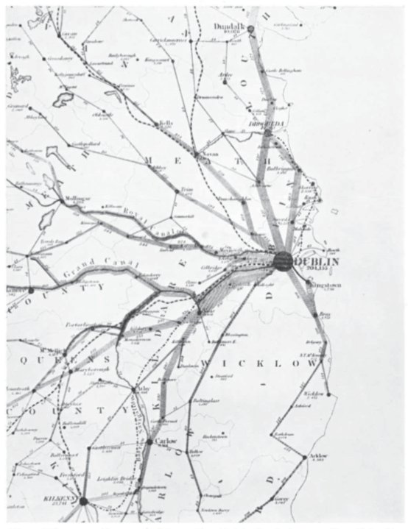
Background
First flow maps:
1837 H. D. Harness. Representing people’s transport in Ireland
- Influenced by military maps
Arthur H. Robinson (1955) The 1837 Maps of Henry Drury Harness, The Geographical Journal, 121,440-450
https://jmichaelbatty.files.wordpress.com/2011/06/harness-1837-flowmap.pdf

Slide 5
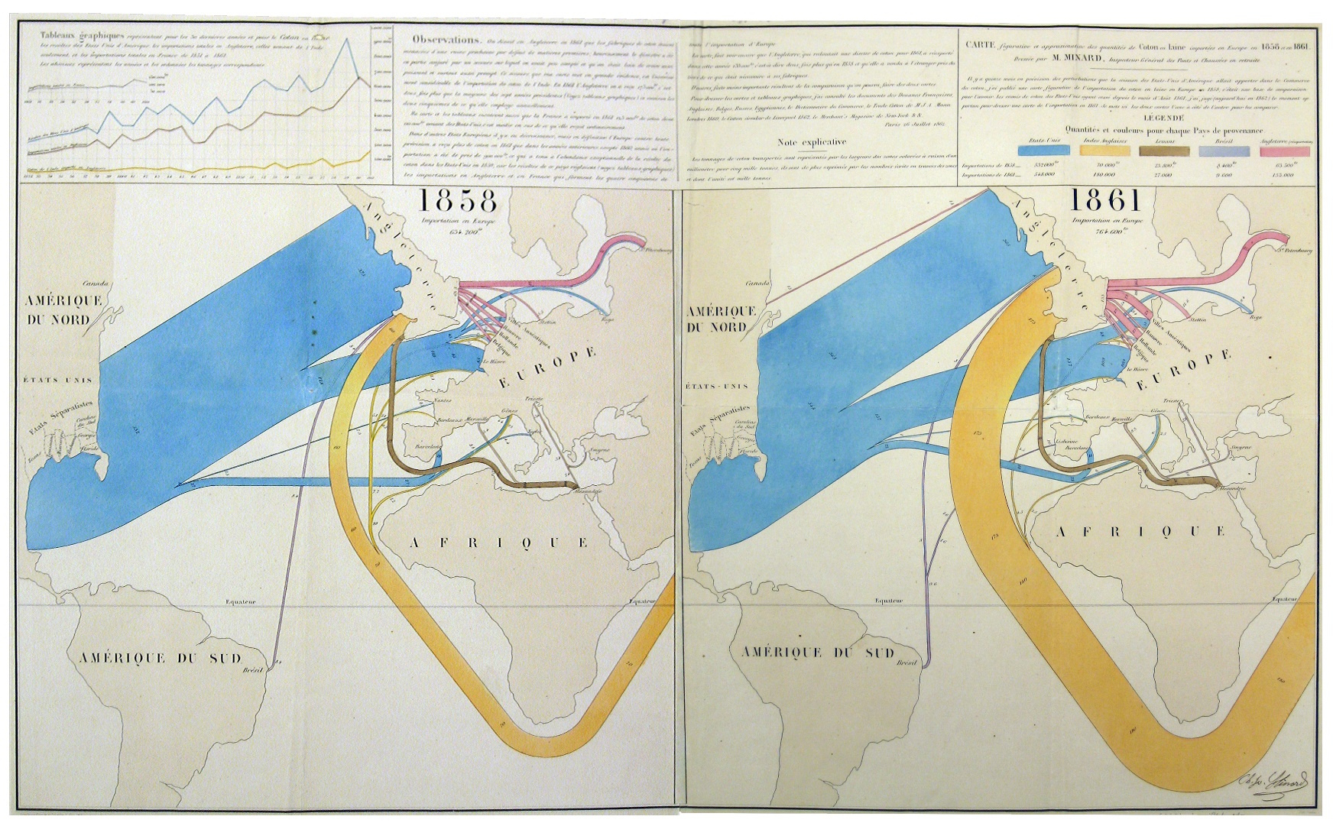
Background
C. J. Minard’s maps:
1845 – 1864 cotton and wool trade
https://cartographia.wordpress.com/category/charles-joseph-minard/

Slide 6
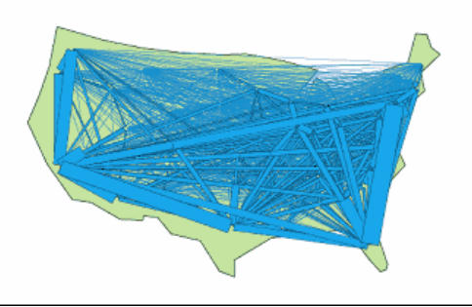
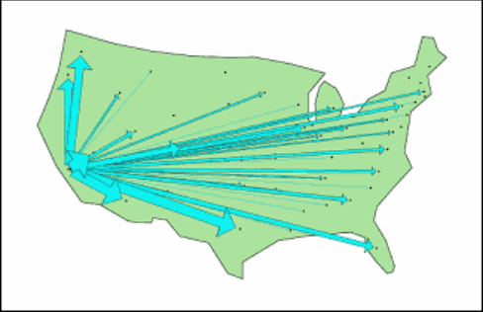
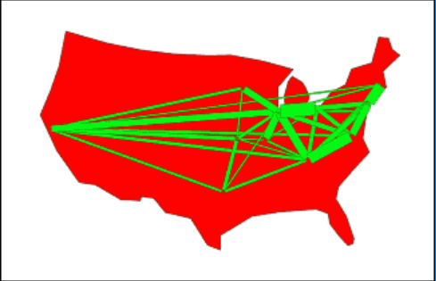
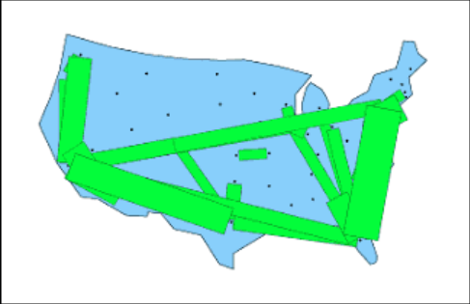
Background
Waldo Tobler as from 1960
Development of Flowmap software (1979)
http://csiss.org/clearinghouse/FlowMapper/

Slide 7
Descriptive representation of flows
There are flows of different material (nominal), different order (ordinal) or different magnitude (quantitative). Semiotics should be applied as in any line map.
Attention must be paid to:
Flow direction - line drawing
Flow orientation – arrow
Generalized drawing of the lines
Data in matrix form (the rows and columns contain the vertices between which the resource flows and the values at their intersections represent the amount of the resource that is transferred from one point to another)

Slide 8
Example: international migrations towards Spain
PAÍS | inmig2017 | X_1 | Y_1 | Lon_1 | Lat_1 | GMI_Cntry
Marruecos | 706520 | -3,6485 | 40,2280 | -6,3178 | 31,8836 | MAR
Rumanía | 652312 | -3,6485 | 40,2280 | 24,9693 | 45,8436 | ROM
Ecuador | 420344 | -3,6485 | 40,2280 | -78,7671 | -1,4274 | ECU
Colombia | 350802 | -3,6485 | 40,2280 | -73,0732 | 3,9008 | COL
Reino Unido | 308872 | -3,6485 | 40,2280 | -2,8956 | 54,1553 | GBR
Argentina | 254230 | -3,6485 | 40,2280 | -65,1677 | -35,3762 | ARG
Francia | 205624 | -3,6485 | 40,2280 | 2,5520 | 46,5645 | FRA
Alemania | 202544 | -3,6485 | 40,2280 | 10,3936 | 51,1066 | DEU
Perú | 186555 | -3,6485 | 40,2280 | -74,3755 | -9,1638 | PER
Venezuela | 162000 | -3,6485 | 40,2280 | -66,1696 | 7,1224 | VEN
Rep Dom | 158393 | -3,6485 | 40,2280 | -70,4846 | 18,8944 | DOM
China | 157190 | -3,6485 | 40,2280 | 103,8340 | 36,5631 | CHN
Bolivia | 152109 | -3,6485 | 40,2280 | -64,6706 | -16,7150 | BOL
Cuba | 132378 | -3,6485 | 40,2280 | -79,0362 | 21,6211 | CUB
Bulgaria | 128078 | -3,6485 | 40,2280 | 25,2315 | 42,7614 | BGR
Portugal | 113095 | -3,6485 | 40,2280 | -8,5627 | 39,6010 | PRT

Slide 9
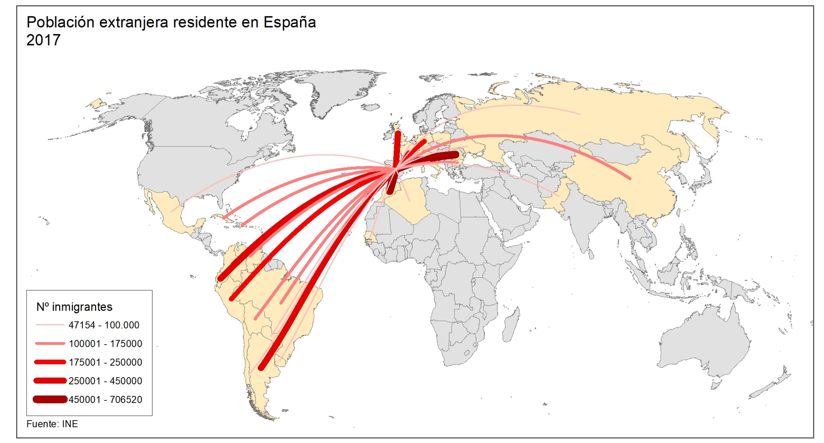
Example: international migrations towards Spain

Slide 10
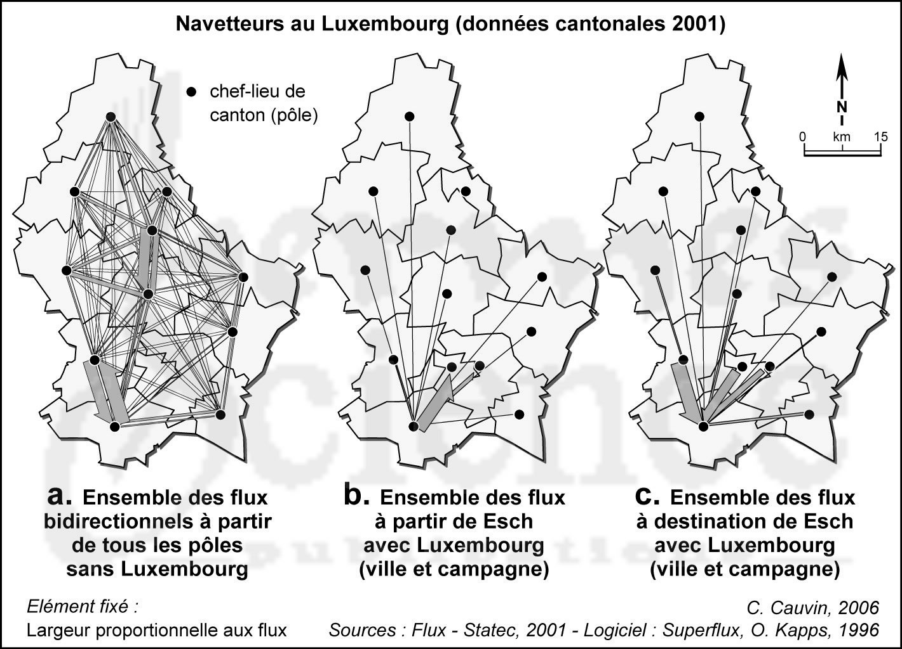
Descriptive representation of flows
Data volume increases exponentially with increasing number of nodes
In the example above from x countries to Spain
The volume of data would be much higher if we consider the Spanish provinces as a destination
In the latter case the result would not be readable
Need to generalize and / or select

Slide 11
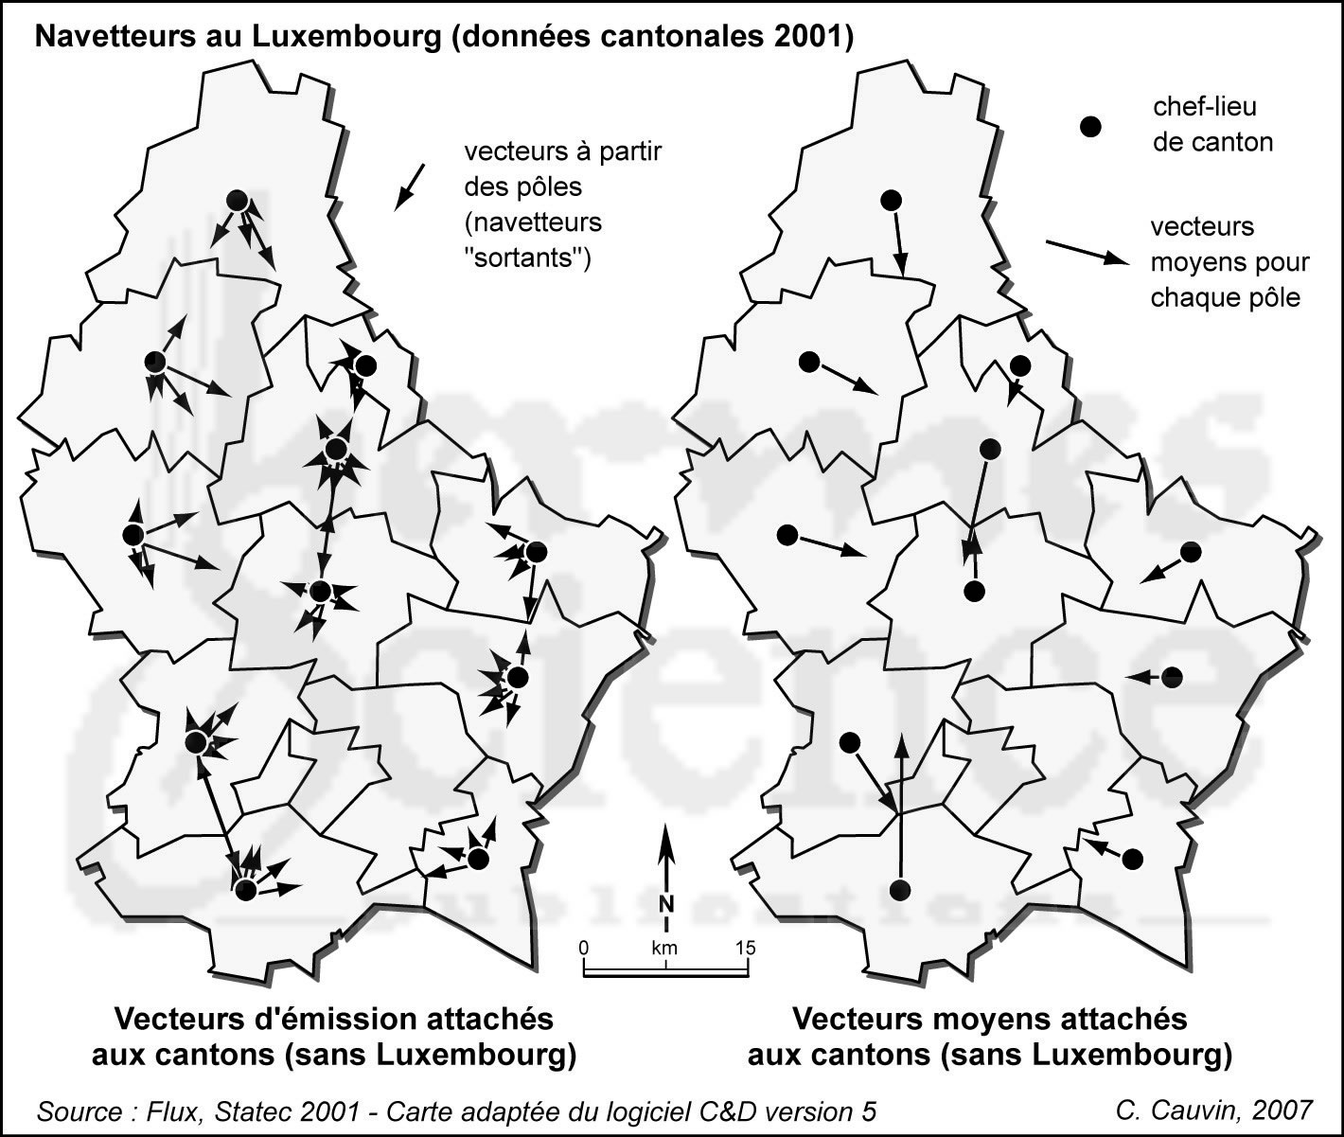
Mathematical representation of flows
The arrow-drawing is replaced by a mathematical vector that has direction, orientation, point of application and length

Slide 12
Bibliography
Cauvin, C., Escobar, F. And Serradj, A, (2010), Thematic Cartography, 3 vols. Londres: Wiley
Dent, B. (1996): Cartography. Thematic Map Design, London: Wm. C. Brown Publishers.
Richardus, P. y Adler, R. (1972). Map projections for geodesists, cartographers and geographers. Amsterdam: North-Holland Publishing.
Robinson, A, Morrison, J, Muehrcke, P, Kimerling, A y Guptill, S (1995): Elements of cartography, New York: Wiley.

