Slide 1
Principles of geovisualization
Patxi Escobar
Dpt. of Geology, Geography and Environmental Sciences
University of Alcala
www.geogra.uah.es/patxi
Environmental Mapping Strategy - EXPLORERS EUROLAB 2O2O

Slide 2
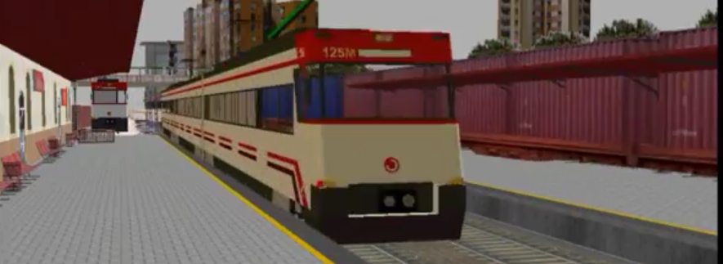
Content
Purpose
Cartographic transformations
On the concept of visualization
Components of geovisualization
Examples
Terrain
Vegetation
Built objects
Atmosphere
Animation
Images taken from exercises carried out by students from Master on GIT, University of Alcala

Slide 3
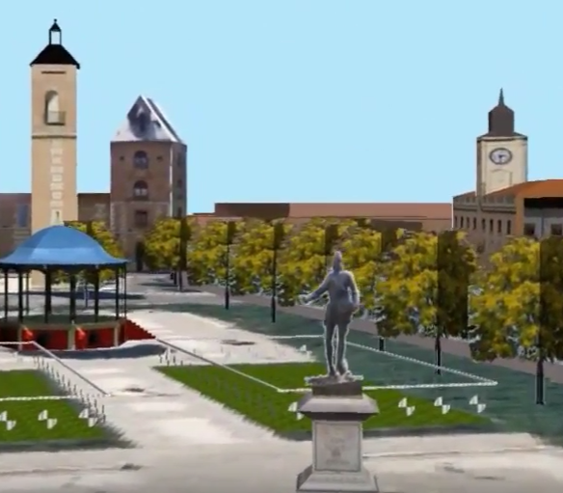
1. Purpose
Why do we want realistic 3D renderings?
See before it happens
Planning (scenarios)
Public health
Sports training (here)
Public participation
See what no longer exists
Image culture
Gaming industry
Facilitate access to information to personnel with no education in mapping
Adopt the latest technical advances in the dissemination of geographic information

Slide 4
2. Cartographic transformations

Slide 5
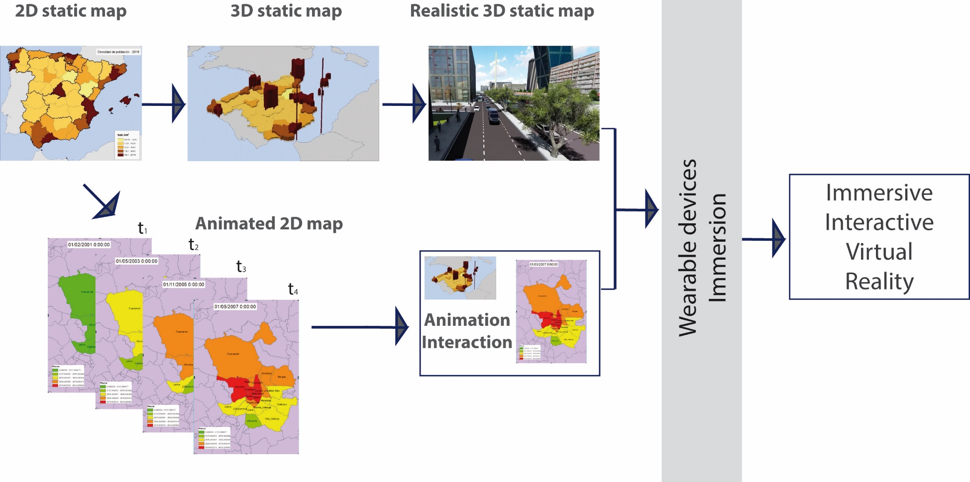
3. On the concept of visualization
From static 2D mapping to Virtual Reality

Slide 6
3. On the concept of visualization
What’s visualization?
Act and consequence of visualizing (mentally developing the image of something abstract)
Scientific visualization is the transformation of scientific and abstract data into images. Emphasis on the construction of knowledge
To see = to understand

Slide 7
3. On the concept of visualization
Scientific visualization
 | LGN5-2004 |  | LGN3-1995
CATEGORY | VALUE | COUNT | VALUE | COUNT |  | Difference 2004-1995
 |  | 2004 |  | 1995 |  | Cells | % | Loss/gain %
Pasture | 0 | 1667312 | 0 | 1753884 |  | -86572 | 95,06 | -4,94
Arable land | 1 | 1001205 | 1 | 1049775 |  | -48570 | 95,37 | -4,63
Forest | 2 | 107920 | 2 | 90535 |  | 17385 | 119,20 | 19,20
Bare soil in built-up area | 3 | 3927 | 3 | 2889 |  | 1038 | 135,93 | 35,93
Swamp/reeds | 4 | 54488 | 4 | 53890 |  | 598 | 101,11 | 1,11
Greenhouse | 5 | 135740 | 5 | 125016 |  | 10724 | 108,58 | 8,58
Urban built-up area | 6 | 834466 | 6 | 801681 |  | 32785 | 104,09 | 4,09
Building in rural area | 7 | 14336 | 7 | 11865 |  | 2471 | 120,83 | 20,83
Dense building in woodland | 8 | 46899 | 8 | 49615 |  | -2716 | 94,53 | -5,47
Building in agricultural area | 9 | 89295 | 9 | 91832 |  | -2537 | 97,24 | -2,76
Leisure green in urban area | 10 | 361786 | 10 | 295039 |  | 66747 | 122,62 | 22,62
Main roads & railways | 11 | 220619 | 11 | 214103 |  | 6516 | 103,04 | 3,04
Coastal zone | 12 | 104364 | 12 | 102404 |  | 1960 | 101,91 | 1,91
Water | 13 | 802612 | 13 | 802441 |  | 171 | 100,02 | 0,02
 | TOTAL | 5444969 |  | 5444969

Slide 8
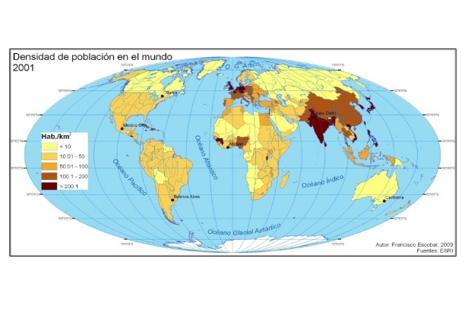
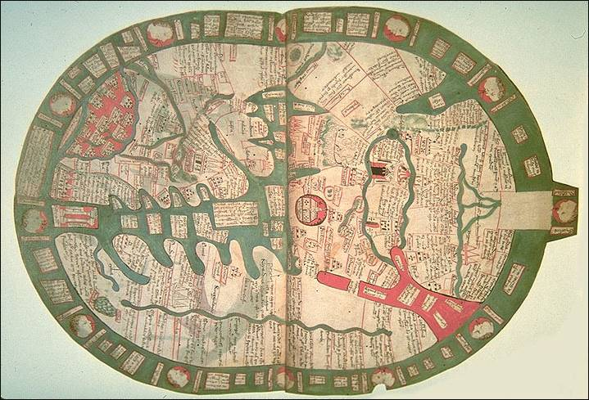
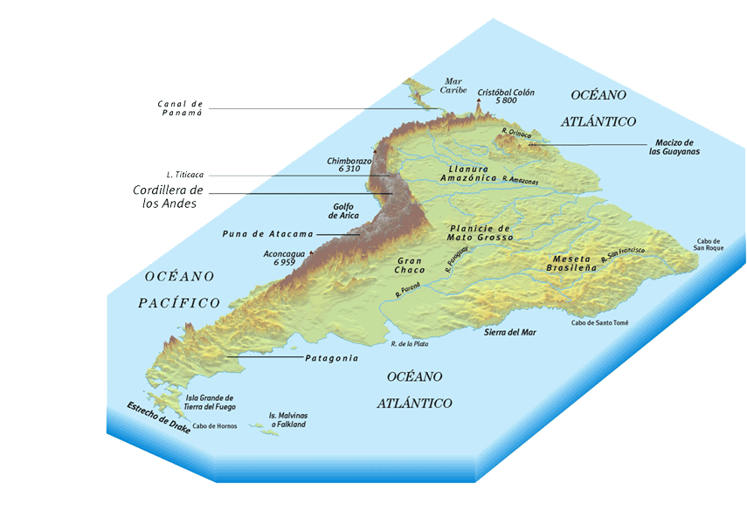
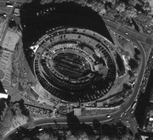
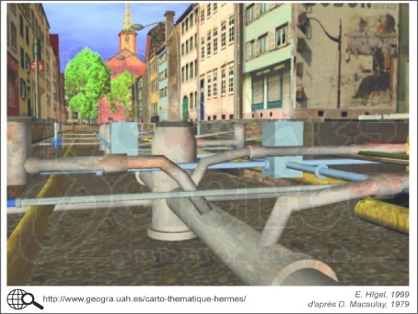
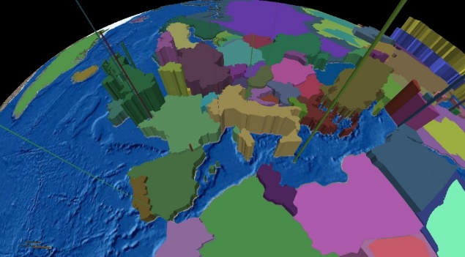
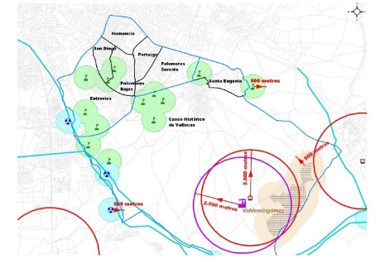
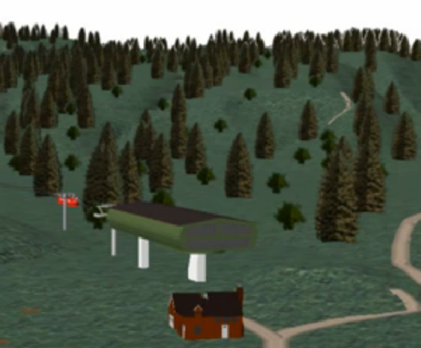
3. On the concept of visualization
Cartographic visualization

Slide 9
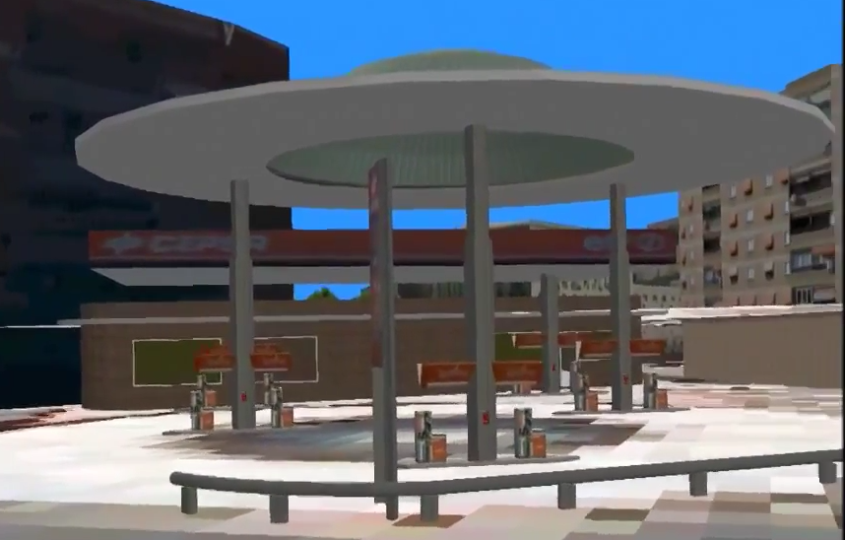
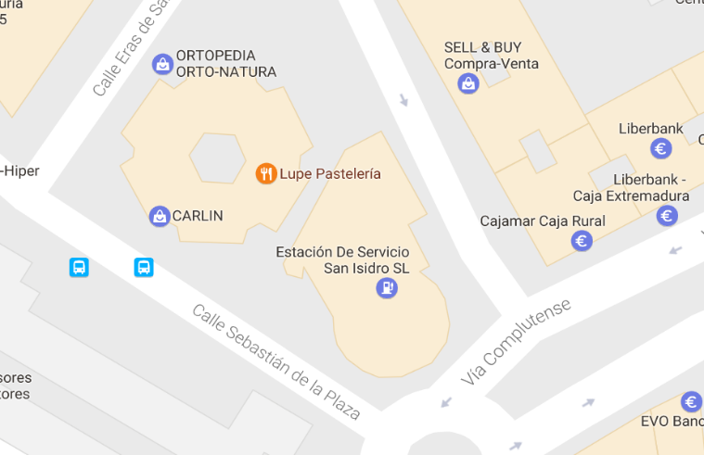
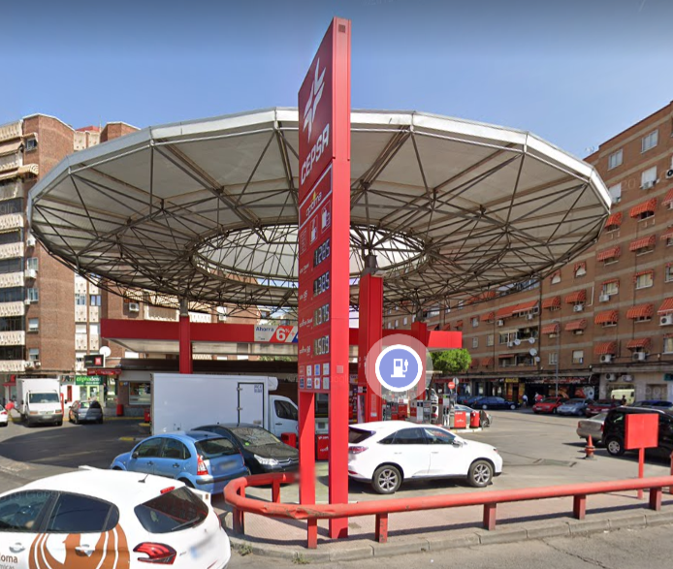
3. On the concept of visualization
Realism vs. abstraction: towards geovisualization

Slide 10
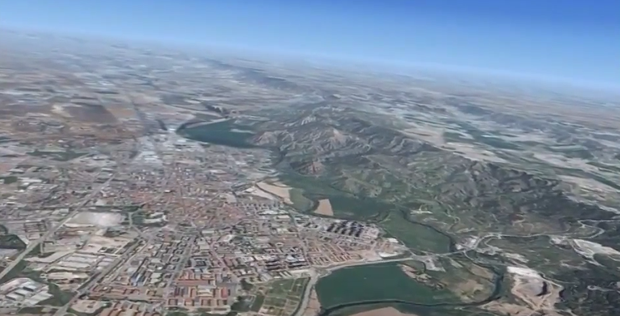
3. On the concept of visualization
Geovisualization
Geographical visualization
Realistic
3D
Digital

Slide 11
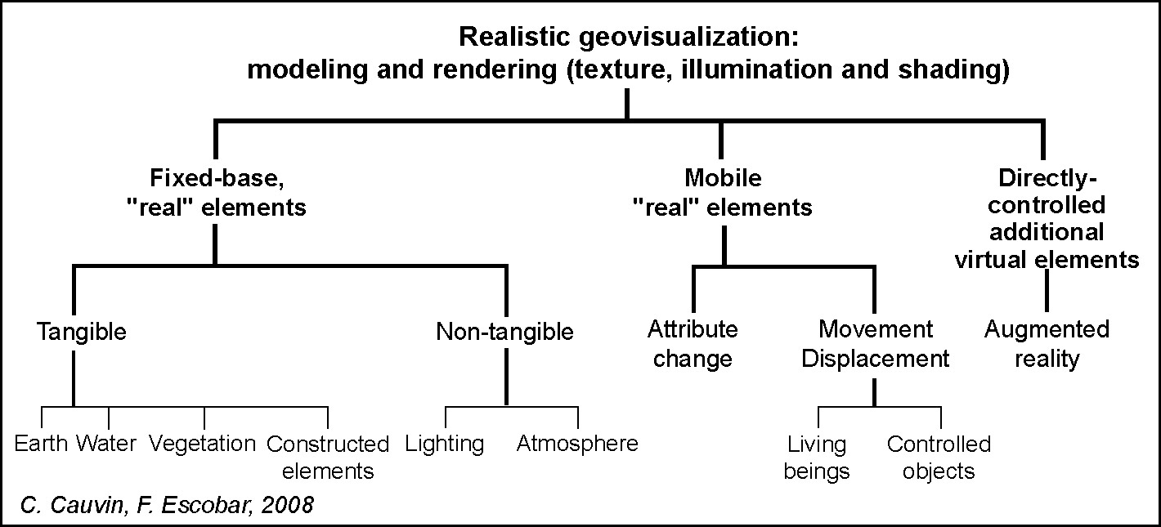
4. Components of geovisualization
* These elements will be modelled in ArcScene
*For modelling water and atmosphere conditions, see Forester software

Slide 12
5. Examples of geovisualization

Slide 13
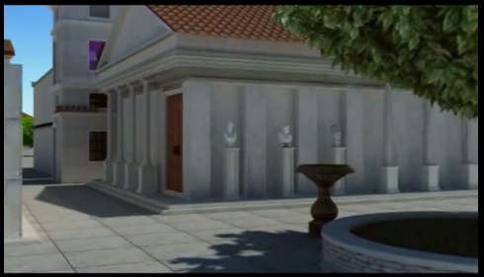
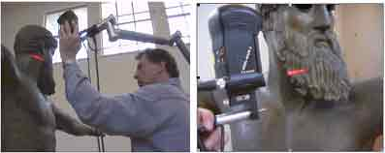
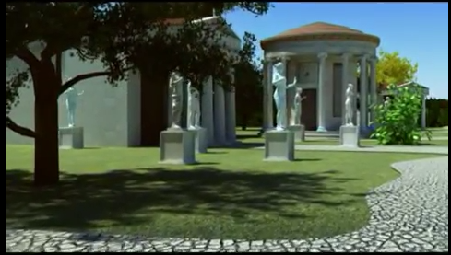
In : Ogleby’, C. (ND) www.gisdevelopment.net/application/archaeology/general/archg0017.htm
Virtual Olympia
https://www.youtube.com/watch?v=F4VeGmxM8tc

Slide 14
Animations from UAH Master on GIT students
Virginia BEZZOLO y Carlos OLAVE - Buenos Aires https://www.youtube.com/watch?v=SsUVTaUdpOI
José Ramón MELENDO y David RIVAS - Burgos en bicicleta https://vimeo.com/122248573 y https://www.youtube.com/watch?v=qB5bT1Lewh8
José Miguel NAVA y Ekhi ROTETA - Salamanca https://www.youtube.com/watch?v=W24EC9JYRjs
Óscar SÁNCHEZ y Macarena GARCÍA – Castellana Norte https://www.youtube.com/watch?v=Cw3GatoPq3s&t=80s
Fernando CASTRO – Pza de Sta Ana, Las Palmas https://www.youtube.com/watch?v=zpgqpmNECKc

Slide 15
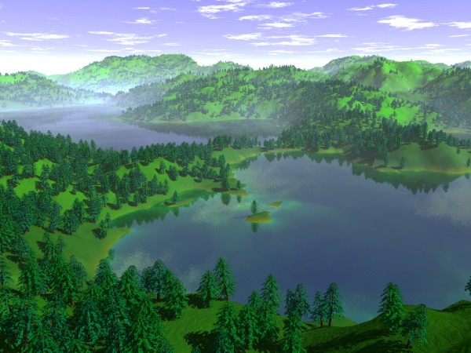
Animations from Stephen Dartnall’s work with Forester www.dartnall.f9.co.uk/

Slide 16
Other innovative representations and animations
Naturopolis – New York, the green revolution https://www.youtube.com/watch?v=FMbyqfkOES4
Best infographies http://lab.rtve.es/resumen-2015/periodismo/graficos-cuentan-historias/
3D GIS https://www.youtube.com/watch?v=edPiNvZJScM
QGIS + Blender animations https://www.youtube.com/watch?v=vX8BeuiXWeU

Slide 17
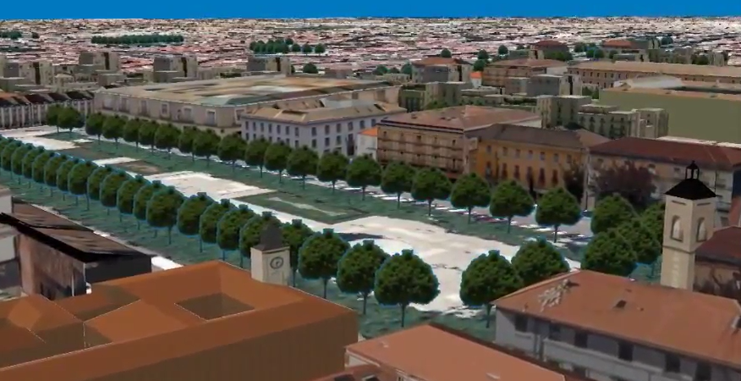
Exercise
Familiarization with ArcScene
Designing a 3D GIS model

Slide 18
6. Terrain
Seven centuries after the invention of perspective, artists and mathematicians continue to search for ways to represent 3 or more dimensions in 2 dimensions (Lozi, 2007)

Slide 19
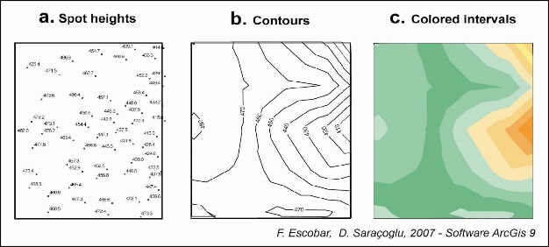
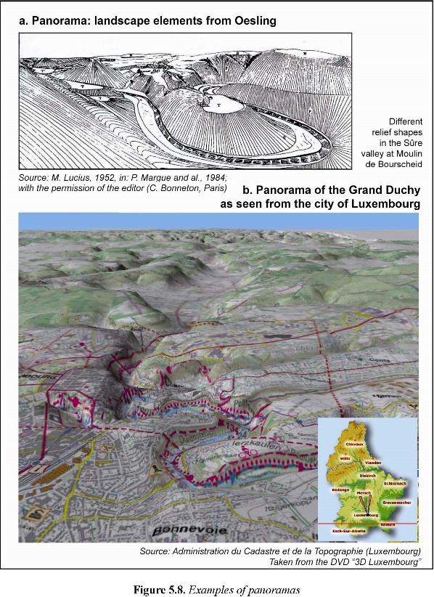
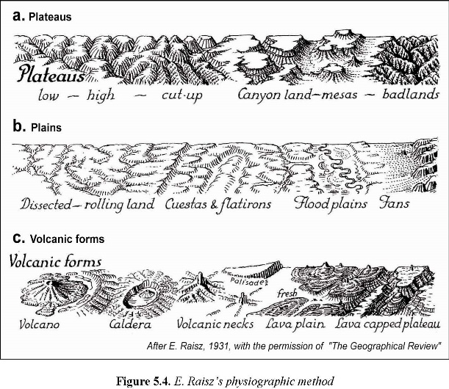
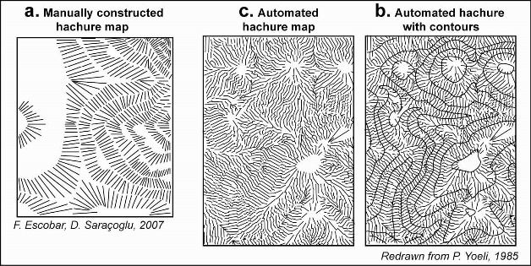
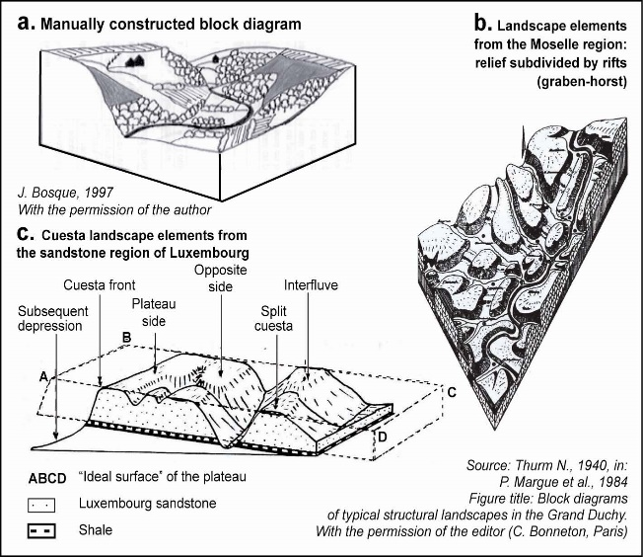
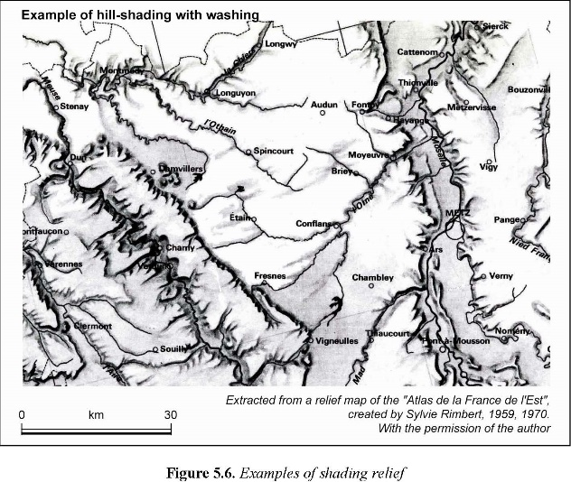
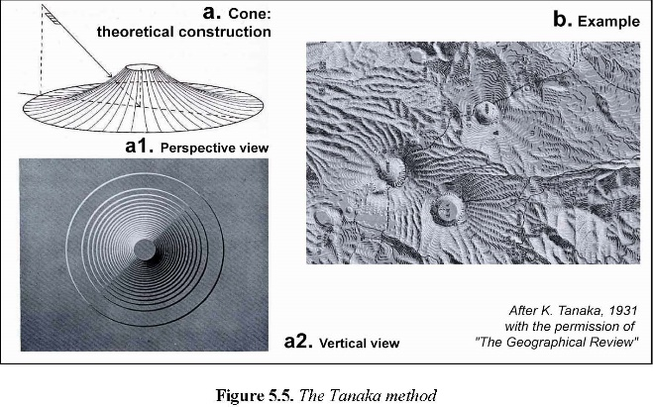
Diversity of 3D products to depict terrain
6. Terrain

Slide 20
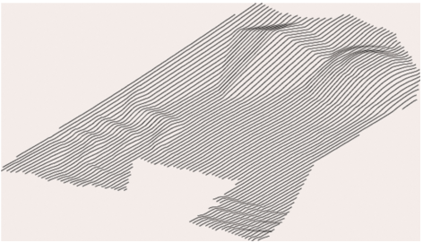
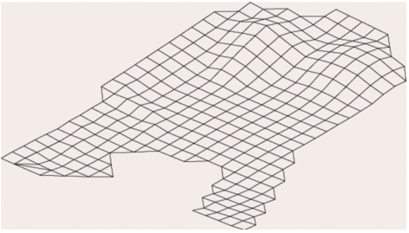
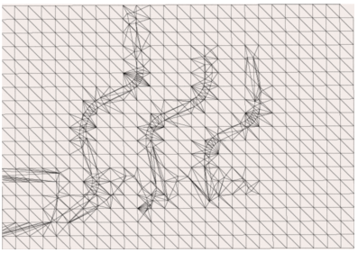
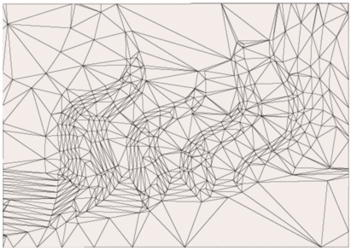
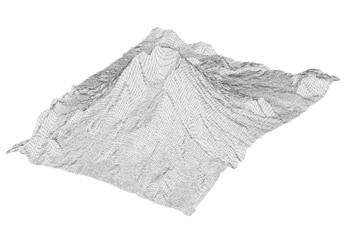
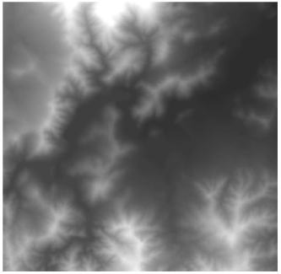
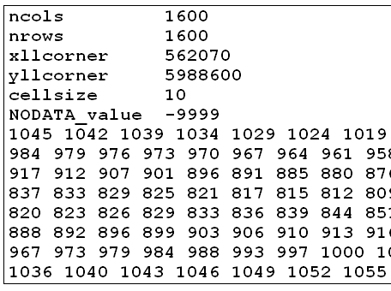
6. Terrain
Diversity in geometry

Slide 21
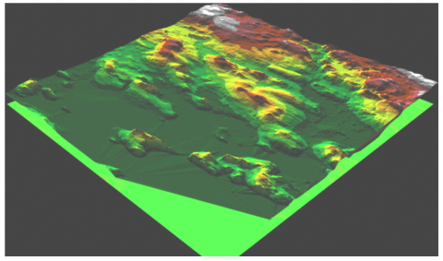
6. Terrain
Diversity in symbology
2D shaded colour ramp
In: Ervin and Hasbrouck, 2001

Slide 22
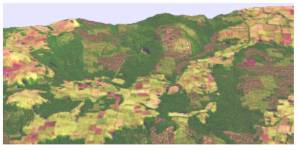
6. Terrain
Diversity in symbology
Generic texture (thematic map, satellite image or othophotography)
In: Ervin and Hasbrouck, 2001
In: Ervin and Hasbrouck, 2001

Slide 23
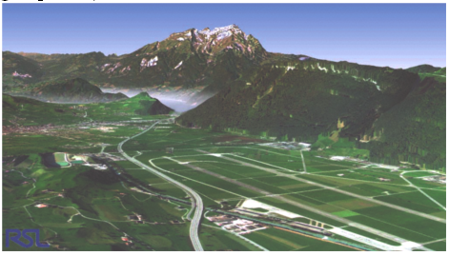
6. Terrain
Diversity in symbology
Geospecific texture. Features are symbolized with specific textures provided by GIS software
In: Ervin and Hasbrouck, 2001
In: Ervin and Hasbrouck, 2001

Slide 24
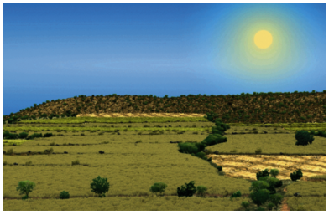
6. Terrain
Diversity in symbology
Generic objects - Features are symbolized by means of 3D objects
In: Ervin and Hasbrouck, 2001
In: Ervin and Hasbrouck, 2001

Slide 25
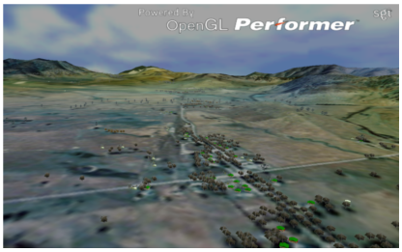
6. Terrain
Diversity in symbology
Specific objects – Features are symbolized by means of 3D objects specifically created for that feature
In: Ervin and Hasbrouck, 2001
In: Ervin and Hasbrouck, 2001

Slide 26
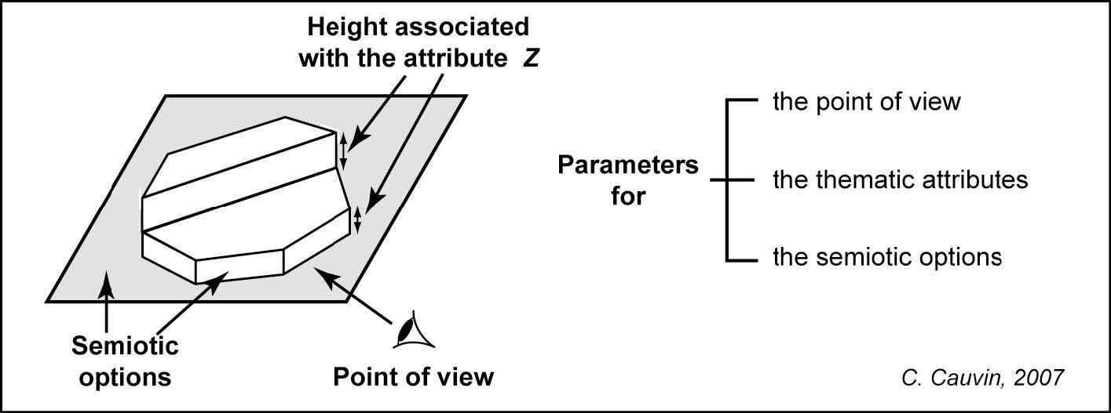
3D visualization parameters
Families of parameters
In: Cauvin et al, 2010

Slide 27
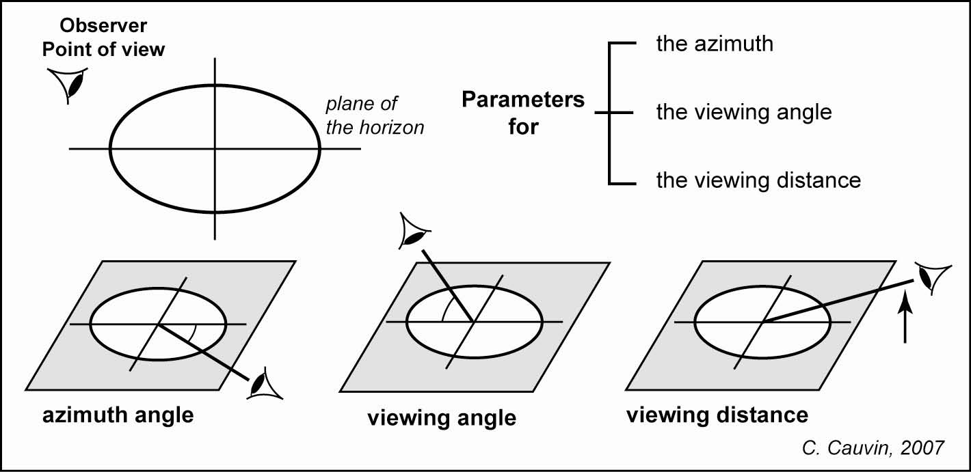
3D visualization parameters
The point of view

Slide 28
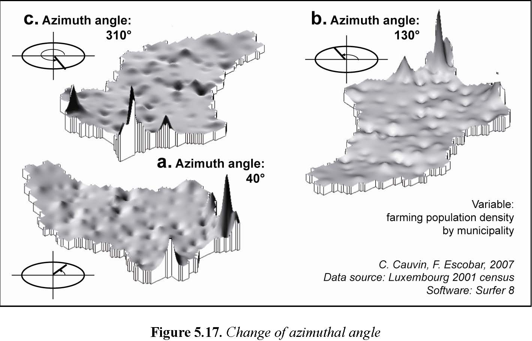
3D visualization parameters
The point of view: 1. The azimuth angle
In: Cauvin et al, 2010

Slide 29
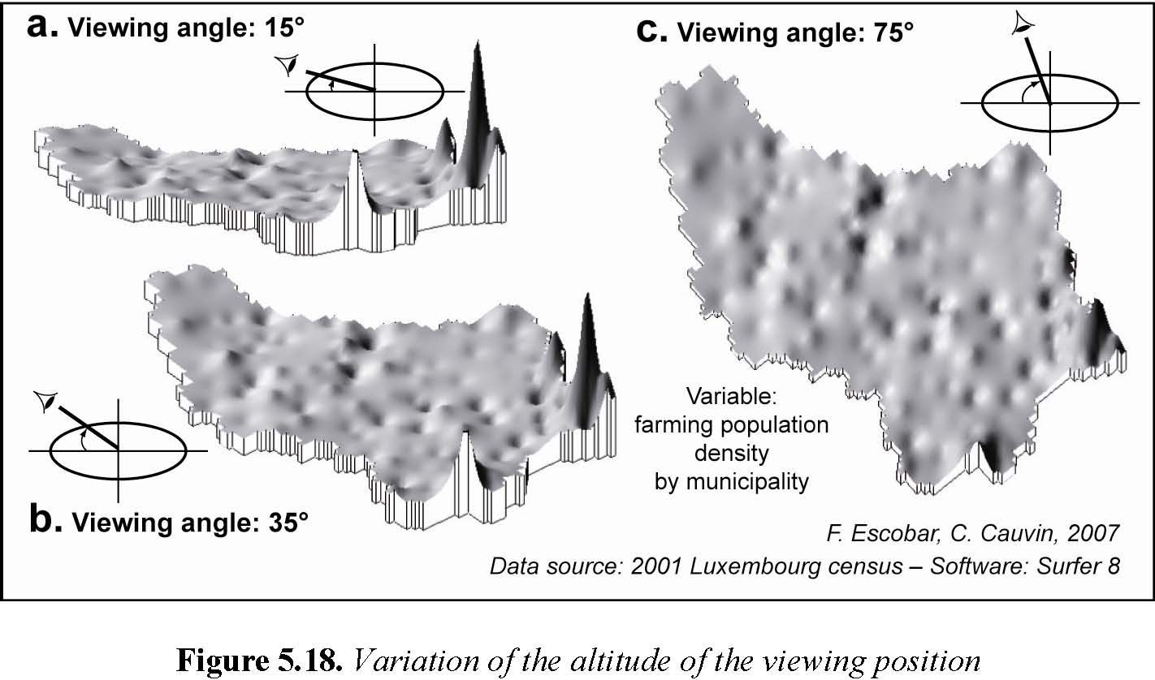
3D visualization parameters
The point of view: 2. The viewing angle
In: Cauvin et al, 2010

Slide 30
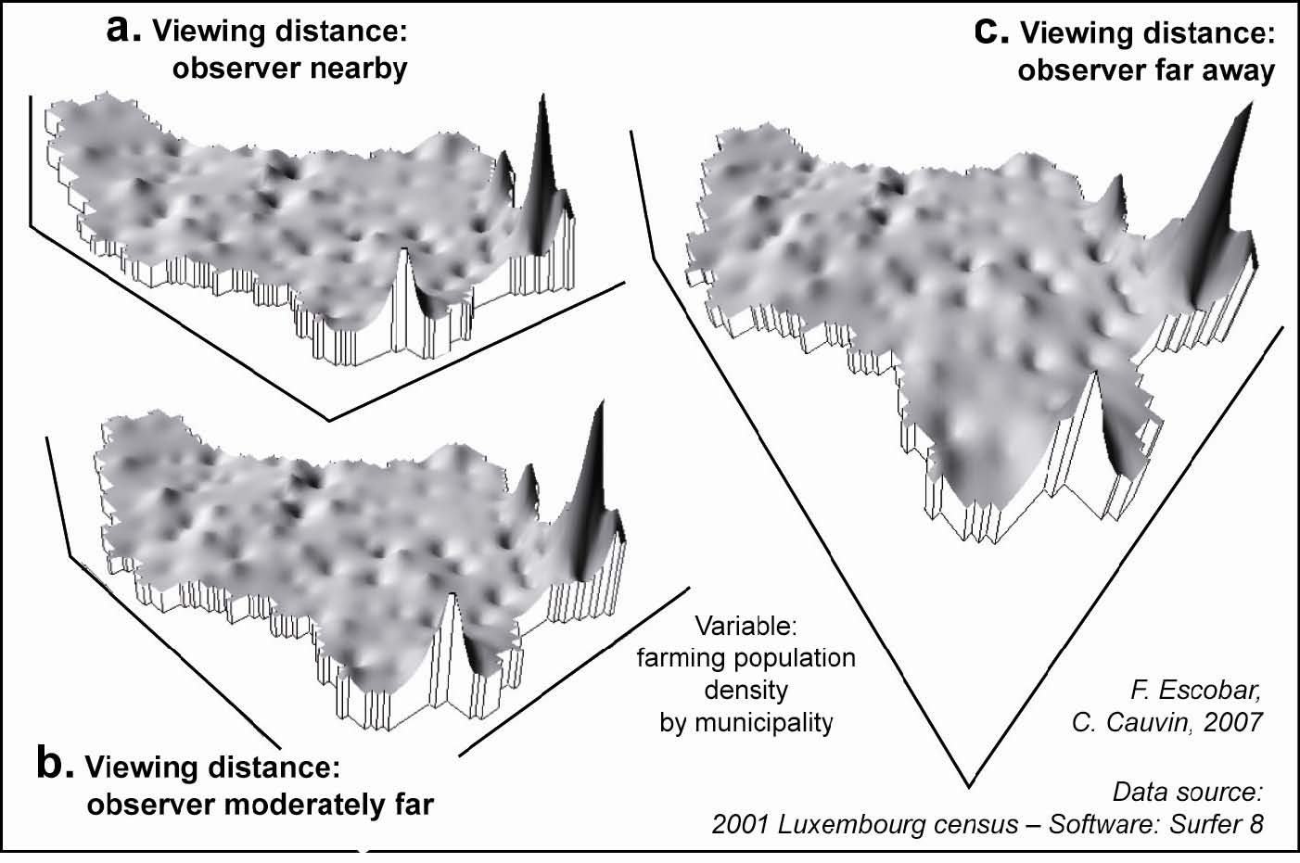
3D visualization parameters
The point of view: 3. The distance
In: Cauvin et al, 2010

Slide 31
7. Vegetation
Characteristics
Changeable:
Seasons, flowering, growth
Movement:
Wind
Complex:
Root, leaves, trunk, branches, flowers, fruits
Varied:
From trees to grass, bush and all of them with a great variety of species

Slide 32
7. Vegetation
Vegetation models
Primitive objects

Slide 33
7. Vegetation
Vegetation models
Two or multiple faces

Slide 34
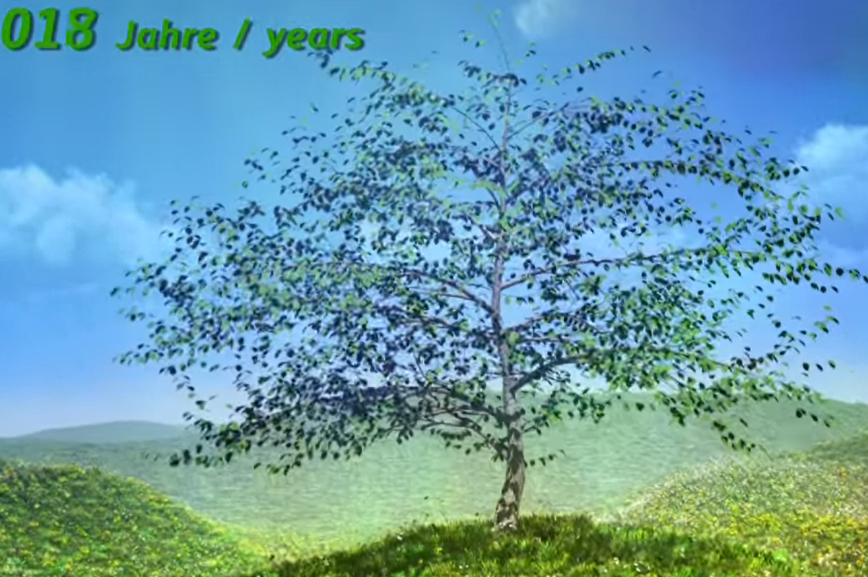
7. Vegetation
Vegetation models
Growing model
http://www.youtube.com/watch?v=RjnKAWxCK3k&feature=related
Muviag. The Growing Tree

Slide 35
7. Vegetation
Vegetation models
Fractal model
http://www.dartnall.force9.co.uk/forester/arbdownload.htm
Software: Forester, by Stephen Dartnall

Slide 36
7. Vegetation
Vegetation models
3D Collada

Slide 37
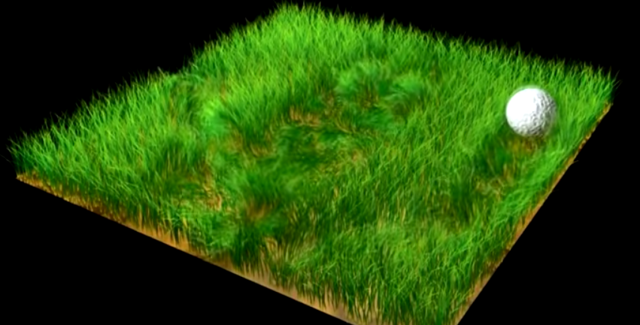
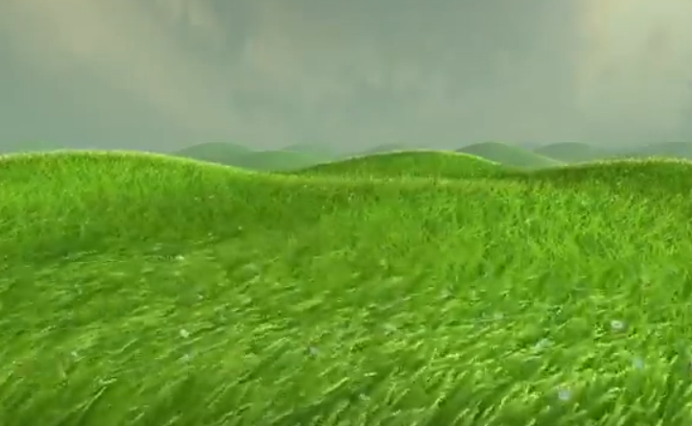
7. Vegetation
Movement
http://www.youtube.com/watch?v=6zdBBK_aOG8&feature=related
http://www.youtube.com/watch?v=NWpxP4O-_fE&feature=related
http://www.d-inter.ru/skills/

