Slide 1
Interval definition
or
Thematic variable classification
Patxi Escobar
Dpt. of Geology, Geography and Environmental Sciences
University of Alcala
www.geogra.uah.es/patxi
Environmental Mapping Strategy - EXPLORERS EUROLAB 2O2O

Slide 2
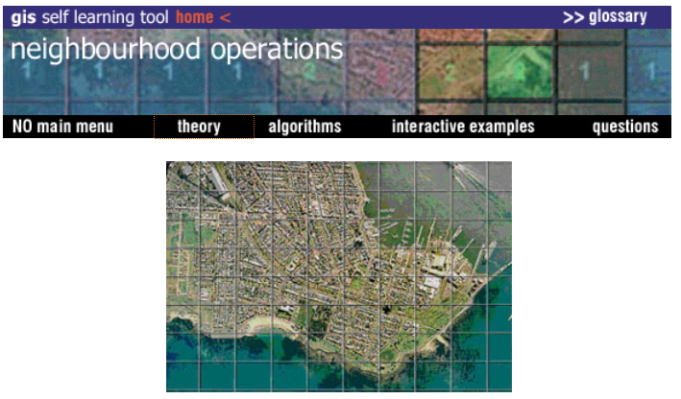
Data levels of measurement
Nominal
Ordinal
Interval
Ratio

Slide 3
Nominal data
Values that represent qualities rather than quantities and do so without reference to a linear scale (eg measured in terms of names, discrete unit designations, or categories)
- Examples: telephone numbers, zip codes, soil types, forest types…
Statistical operations can be applied to maps with data at nominal scale: Majority, Minority and Diversity (Variety, Variability)
A special case: binary nominal measurement scale

Slide 4
Ordinal data
As a measure that quantifies differences in order (eg in terms of values that are 'more' or 'less', 'larger' or 'smaller'), not by magnitude, the size of the intervals is not specified. Ordinal data is commonly used where quantitative differences are apparent but difficult to measure (eg when values represent an order by categories)
- Examples: distinction between poor, fair, and good quality agricultural land (exactly how much better or worse each is compared to the others is not stated)
Statistical operations can be applied to maps with ordinal scale data: Maximum, Minimum, Median, Majority, Minority, Diversity (Variety) and Difference.

Slide 5
Interval level of measurement
Measure representing quantities whose start is arbitrarily set
- Examples: degrees centigrade, hours of the day ...
Statistical operations can be applied to maps with ordinal scale data: Sum, Average, Maximum, Minimum, Median, Majority, Minority, Diversity (Variety) and Difference.

Slide 6
Ratio level of measurement
Measure representing quantities whose start is arbitrarily set
- Examples: degrees centigrade, hours of the day ...
Statistical operations can be applied to maps with ordinal scale data: Sum, Average, Maximum, Minimum, Median, Majority, Minority, Diversity (Variety) and Difference.

Slide 7
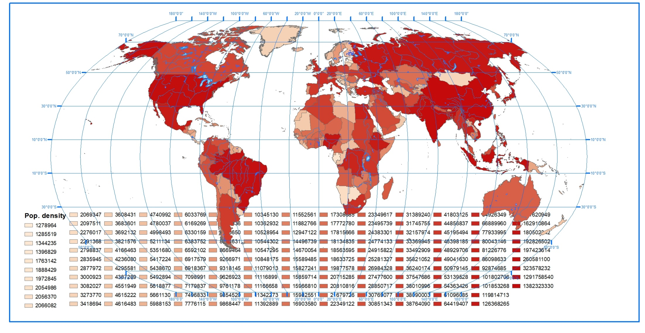
Classification / "discretization" of the thematic variable
The issue

Slide 8
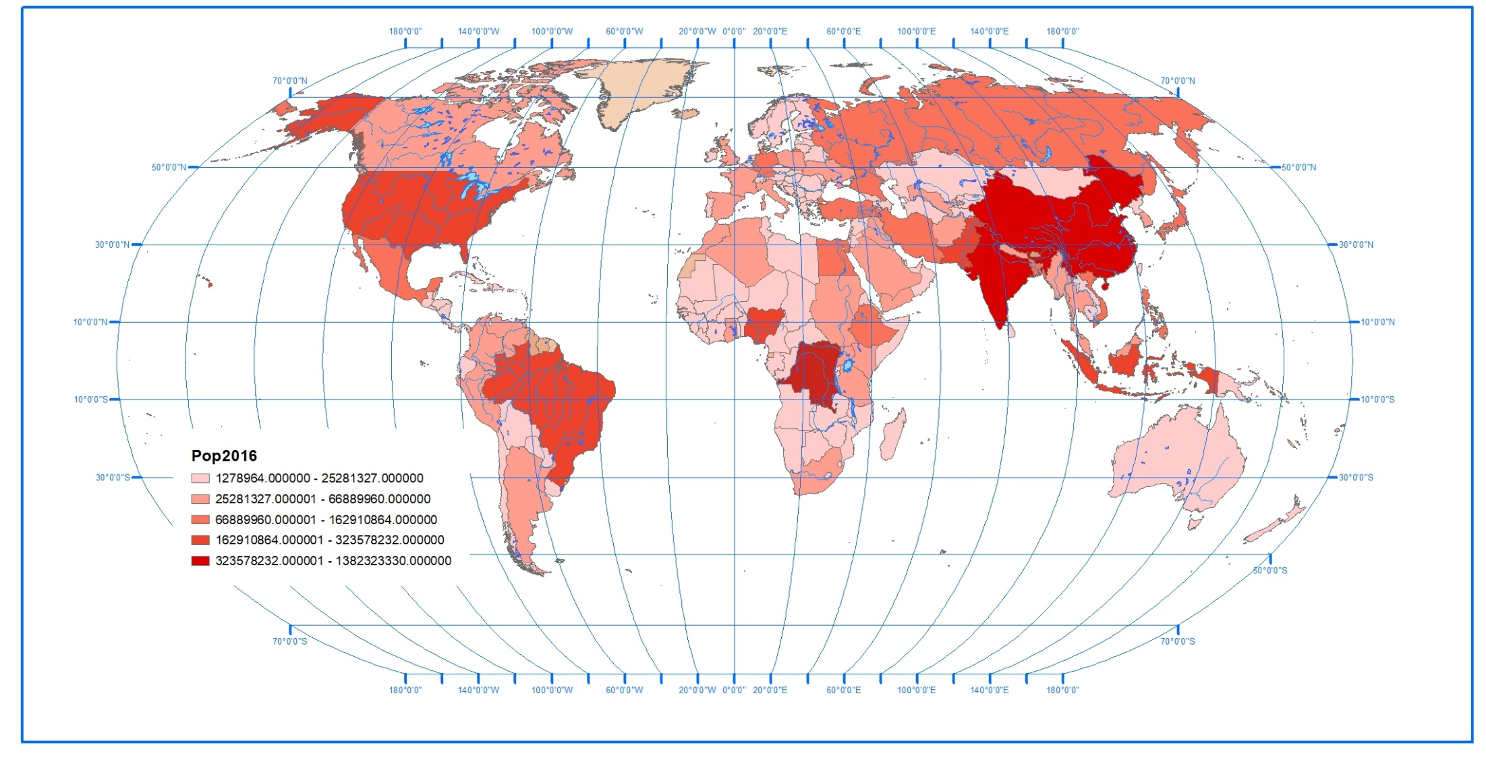
Classification / "discretization" of the thematic variable
The solution

Slide 9
Classification / "discretization" of the thematic variable
- It consists of cutting a statistical series into classes or intervals
- Both the number of classes and the boundaries between them greatly affect the mapping results
- A difficult decision

Slide 10
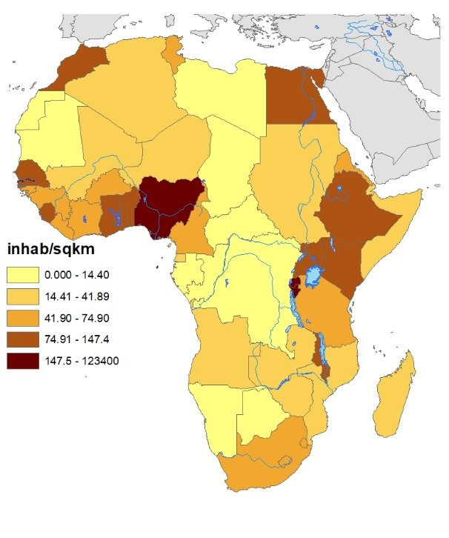
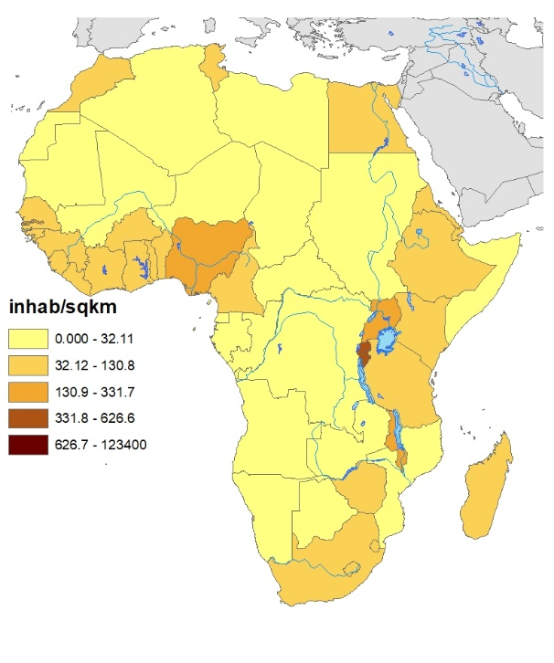
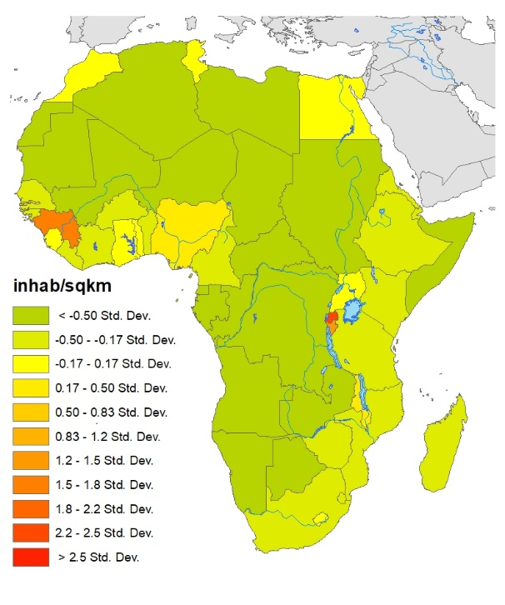
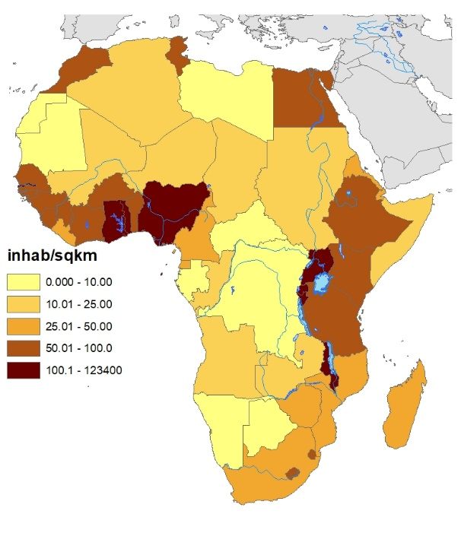
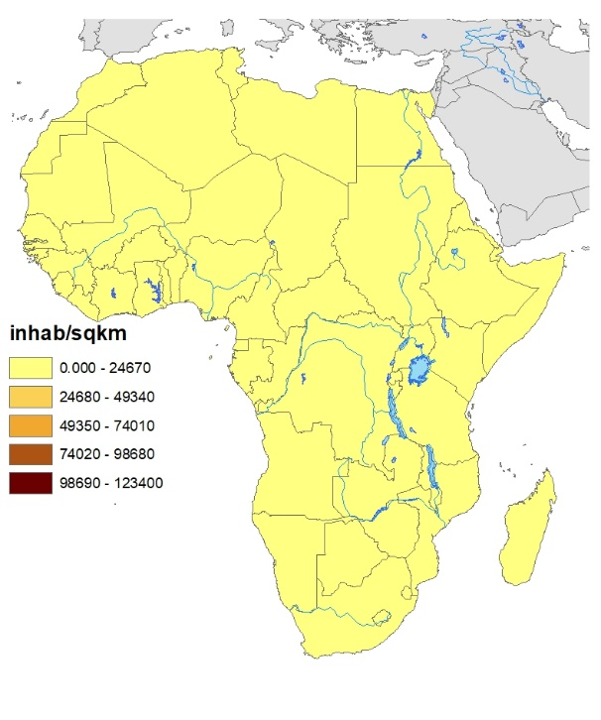
Classification / "discretization" of the thematic variable
Population density
Same data
Same cartographic base
Same software

Slide 11
Classification / "discretization" of the thematic variable
Conditions
Classes must cover the whole set of values
A value must belong to a class and only one (exclusivity)
Classes must not be empty (exhaustiveness)
The precision of the limit values must respect that of the values of the original variable

Slide 12
Classification / "discretization" of the thematic variable
The number of classes - absence of precise rules
Logic - It is understood that a high number of classes is closer to reality while a small one implies excessive generalization
Technique - Current printing media easily allows 256 levels of gray
Visual - Pays attention to the objective of the map and the user's perceptive possibilities

Slide 13
Logic
Brooks and Carruthers propose a number of classes equal to or less than five times the decimal logarithm of the number of observations
Huntsberger proposes a number of classes equal to 3.3 times the decimal logarithm of the number of observations In both cases the result is a too high number of classes

Slide 14
Types of classification methods
Intuitive (user defined – own rules)
Exogenous (user defined – expert knowledge)
Equal intervals (and by arithmetic or geometric progression)
Quantiles (tertiles, quartiles, quintiles…)
Standard deviation
Natural breaks (Jenks)

Slide 15
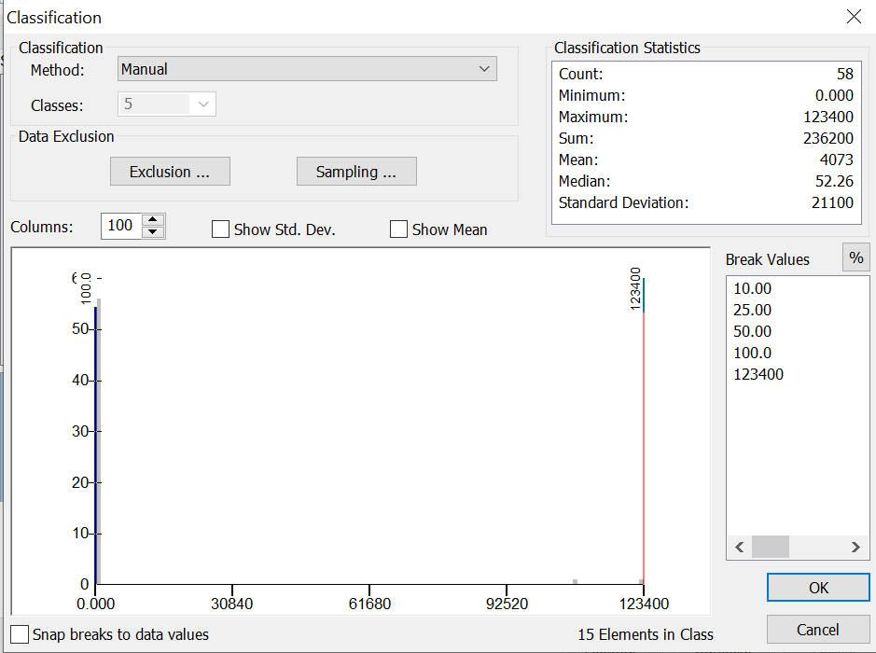
Intuitive
It may be based on observed discontinuities in the data or
In the experience of the cartographer who decides an a priori classification
Impossible to compare
To be avoided except in very particular cases
Warning: it can be misleading

Slide 16
Exogenous
They are based on an external benchmark (eg GDP of Spanish regions with respect to the European average)
They allow comparisons
In practice, both this method and the previous one materialize in the same way

Slide 17
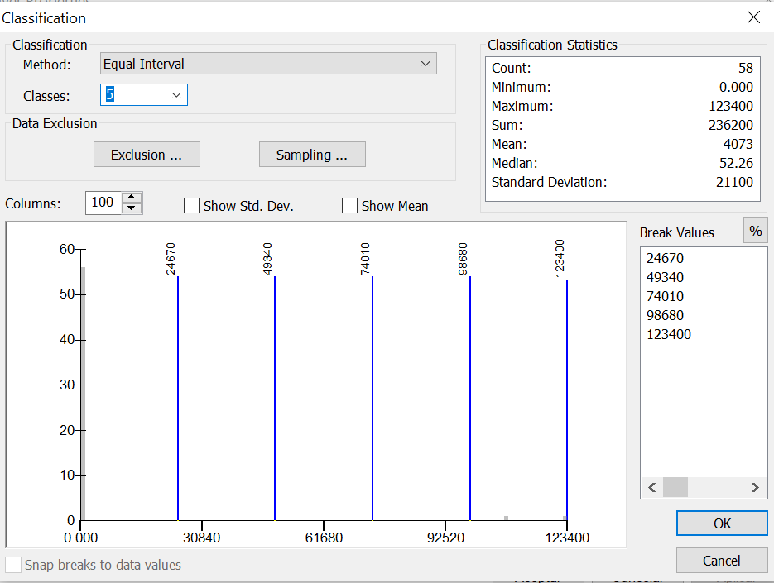
Equal interval
Frequently used
All classes present same class width
Only appropriate in case of similar size areas and where the histogram is rectangular

Slide 18
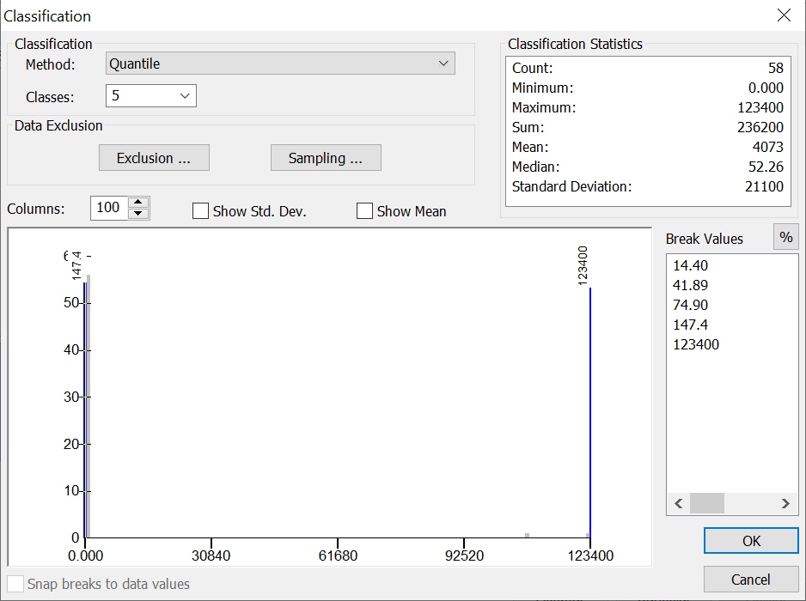
Quantiles
Ensures equal number of elements in each class
Ignores the distribution characteristics
Caution with very different size areas – it can be solved with average per area

Slide 19
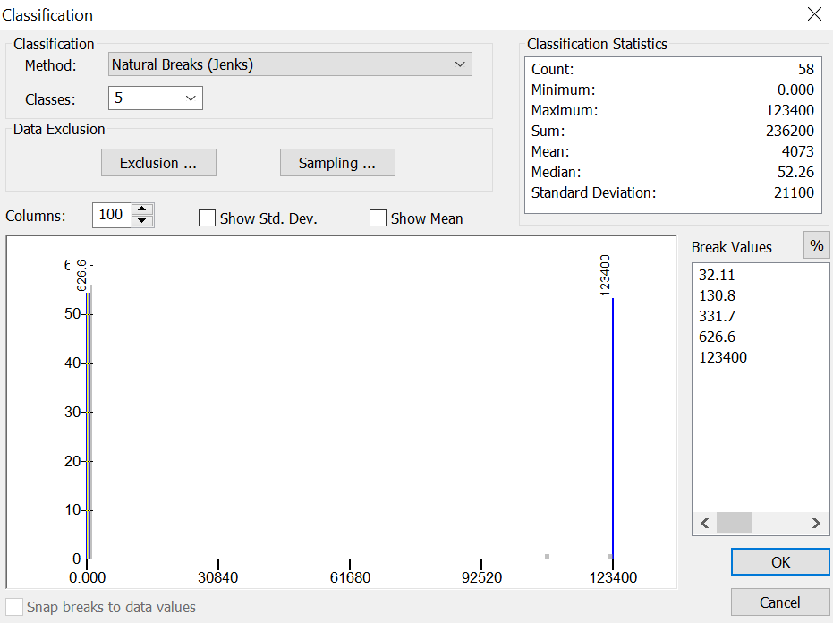
Natural breaks (Jenks)
It is calculated around the statistical variance
Through an iterative process, it seeks to minimize the intra-class variance, that is, it seeks to maximize the homogeneity of the classes
It helps to determine more or less homogeneous groups. Offers poor results in defining class boundaries

Slide 20
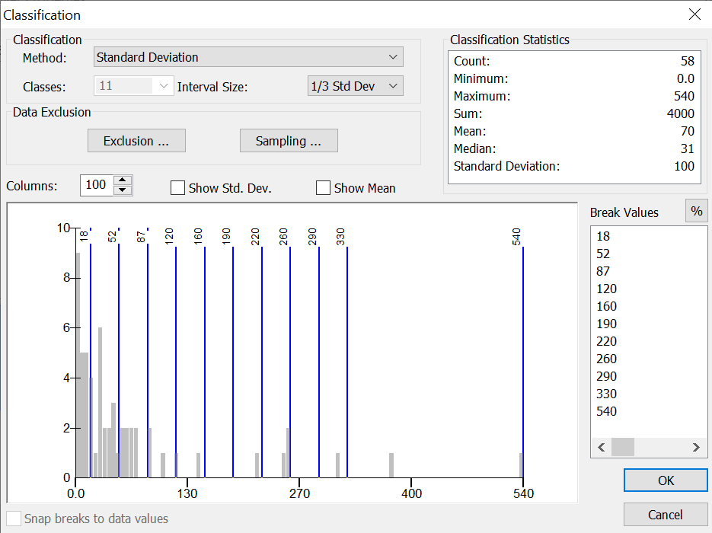
Standard deviation
Only appropriate in case of having a variable of normal distribution.
Of interest when trying to emphasize deviation from the mean

Slide 21
Bibliography
Cauvin, C., Escobar, F. And Serradj, A, (2010), Thematic Cartography, 3 vols. Londres: Wiley
Dent, B. (1996): Cartography. Thematic Map Design, London: Wm. C. Brown Publishers.
Richardus, P. y Adler, R. (1972). Map projections for geodesists, cartographers and geographers. Amsterdam: North-Holland Publishing.
Robinson, A, Morrison, J, Muehrcke, P, Kimerling, A y Guptill, S (1995): Elements of cartography, New York: Wiley.

