Slide 1
Generalization: A necessity and a nuisance
In consists in the modification of data aimed at (1) balancing undesired effects of size reduction and (2) improving communication
Transformation of paramount importance. It has always been there. It has been renovated by the technology

Slide 2
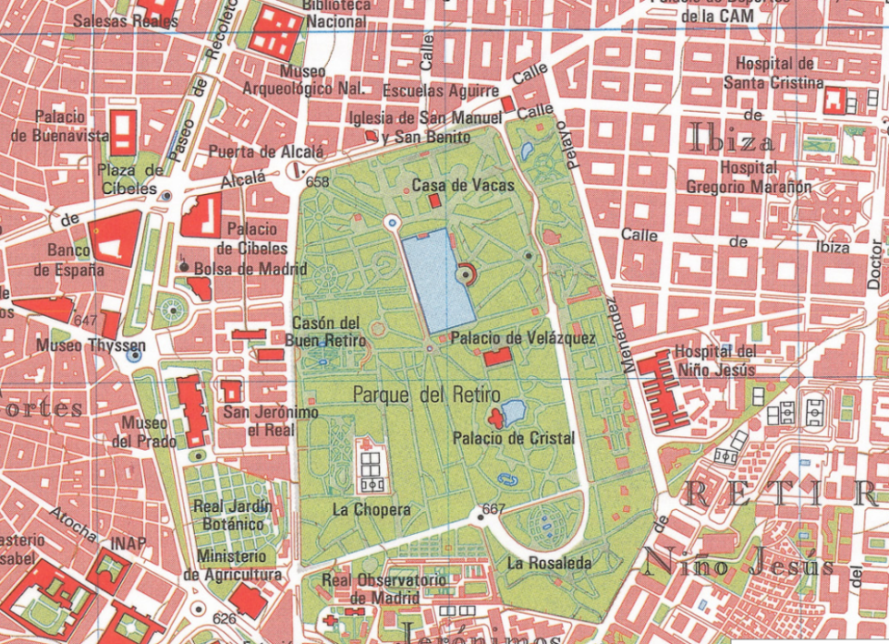
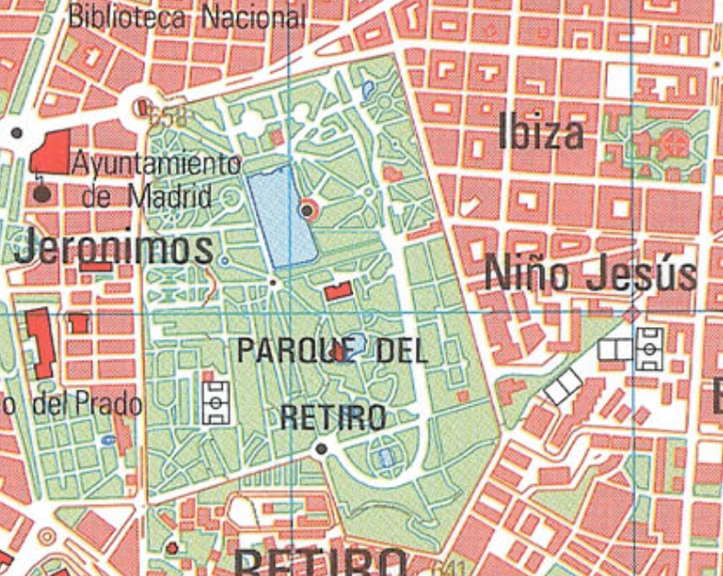
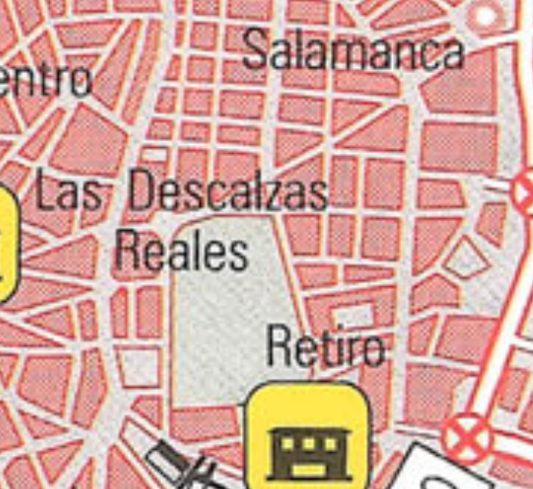
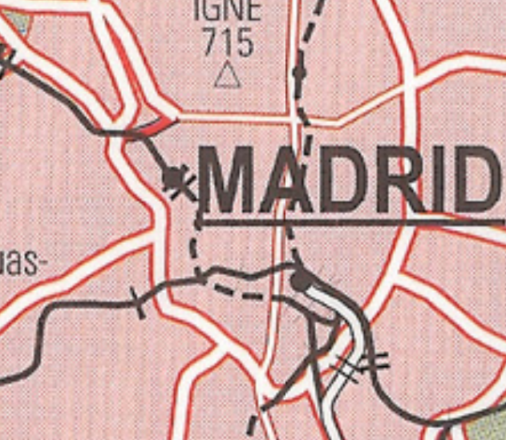

Slide 3
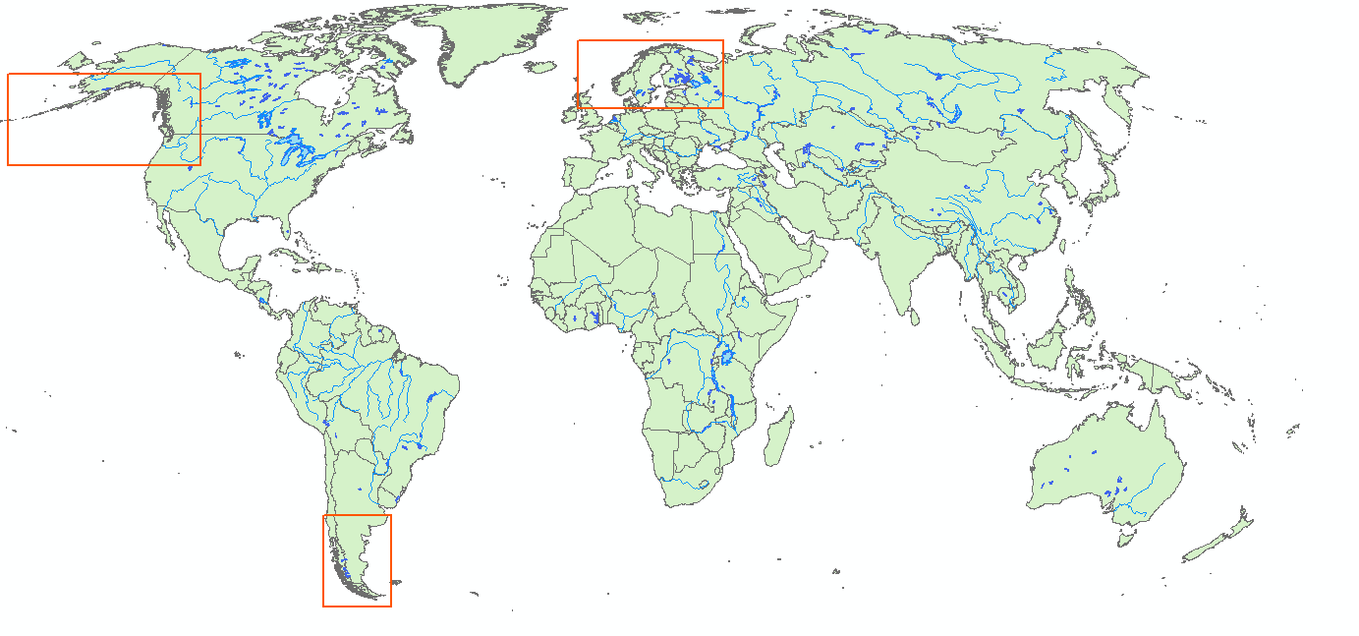

Slide 4
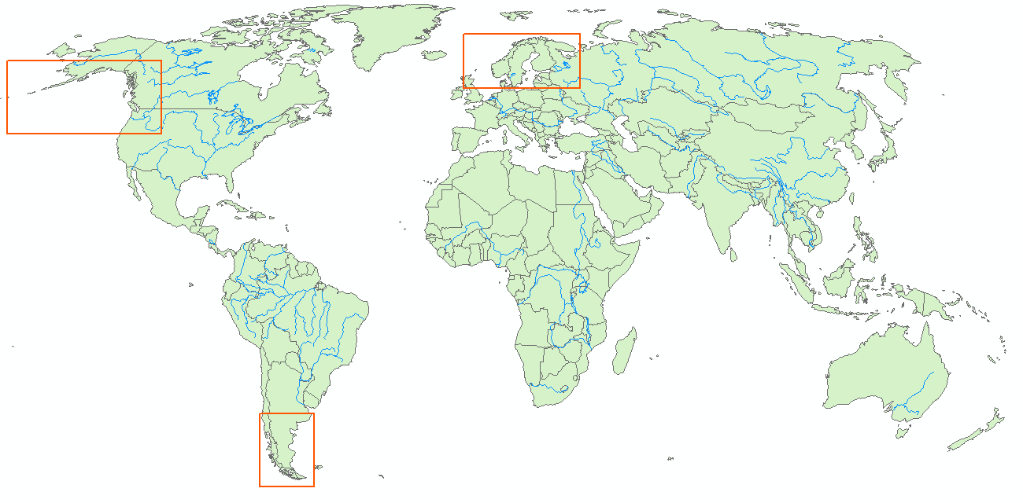

Slide 5
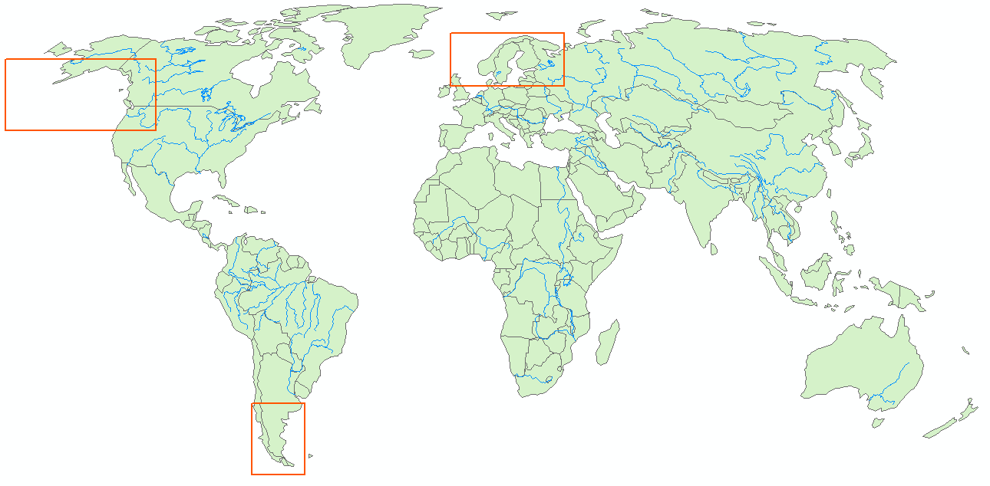

Slide 6
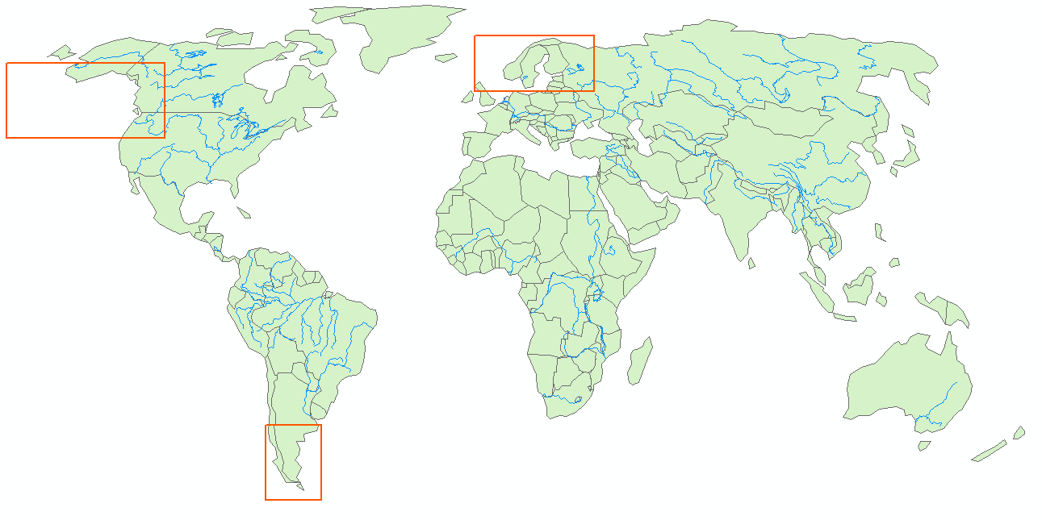

Slide 7
Generalization
Objective: To reduce mapping object complexity
How can we reduce information in such way that it is appropriate to the map scale?
It depends on: objective, scale, semiotics, data quality and output display format
Necessary for:
Improving visual quality
Facilitating different spatial detail level
Reducing amount of information
Producing maps at different scales from a single source map
A nuisance due to:
It causes changes in surfaces and distances measures

Slide 8
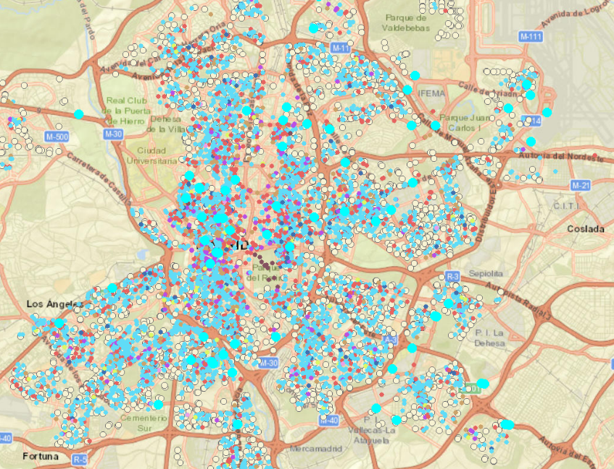
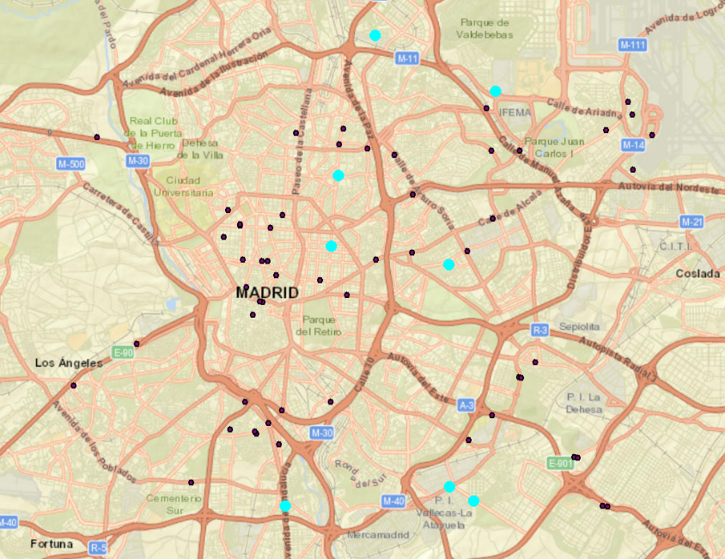
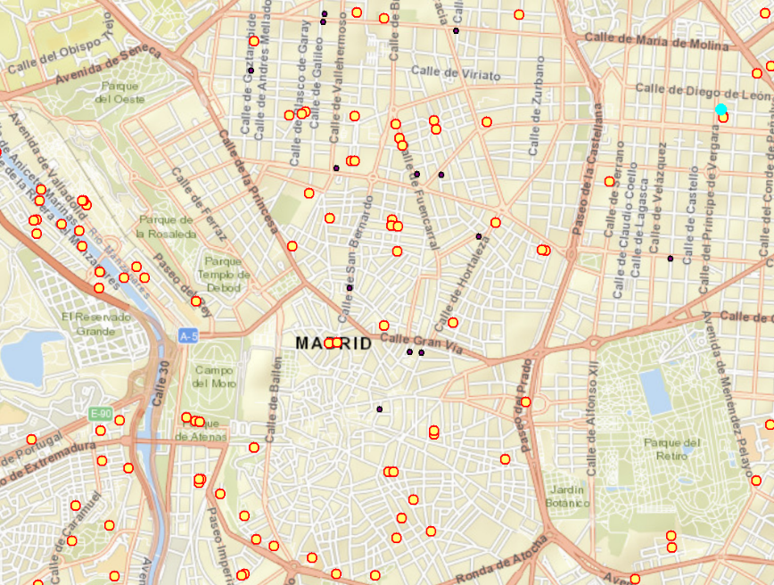
Calidad visual
Nivel de detalle
y cantidad de información

Slide 9
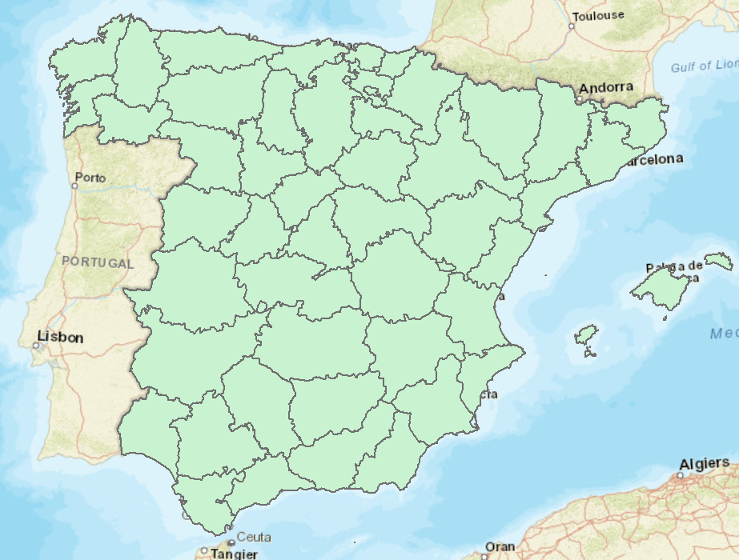
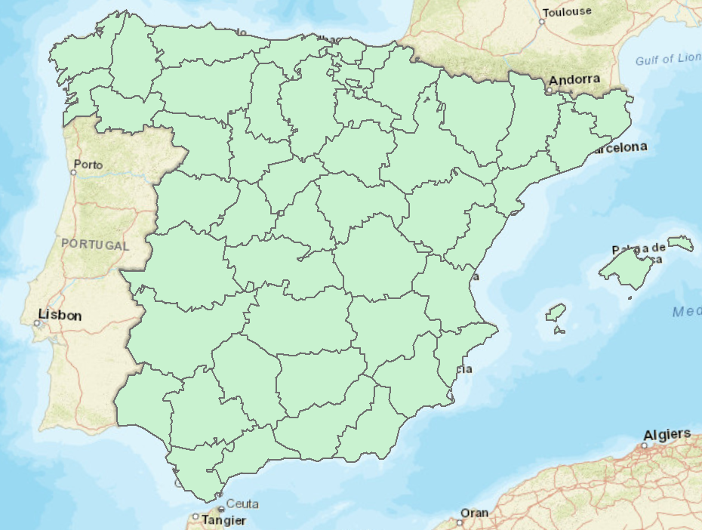
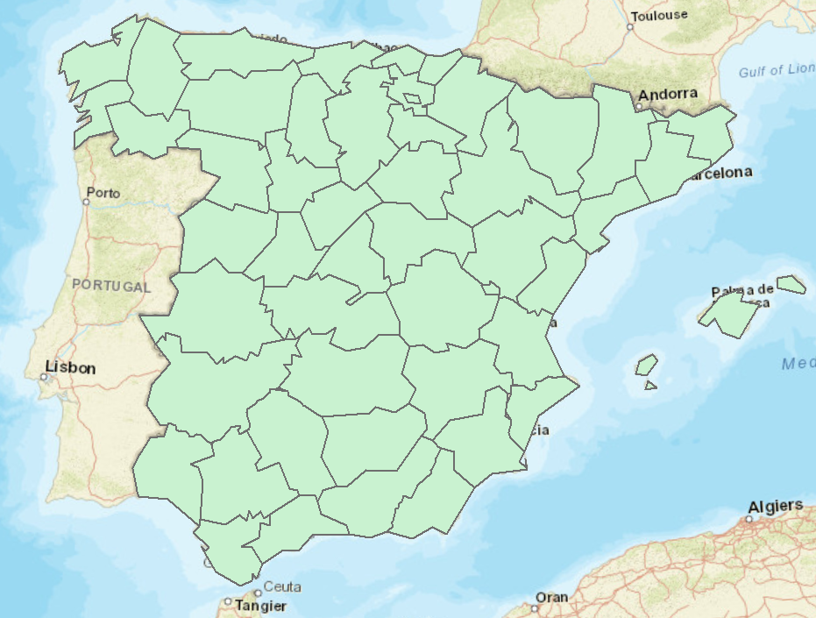
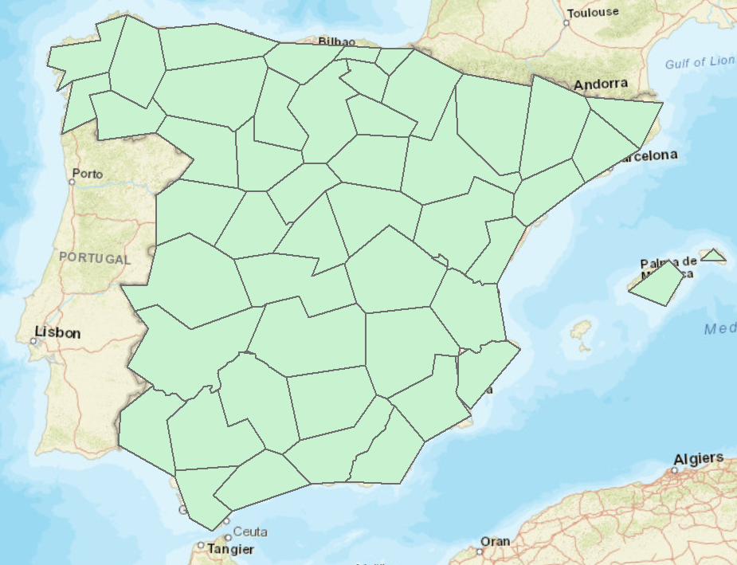
Reducción de información

Slide 10
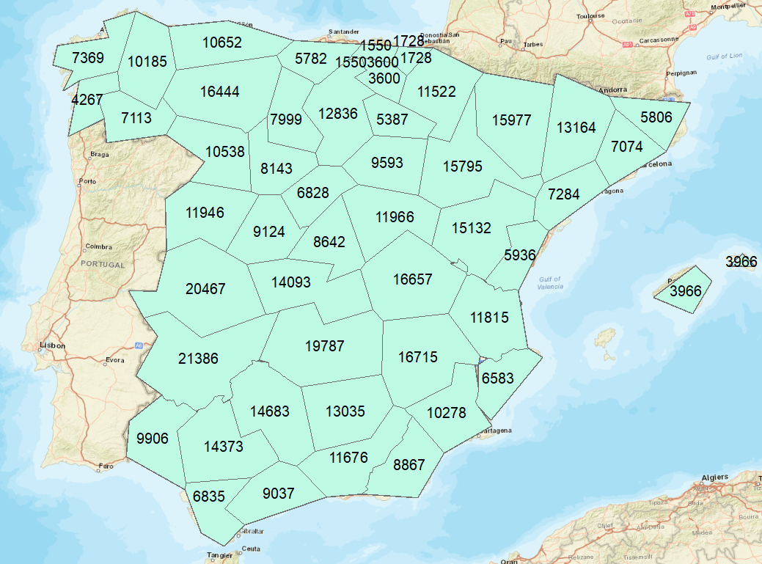
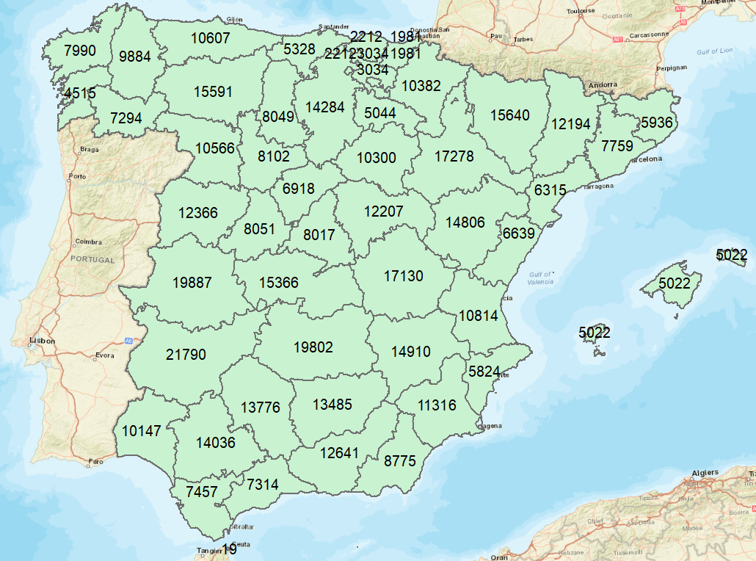
Variaciones en las mediciones de áreas y distancias
Superficie provincial en km²

Slide 11
Generalization paradox
As the map size decreases, objects become smaller and smaller
However, when the scale is too reduced, the features size is exaggerated
Example: cities

Slide 12
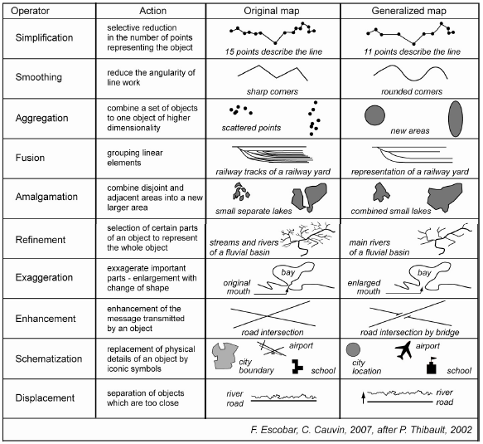
Generalization types

Slide 13
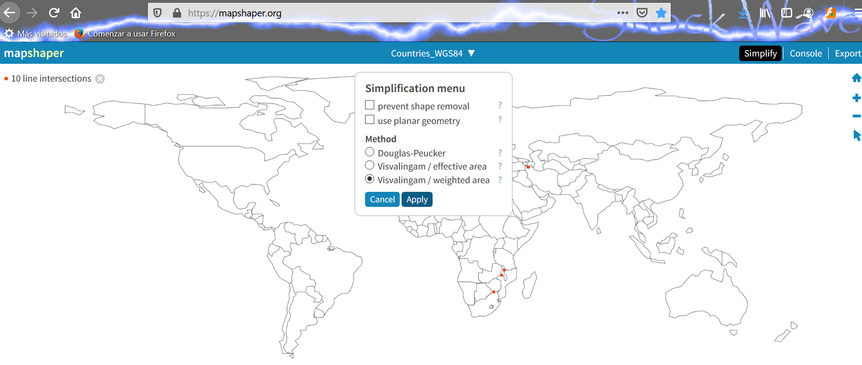
Line simplification
https://mapshaper.org/

