Slide 1
Estimating and mapping forest canopy fuel parameters from GEDI LiDAR data in Europe
Elena Aragoneses, Mariano García, Paloma Ruiz-Benito & Emilio Chuvieco
(e.aragoneses@uah.es)
University of Alcalá (Spain)

Slide 2
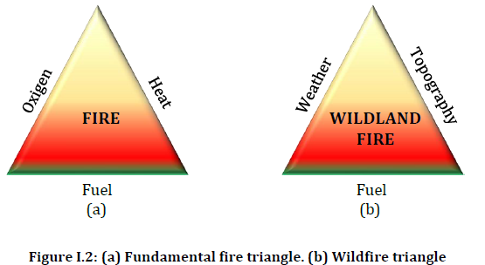
Introduction
Improving actual efforts to prevent and contain crown wildland fires in Europe
Around 5 million ${km}^{2}$ burn annually in the world
EU countries 2020
Total burnt area
Cumulative area of fires
surpassed 2008-2019 average values
2% of European fires are crown fires → extreme → most damages
Europe 2000-2017
480,000 burnt ha/year
3 billion euros/year
34 people/year
Key element: fuel
Source: Phd Thesis (M.L. Pettinari, 2015).

Slide 3
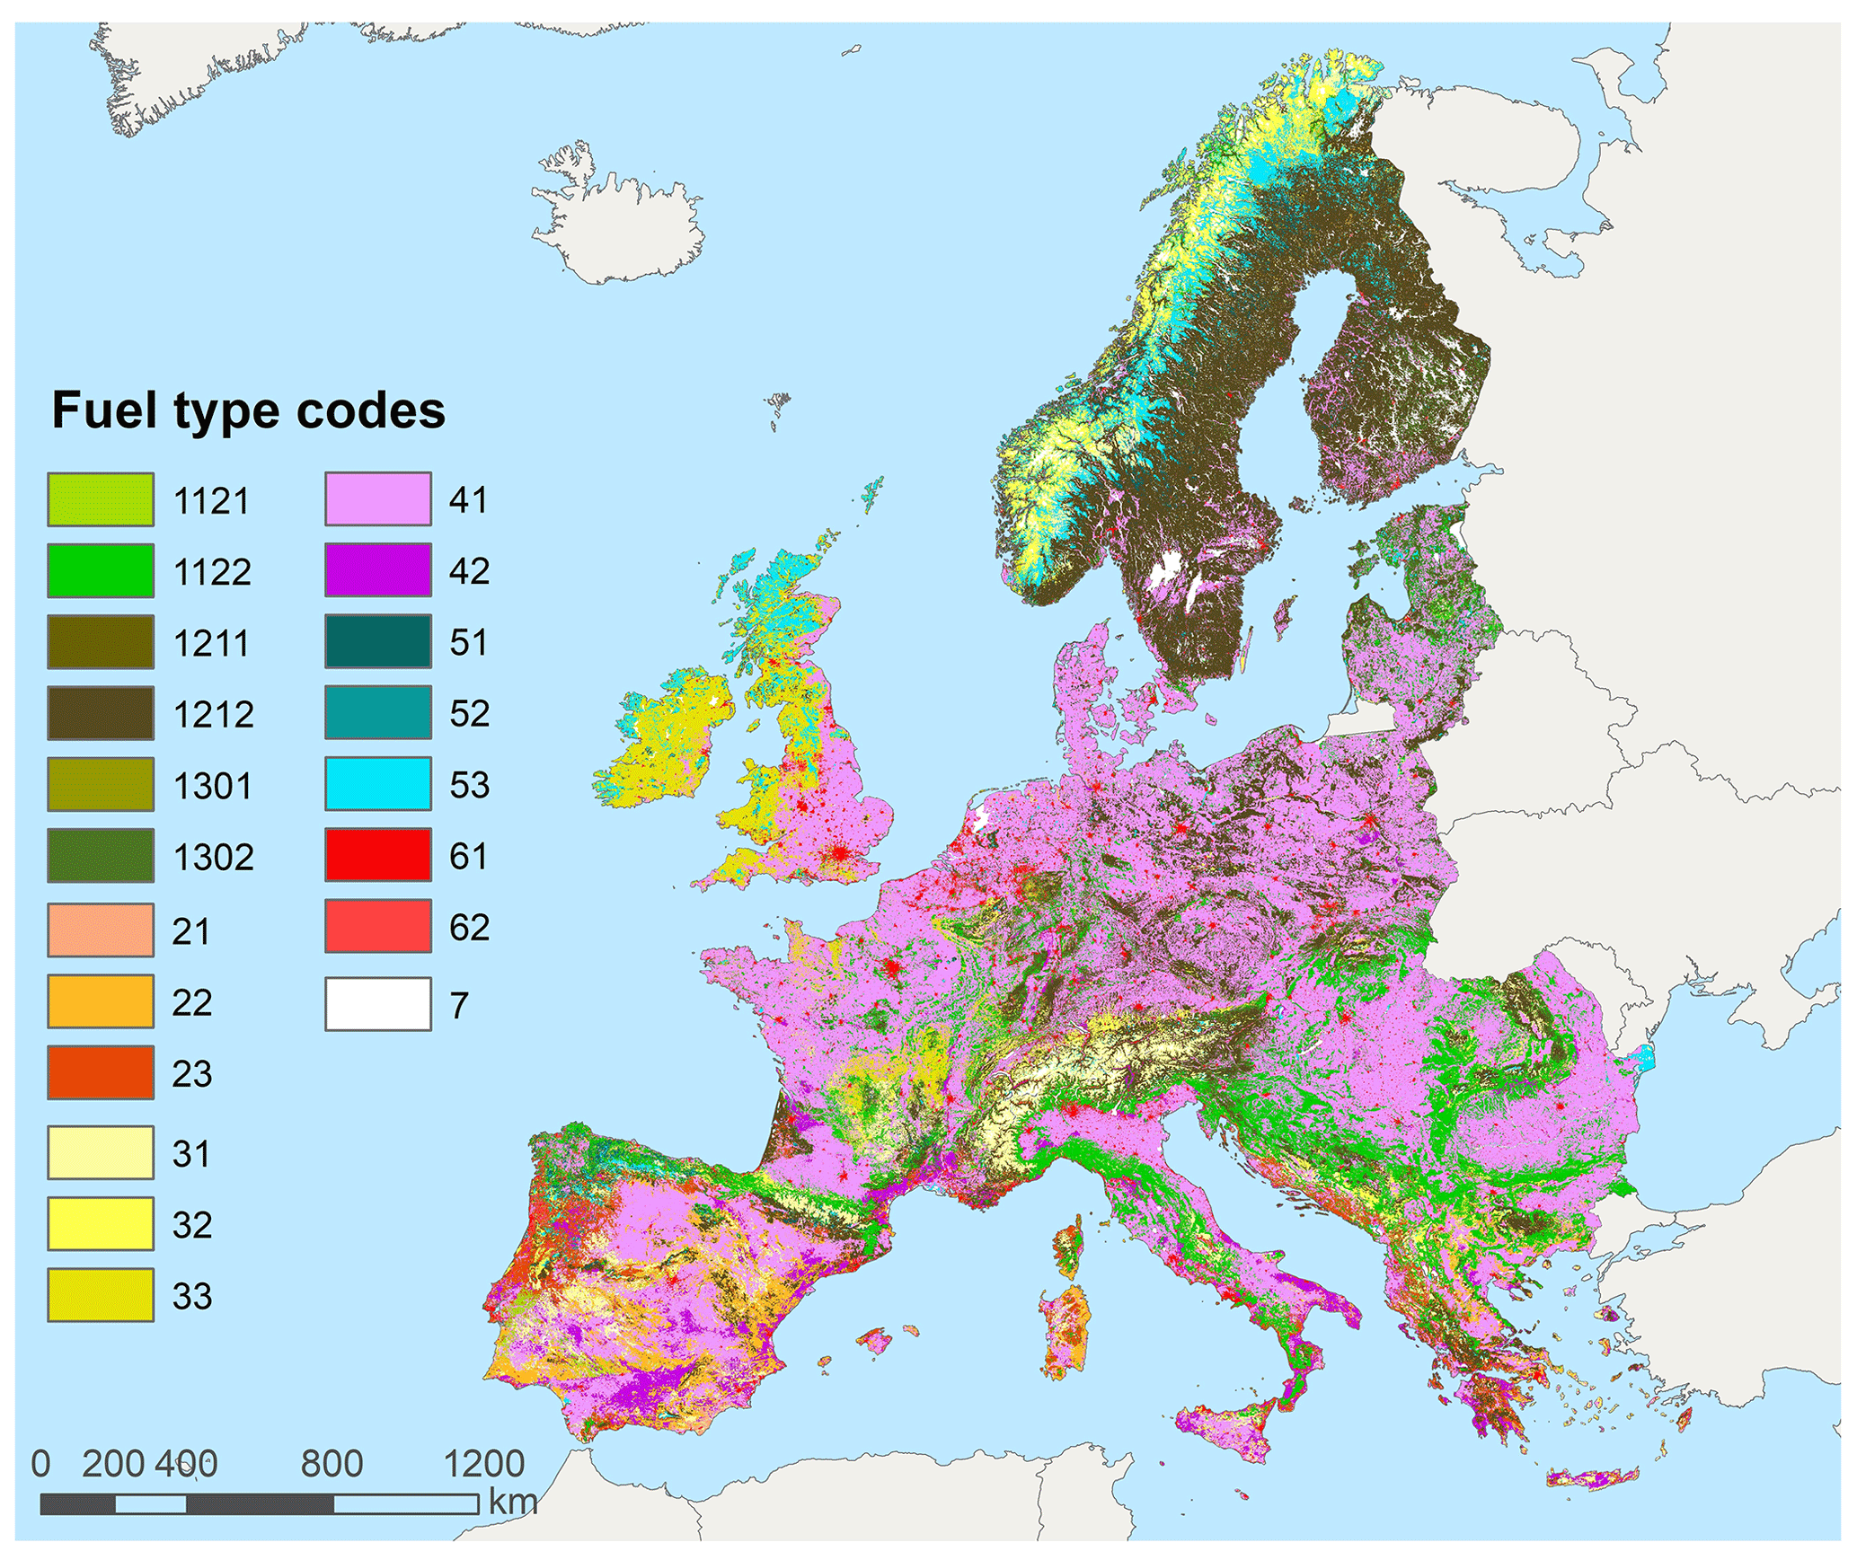
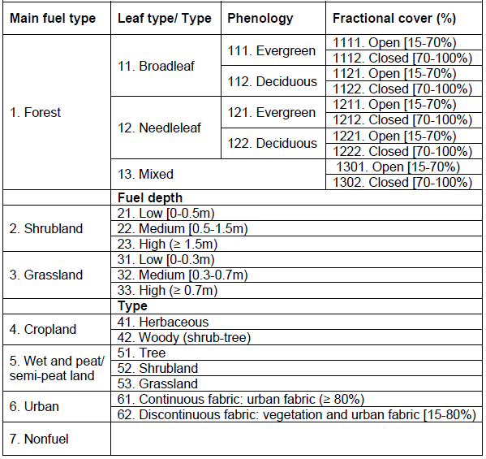
European fuel mapping background for fire risk prevention
Hierarchical
Europe’s diversity
Surface and crown fuels
Aragoneses et al. 2023 https://doi.org/10.5194/essd-15-1287-2023

Slide 4
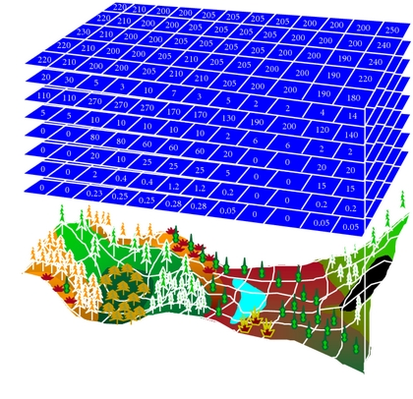
Modelling fire behaviour
Fuel parameters: Numerical values required to model the fuel fire behaviour (height, fuel load, particle size, etcetera)
Why are they necessary? They serve to model fire behaviour → prevent fire risk

Slide 5
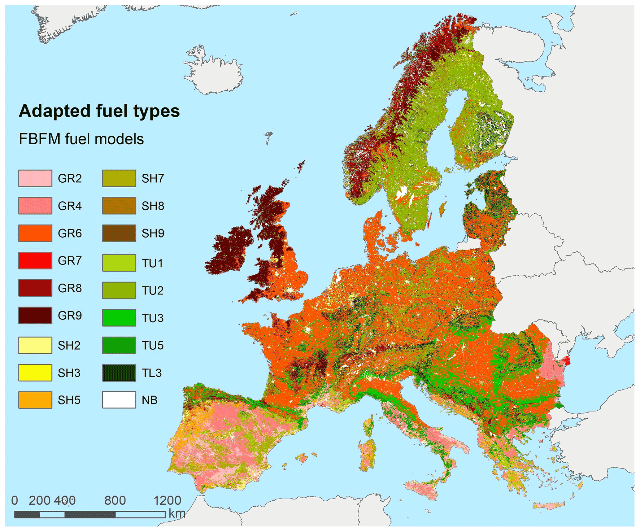
First assignment of standard fuel models
Crosswalk from FirEUrisk fuel types to FBFM fuel models (Scott and Burgan, 2005)
Use of expert knowledge
Only surface fuels
Aragoneses et al. 2023 https://doi.org/10.5194/essd-15-1287-2023

Slide 6
Objective
Parameterize European forest canopy fuels
Serve for fire behaviour and propagation
Reduce fire risk in Europe associated to crown fires
Approach: Create continuous maps of European forest canopy fuel parameters

Slide 7
Canopy base height
Height from the ground to a forest stand's canopy bottom → transferability from surface to canopy fuels (surface to canopy fires: the most extreme) → altura de base de copa
Lower the canopy base height + higher the understory → more transferability potential → more risk of canopy fire (extreme fire)
Length of CBH
Presence of understory
Flame length

Slide 8
Crown fuel parameters and used data
Forest canopy fuel parameters to be estimated – useful for fire behaviour modelling:
Canopy mean height – DONE
Canopy cover - DONE
Canopy base height – DONE
Fuel load - ONGOING
Canopy bulk density - ONGOING
Forest inventory data
Discrete waveforms: airborne LiDAR → calibration of models
Full-waveforms (continuous pulse of energy): satellite LiDAR (GEDI mission) → interpolation for wall-to-wall maps
Almost global coverage
https://gedi.umd.edu/

Slide 9
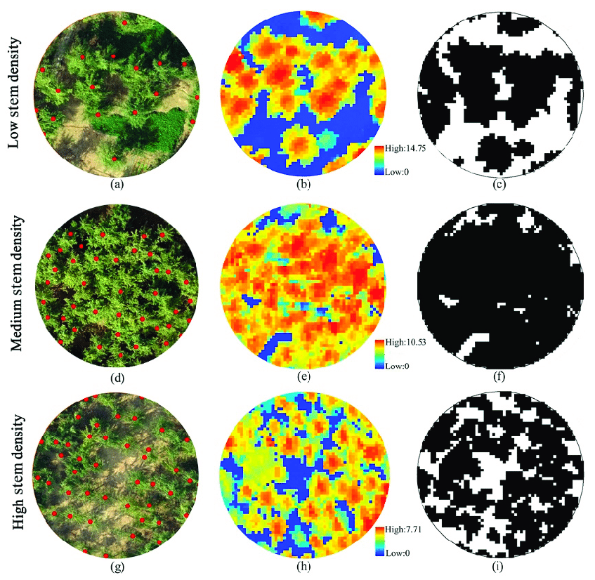

Slide 10
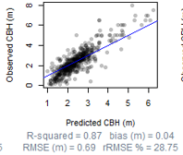
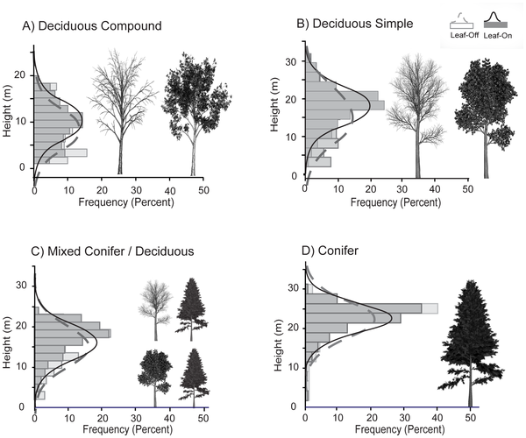
Methodology : reference data for CBH
Spanish National Forest Inventory (SNFI)
Predict for the PNOA LiDAR year
CBH models by species
Spain -> 4 areas
CBH measures in 2 SNFI
(1986-1996)
CBH reference data for GEDI-based model calibration
Using data from 3 and 4 SNFI
Mixed-effects models based on tree height and DBH
Notes:
Different density of pulses lead to different simulation metrics

Slide 11
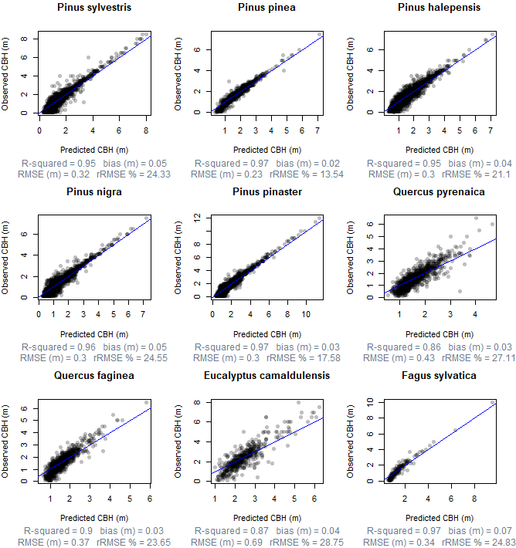
Results: CBH reference models by species in SNFI

Slide 12
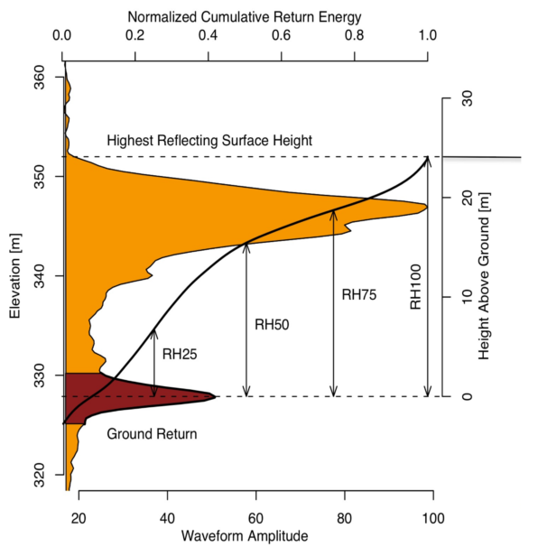
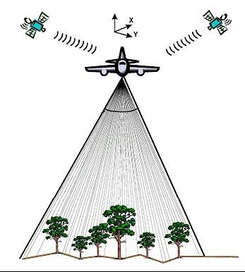
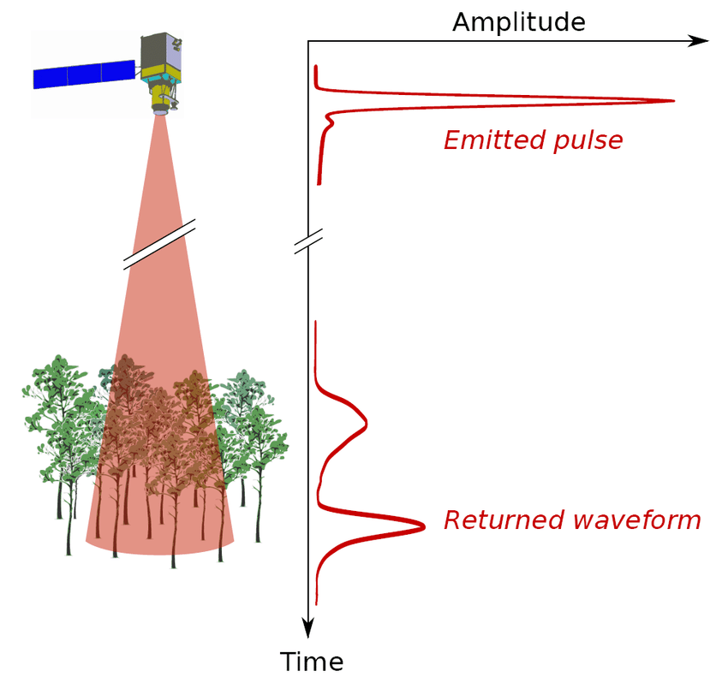
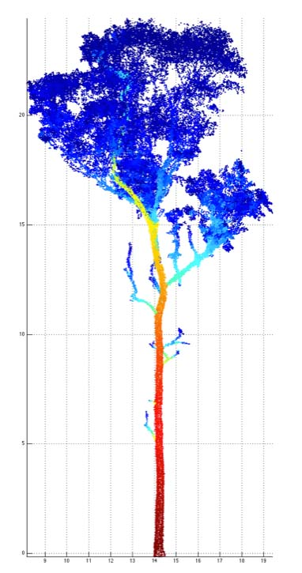
Methodology : Calibration of GEDI-based models
Forest inventory data and input airborne LiDAR (ALS)
Simulate satellite GEDI-like waveforms
GEDI-based model using reference data from ALS and forest inventory
Spain -> 4 areas
Germany -> 2 areas
Slovenia -> 1 area
Clip by forest plots
Simulation -> Extract metrics
https://mundogeo.com/2000/01/01/sistemas-laser-aerotransportados-la-revolucion-de-modelos-digitales/
https://hal.archives-ouvertes.fr/hal-01522855/document
https://www.science20.com/news_articles/weighing_trees_now_with_lasers-151665
Notes:
Different density of pulses lead to different simulation metrics

Slide 13
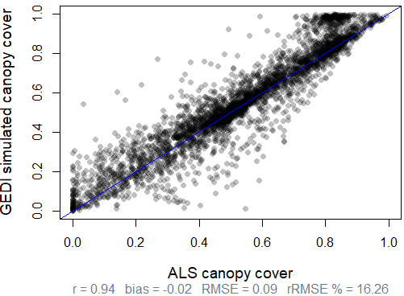
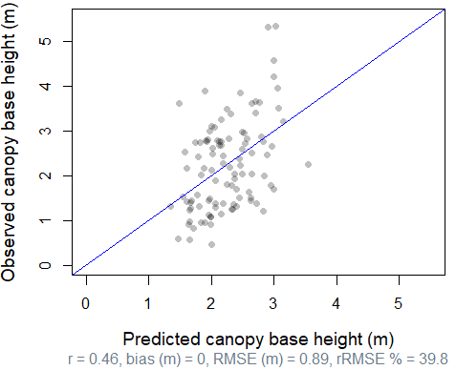
Results: calibration of GEDI with reference data
Canopy cover
Canopy height
Canopy base height

Slide 14
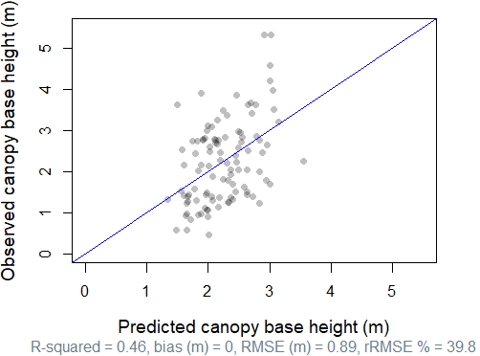
Results: CBH GEDI-based model
CBH (m) = – 0.0006515 GE** + 0.1958871 SE* – 0.2642275 RH10* + 0.1649544 RH85*** + 2.5386346***
GE: ground elevation
SE: signal start → RH0
RH: relative height
Exhaustive search for parameters
Most pasimoniosus
Lowest AIC
No multicollinearity between params. (low VIF)

Slide 15
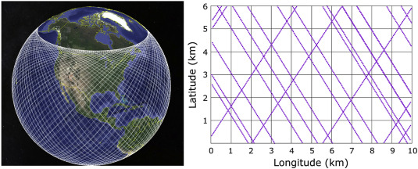
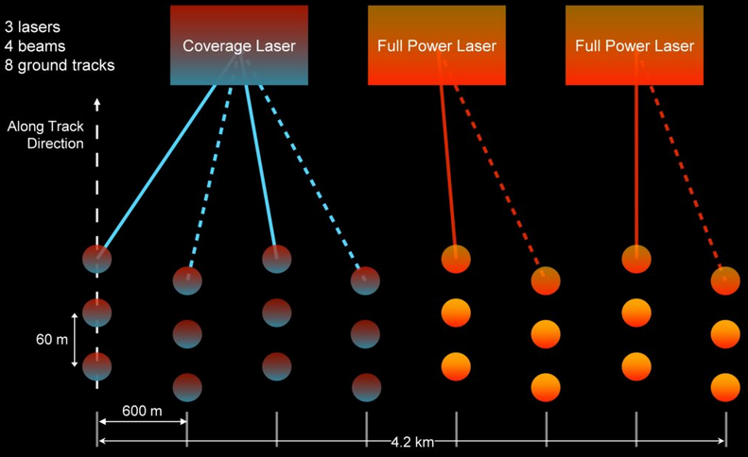
Methodology: Interpolation model of GEDI data
Next step: Use spaceborne GEDI data to derive forest canopy height and cover
But we need to interpolate because GEDI data is not spatially continuous
Inverse distance weight (IDW) interpolation of GEDI data
Forest fuel polygons with spacebrone GEDI footprints
92 % forest under 51.6ºN
Random forest regression models of GEDI + multispectral+ RADAR data + biopysical variables
Forest fuel polygons without spaceborne GEDI footprints
(small polygons under 51.6ºN and all polygons above 51.6ºN, GEDI coverage)
https://www.sciencedirect.com/science/article/pii/S2666017220300018

Slide 16
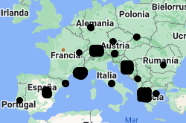
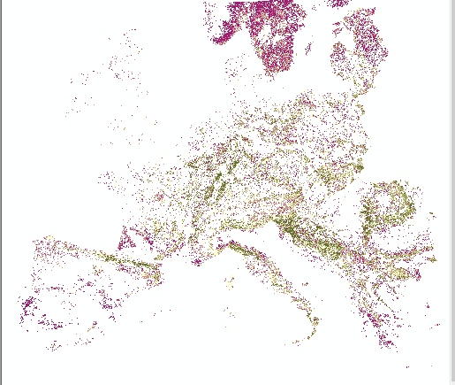
Methodology: regression models
Input layers
Optical imagery
Landsat 8 composites’ (May- September) statistics
6 spectral indices
RADAR imagery
PALSAR
Biophysical variables
Temperature
Precipitation
Biogeographic regions
Elevation
Slope
Net primary production
Tree cover
Top canopy height
Biomass
Digital surface model
https://www.sciencedirect.com/science/article/pii/S2666017220300018
Training (70%)
Random forest regression model
Continuous map for forest canopy parameters (1 km)
Validation (30%)

Slide 17
Results regression models: Example for canopy height
Plots of observed versus predicted forest anopy cover. The blue line is 1:1. The dashed line is the best fit line for our model.
Most important variables for the three parameters:
Top of canopy height and HV polarization RADAR

Slide 18
Final results: wall-to-wall maps on canopy parameters

Slide 19
Generation of uncertainty maps
Steps
Generation of reference data
Calibration of GEDI models
Extrapolation (IDW or RF)
Propagation of independent errors

Slide 20
Final results: uncertainty maps on canopy parameters

Slide 21
Discussion and conclusions
We wanted to help preventing crown fires, the most severe, by creating pixel-level maps on canopy fuel parameters: canopy mean height, canopy cover, canopy base height
Key technology: GEDI LiDAR (vertical structure of fuel types) both discrete and full-waveform
Currently working on similar approaches to derive canopy bulk density → raw GEDI waveform
Elena Aragoneses: e.aragoneses@uah.es
Notes:
https://dinaspampinato.com/visual-thinking/

