Slide 1
V Simposio de Doctorandos de la UAH en Investigación con Tecnologías de la Información Geográfica
Forest canopy fuel load mapping using UAV high resolution RGB and multispectral imagery
Student
Álvaro Agustín Chávez Durán
Principals : Dr. Mariano García Alonso
Dra. María Inmaculada Aguado Suárez
Dra. Blanca Figueroa Rangel
Dr. Miguel Olvera Vargas
November 2023

Slide 2
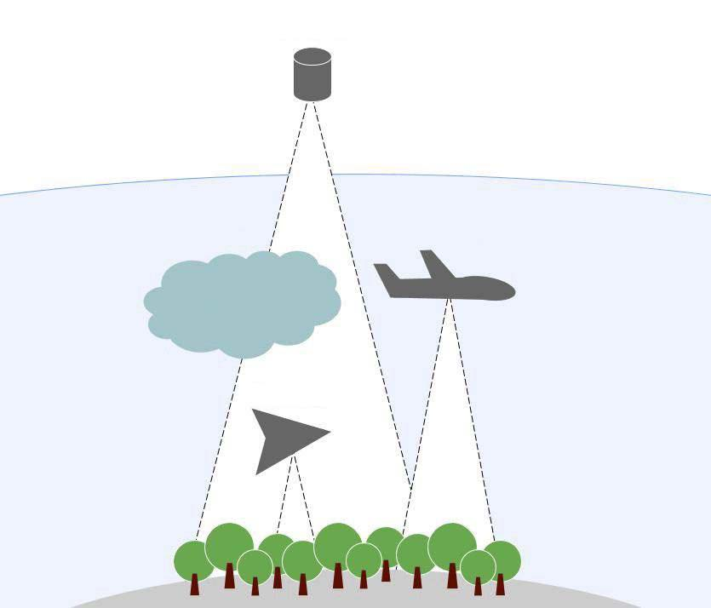
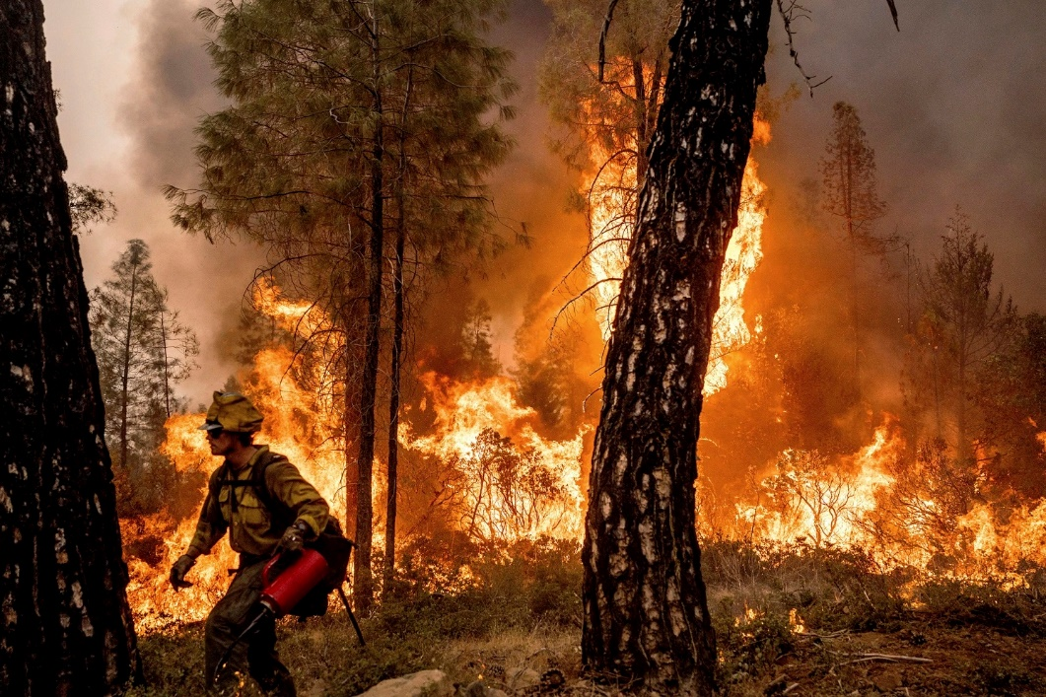
INTRODUCTION
Satellite
Atmosphere
Airplane
Clouds
Drone
Source: nbcnews, 2022.
Prevention – Fight - Effects
Transition
Fight and Suppression
(Reactive mode)
Fire management
(Proactive mode)
Operational level, knowledge in action.
Source: arquidron, 2022.

Slide 3
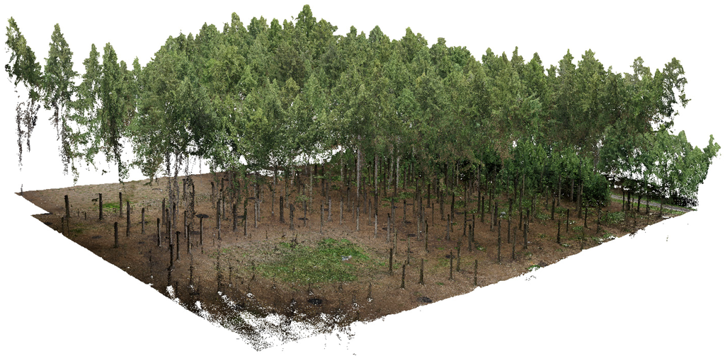
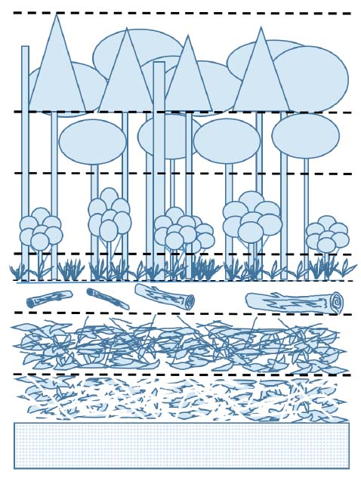
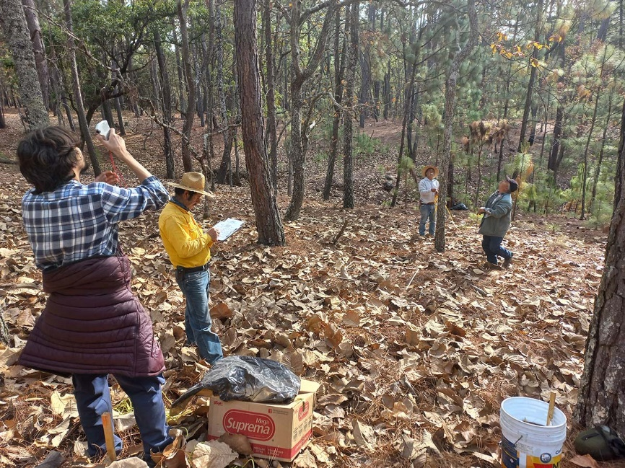
Drone
Forest fuel complex
Fuente: sensefly, 2020.
Field data
Fuente: Flores et al., 2018.

Slide 4
OBJECTIVE
To develop a methodology for mapping the spatial distribution of canopy fuel loads in mixed forests, utilizing geospatial data, UAV RGB and multispectral imagery.
HYPOTHESIS
The designed methodology, allows mapping canopy fuel loads consistently with its variability and three-dimensional spatial distribution.

Slide 5
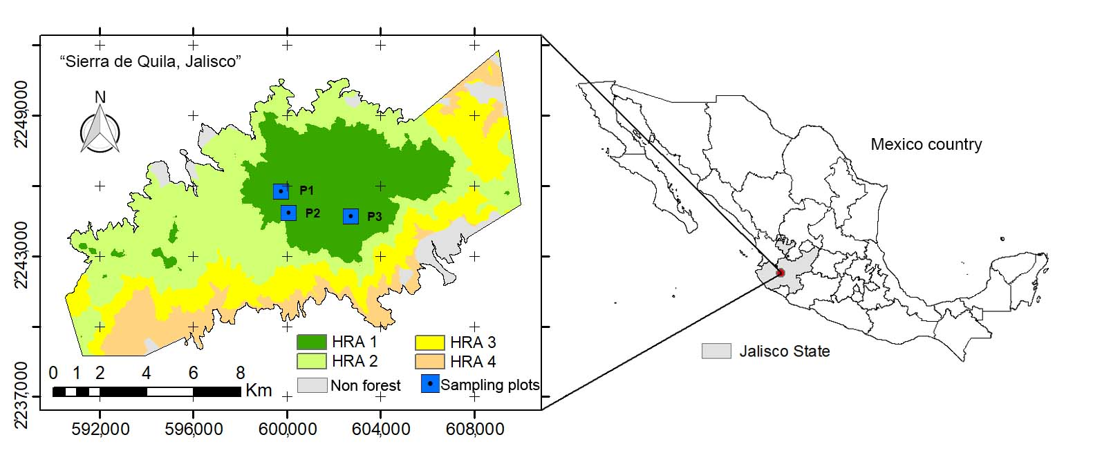
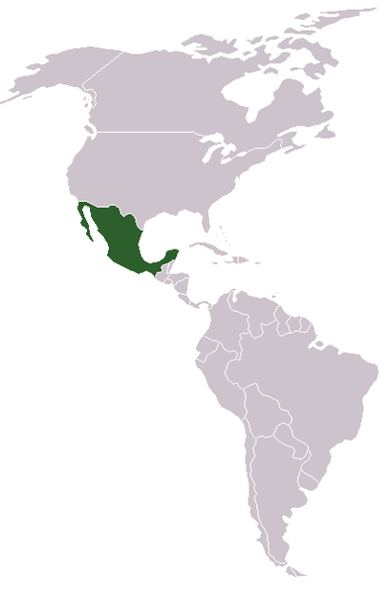
Study zone
Protected Natural Area
“Sierra de Quila” 14,168 ha
Mixed Pine - Oak forest

Slide 6
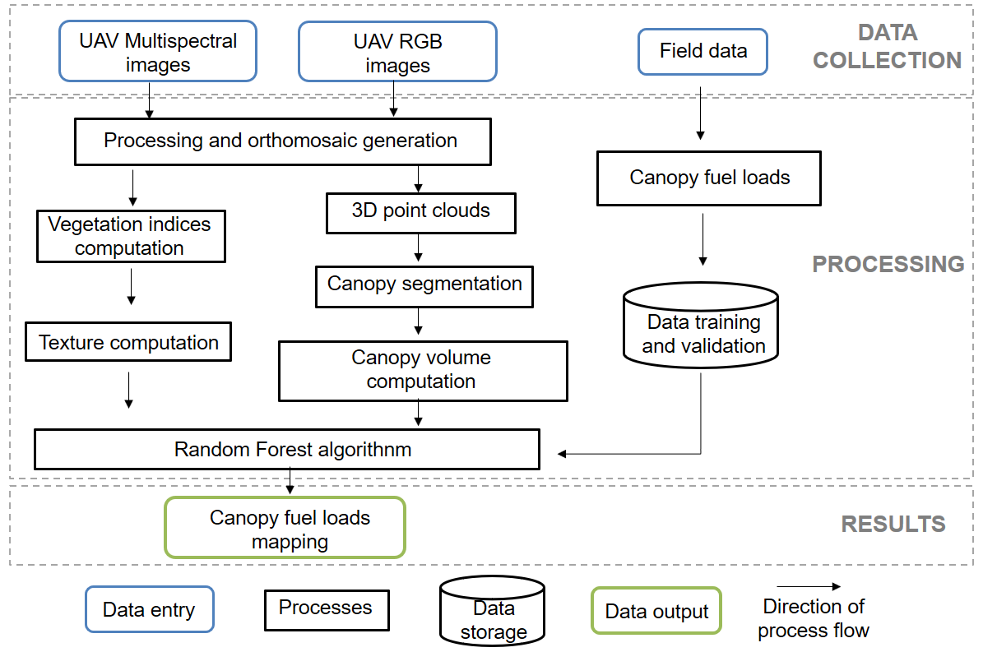
MATERIALS AND METHODS

Slide 7
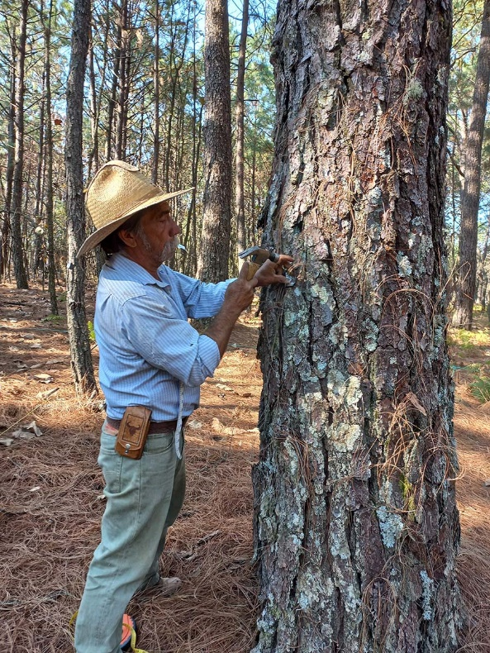
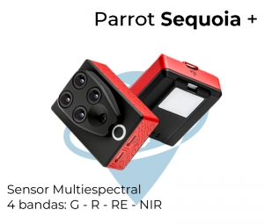
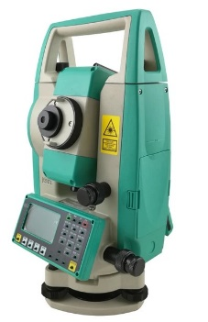
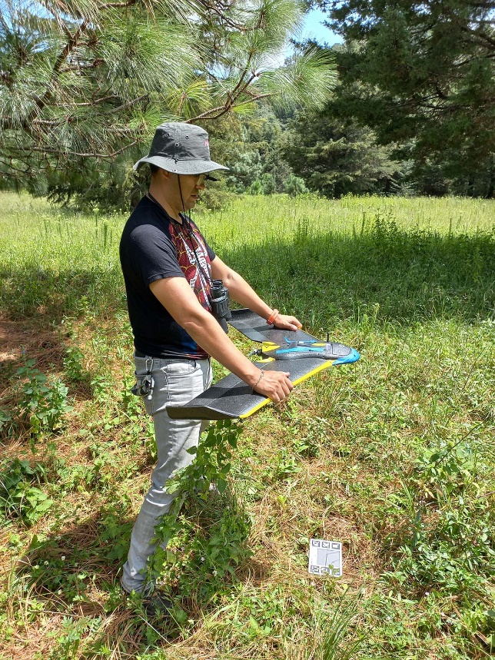
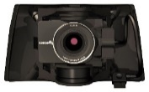
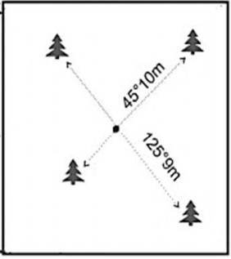
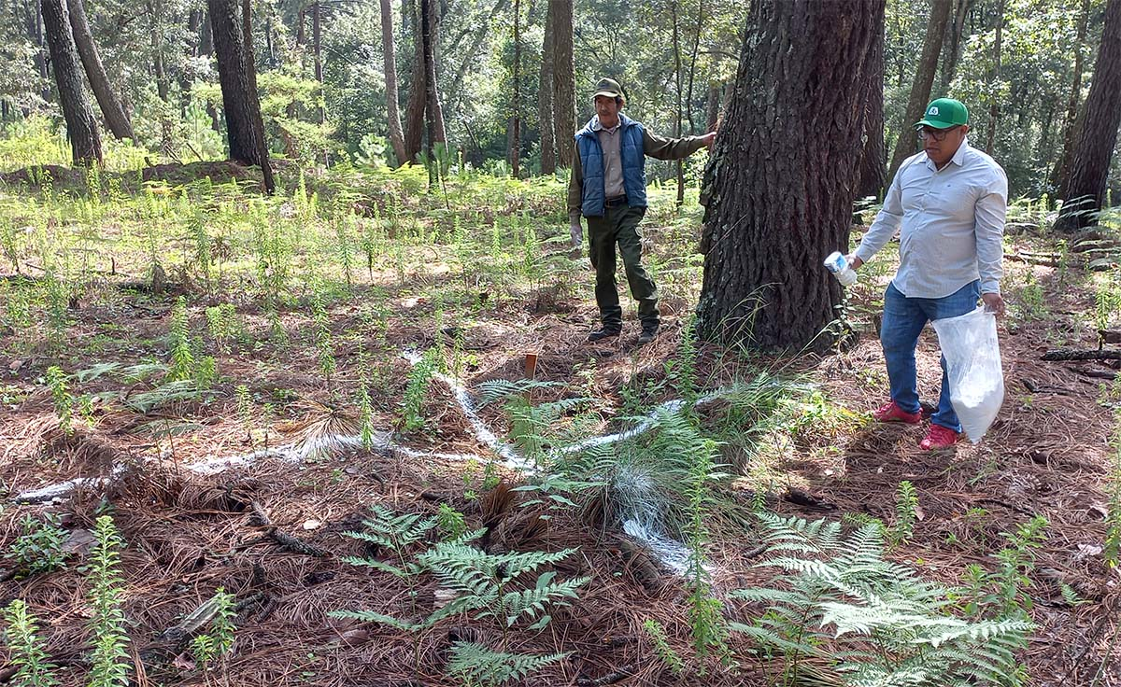
20 cm
SenseFly S.O.D.A. 3D
7 cm

Slide 8
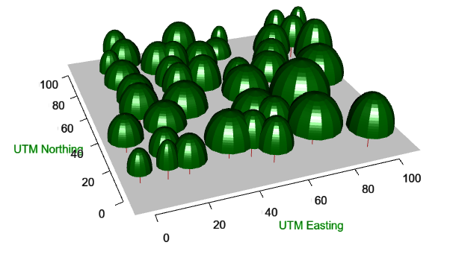
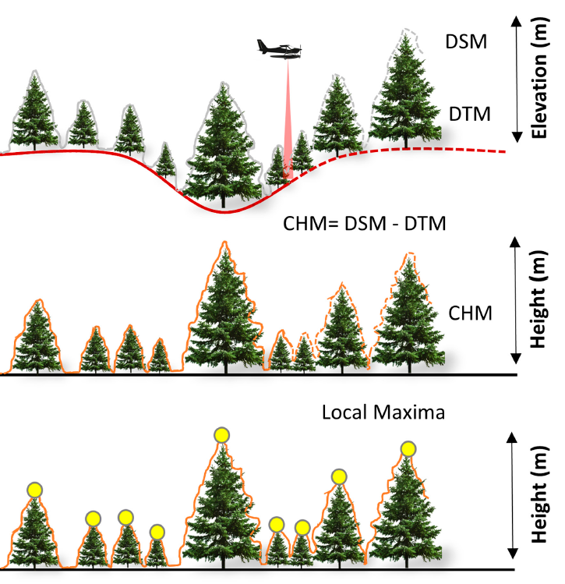
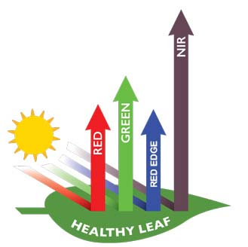
TREETOP. Shiny-based application
Random Forest
Vegetation indices
Allometric equations

Slide 9
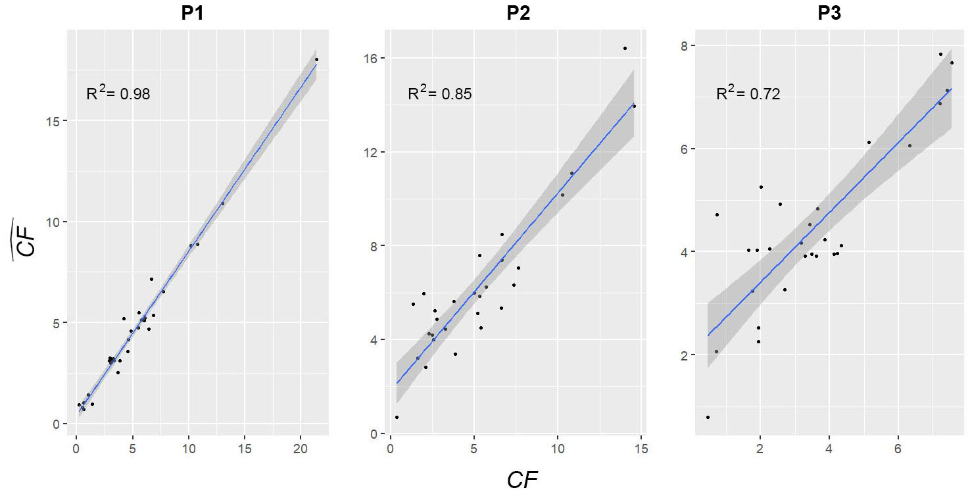
RESULTS
R² = 0.75; RMSE = 1.78 Mg; Relative Bias = 18.62%
Pinus and Quercus
tended to cluster
Only Pinus
tended to cluster
All trees
randomly distributed

Slide 10
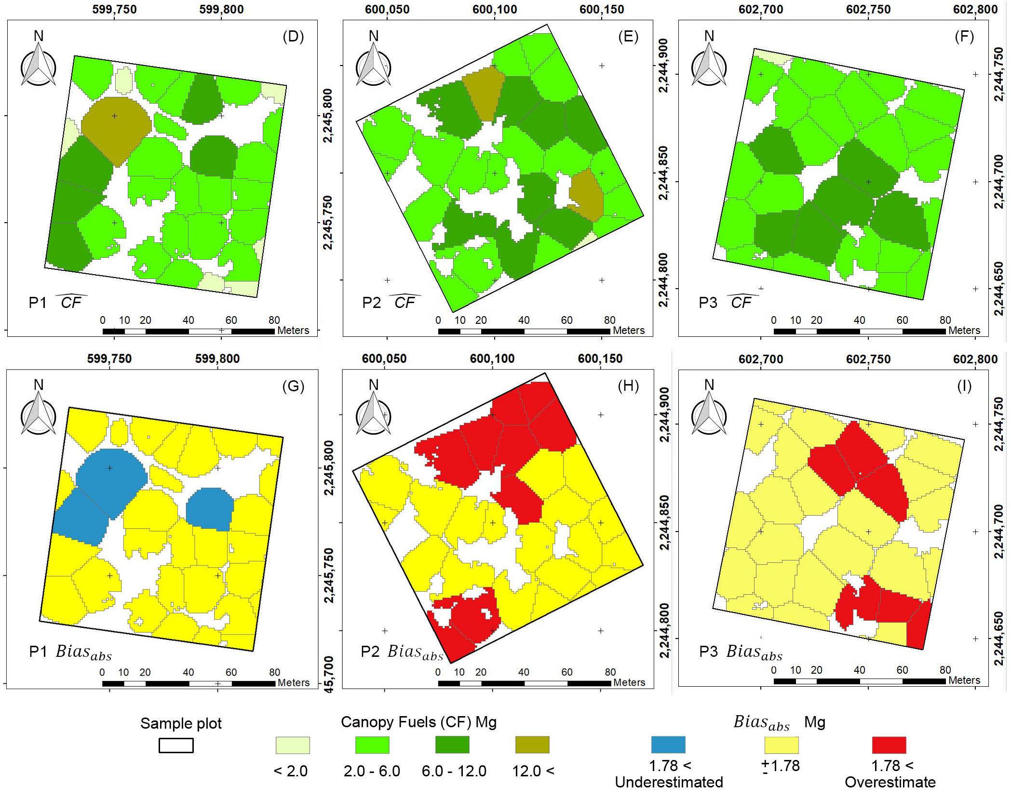
Importance of the variables
Canopy volume: 80.67%,
Red band texture: 7.00%,
Red edge band texture: 5.99%,
NDVI: 4.15% and
EVI: 2.19%.

Slide 11
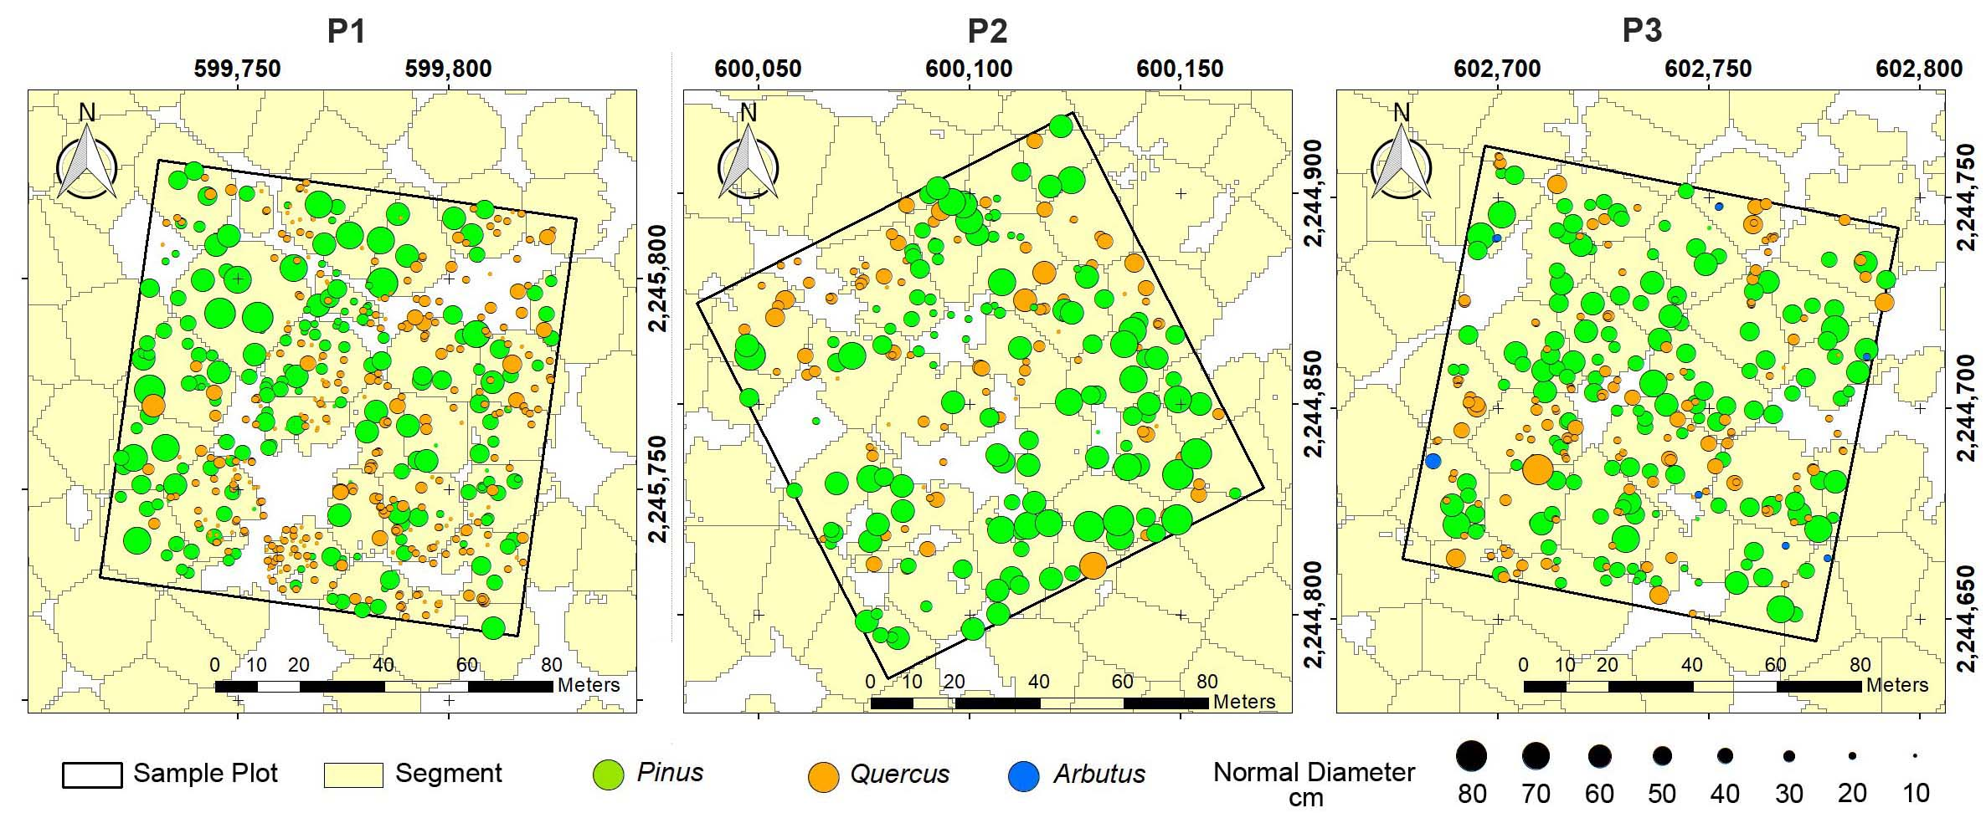
FINAL CONSIDERATIONS
The proposed methodology achieved good precision.
High level of complexity of mixed forests.
Mapping canopy fuel loads is consistent with its variability and three-dimensional spatial distribution.
Enabled the highest precision at the lowest cost, encouraging frequent updating of forest fuels maps.

Slide 12
E-mail: alvaro.chavez@edu.uah.es

