Slide 1
The roles of anthropogenic and climatic factors in driving the initiation of large wildfires in Europe
Lead beneficiary: UAH
Clara Ochoa

Slide 2
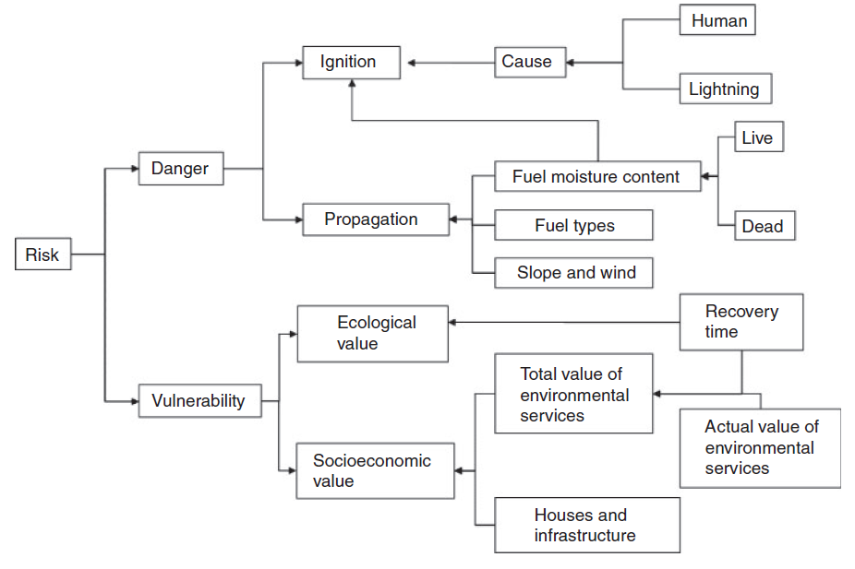
Conceptual scheme
Risk: potential for adverse consequences or impacts due to the interaction between one or more natural or human-induced hazards, exposure of humans, infrastructure and ecosystems, and systems’ vulnerabilities
Danger: likelihood that a fire ignites and propagates. It implies the consideration of the variables associated to human and natural causes leading to a fire ignition.
Proposed framework for an integrated fire risk assessment system (Chuvieco et al. 2014)

Slide 3
Contents
1. Dependent variable
2. Independent variables
3. Creation of database and balance of the data
4. Creations of models and fine tuning
5. Results
6. Conclusions

Slide 4
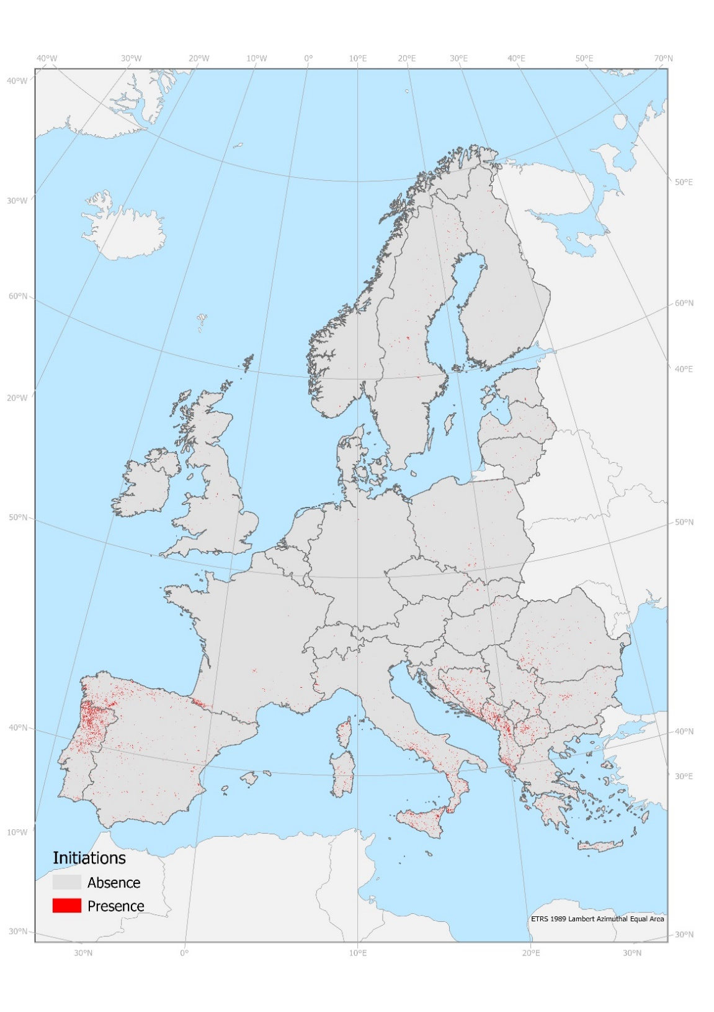
Dependent Variable: fire initiations
Initiations Points (2001- 2019) created from pixel-based the FireCCI51 burned area (> 100 ha) product using the FRY flood-fill algorithm (Laurent et al., 2018).
Exclusion of points in non burnable areas, cropland except those < 1000 m from forests, grassland and Shrubs.
One subset just with initiations with burned area > 1000 ha (2 %)

Slide 5
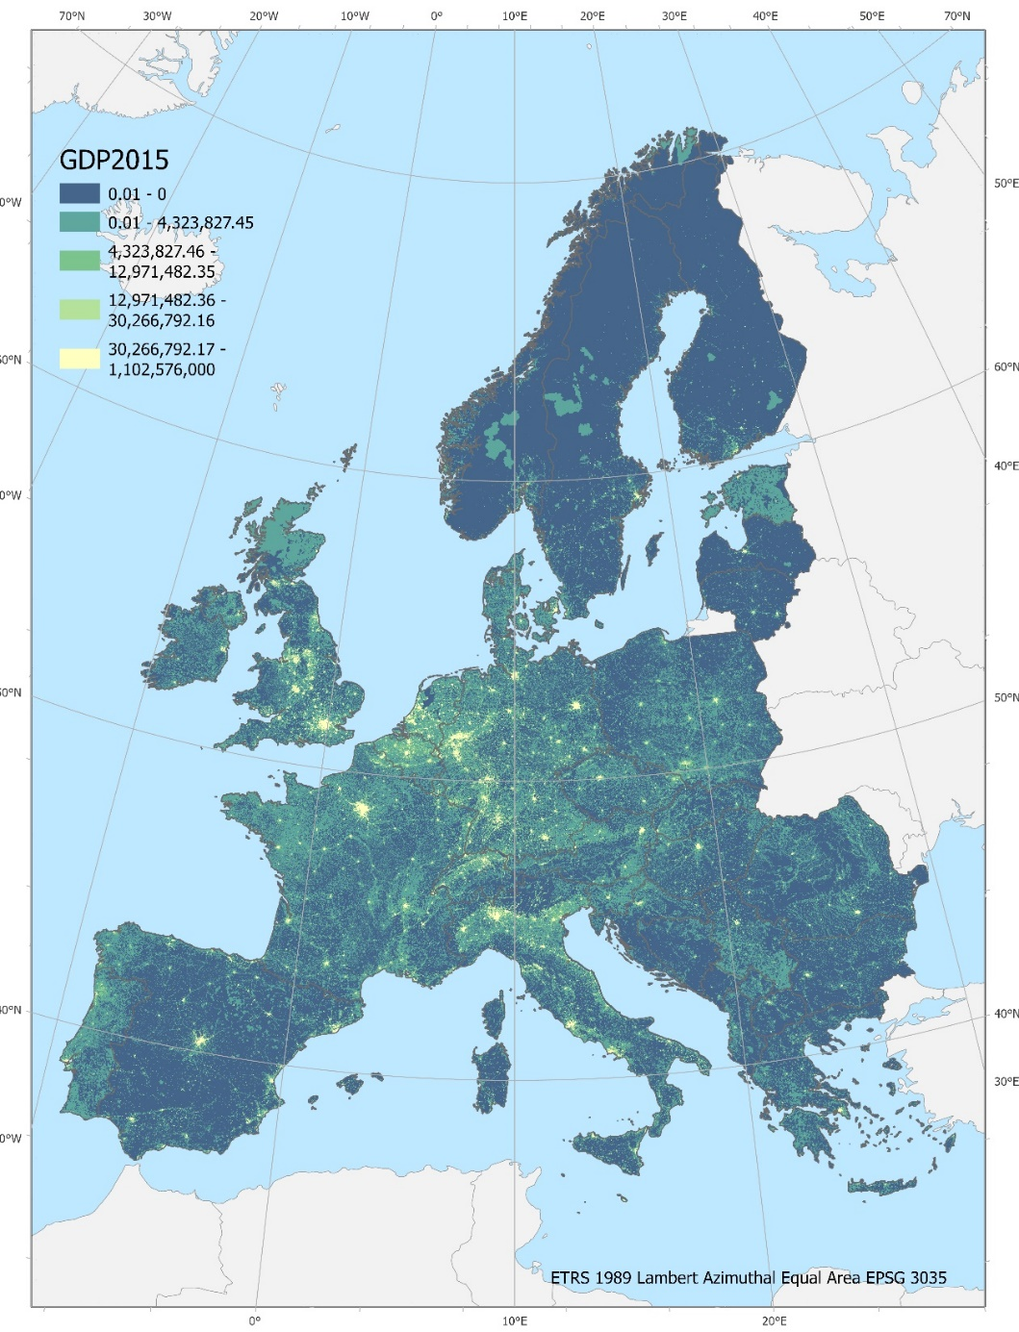
Socio economic Independent Variables
Variable | Source
1. Distance to roads | Meijer et al 2018 (GLOBIO)
2. Forest-Agricultural Interface (FAI) | From Fuel Map (Aragoneses et at., 2023)
3. Wildland- Urban Interface (WUI) | (Bar-Massada et al., 2013)
4. Wildland- Agricultural Interface (WAI) | From Fuel Map (Aragoneses et at., 2023)
5. Wildland- Forest Interface (WFI) | From Fuel Map (Aragoneses et at., 2023)
6. Forest-Urban Interface (FUI) | From Fuel Map (Aragoneses et at., 2023)
7. Population density | EEA
8. Grazing | FAO
9. GDP | Aalto University, Helsinki
10. Population older than 65 years | SEDAC-CIENSIN

Slide 6
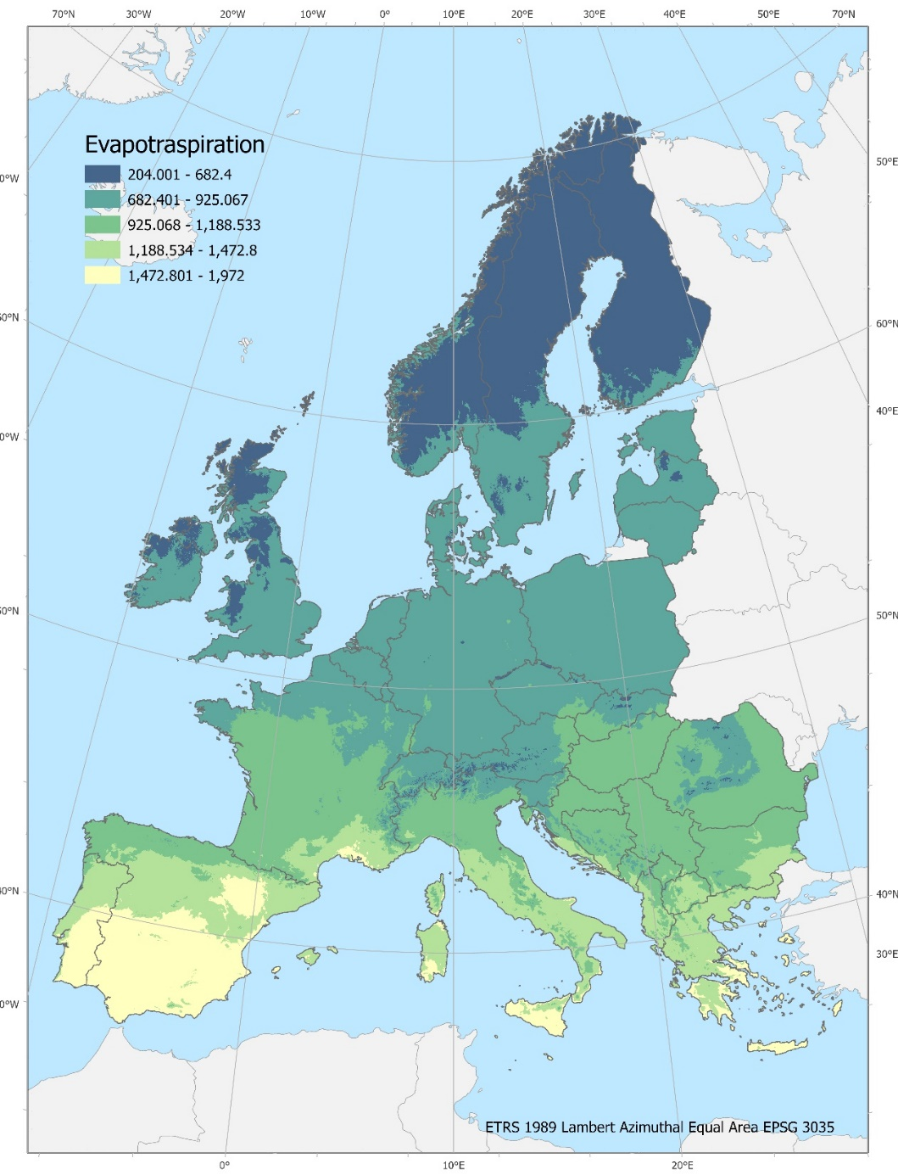
Biophysical Independent Variables
Variable | Source
11.Evapotranspiration | Antonio Trabucco, Robert Zomer (2019)
12. Aridity Index | Antonio Trabucco, Robert Zomer (2019)
13. Bioclimates | European Commission and the University of Edinburgh
14. Ecological Regions | FAO

Slide 7
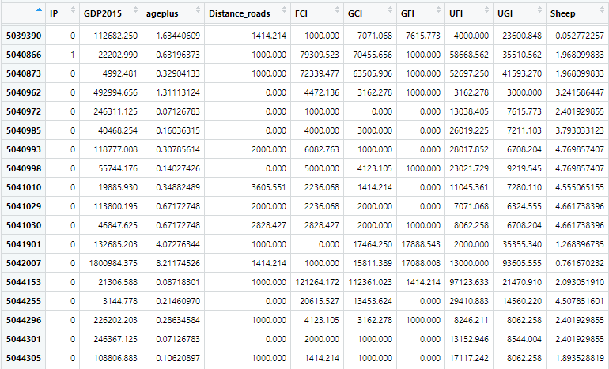
Creation Data Base
Total Points = 4823967
Ignition Point = 33388 ( ~1%)
Non-ignition = depending on model

Slide 8
Model and fine tuning
Cross-validation is a technique used in machine learning and statistical modeling to assess the performance and generalizability of a predictive model. It involves splitting a dataset into multiple subsets or "folds" for training and testing the model iteratively.
SMOTE, which stands for "Synthetic Minority Over-sampling Technique," is a technique used in imbalanced machine learning datasets to address the problem of having significantly fewer examples in one class compared to the others
Models | Climatic | Human | Mixed | Climatic 1000 | Human 1000 | Mixed 1000
Number of initiations points | 33388 | 33388 | 33388 | 930 | 930 | 930
Hyperparametes (CV): max_depth: max_features: min_sample_leaf: min_sample_split: n_estimators: | 10 Auto 4 10 200 | 10 Auto 4 2 100 | 10 Auto 1 5 100 | None Auto 4 2 50 | 10 Auto 1 2 5 | 20 Auto 2 2 200
Absence sampling method | Stratified sampling 1:1.5 | SMOTE sampling | Stratified sampling 1:1.5 | Stratified sampling 1:1.5 | SMOTE sampling | Stratified Sampling 1:1.5
AUC | 0.78 | 0.61 | 0.80 | 0.79 | 0.62 | 0.82
Accuracy | 0.79 | 0.59 | 0.81 | 0.79 | 0.64 | 0.83

Slide 9
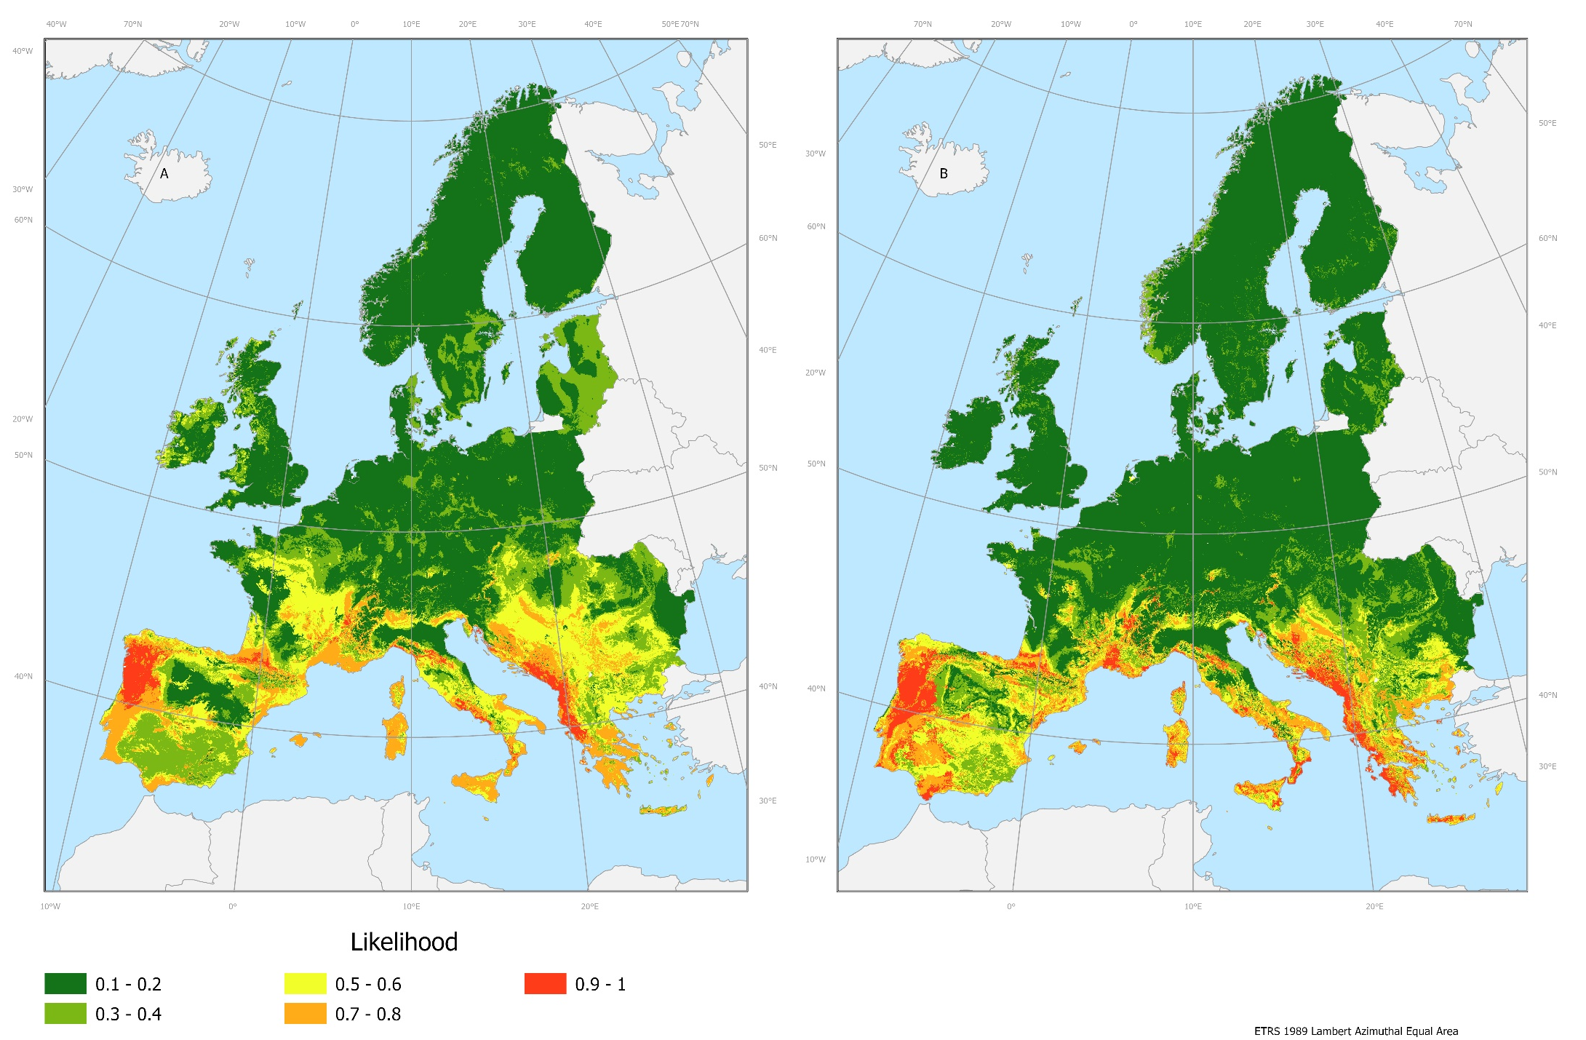
Results: likelihood for climatic models
Left: initiations with burned area > 100 ha
Right: initiations with burned área > 1000 ha

Slide 10
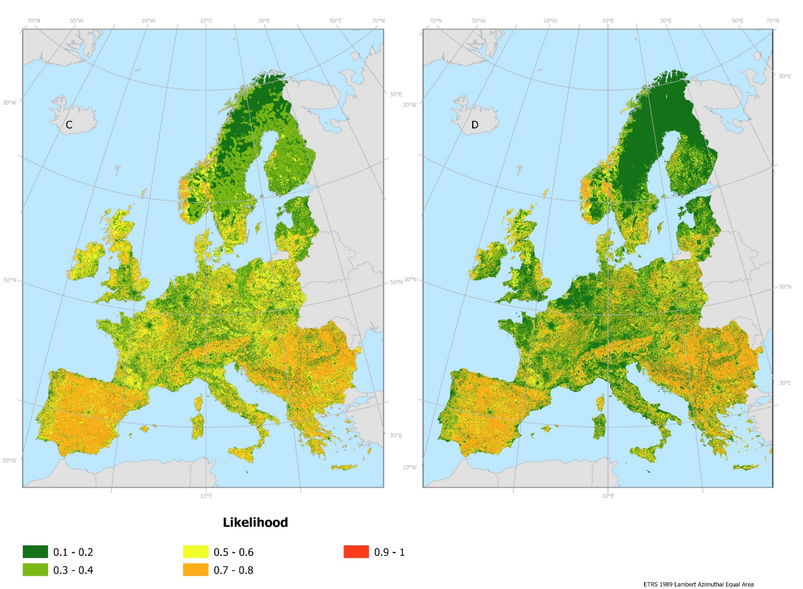
Results: likelihood for human models
Left: initiations with burned area > 100 ha
Right: initiations with burned área > 1000 ha

Slide 11
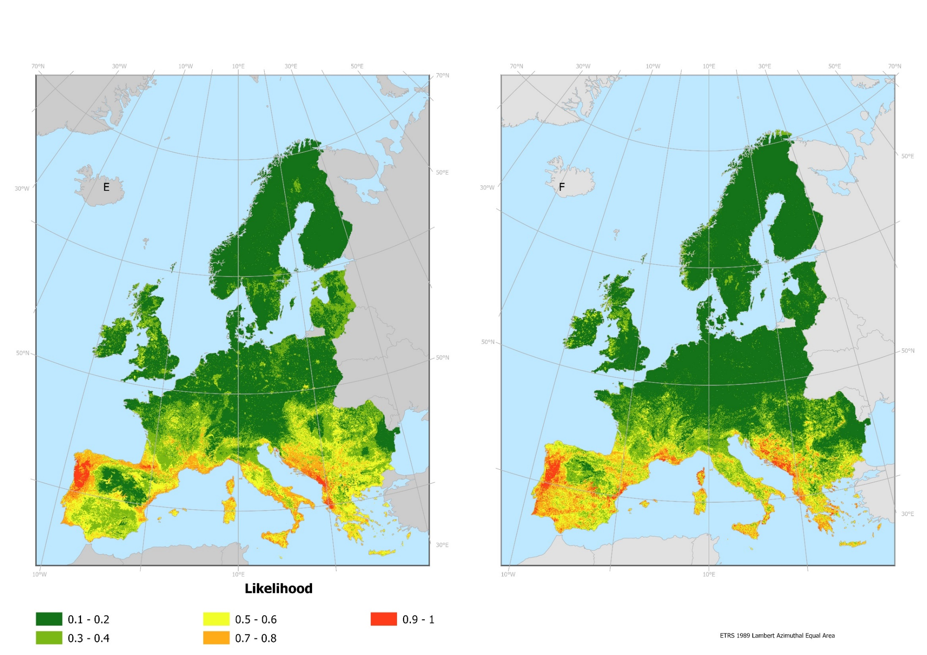
Results: likelihood for mixed models
Left: initiations with burned area > 100 ha
Right: initiations with burned área > 1000 ha

Slide 12
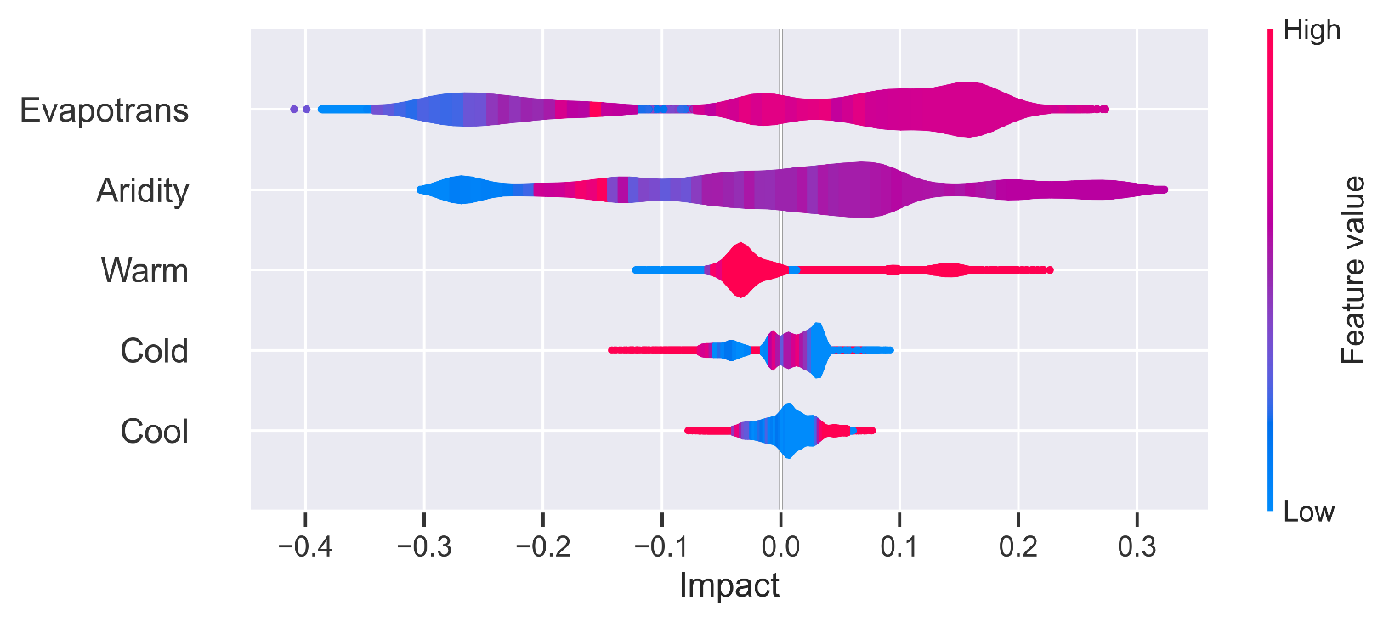
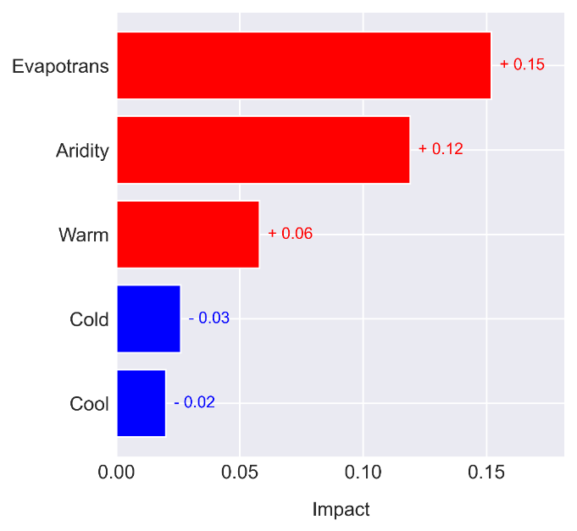
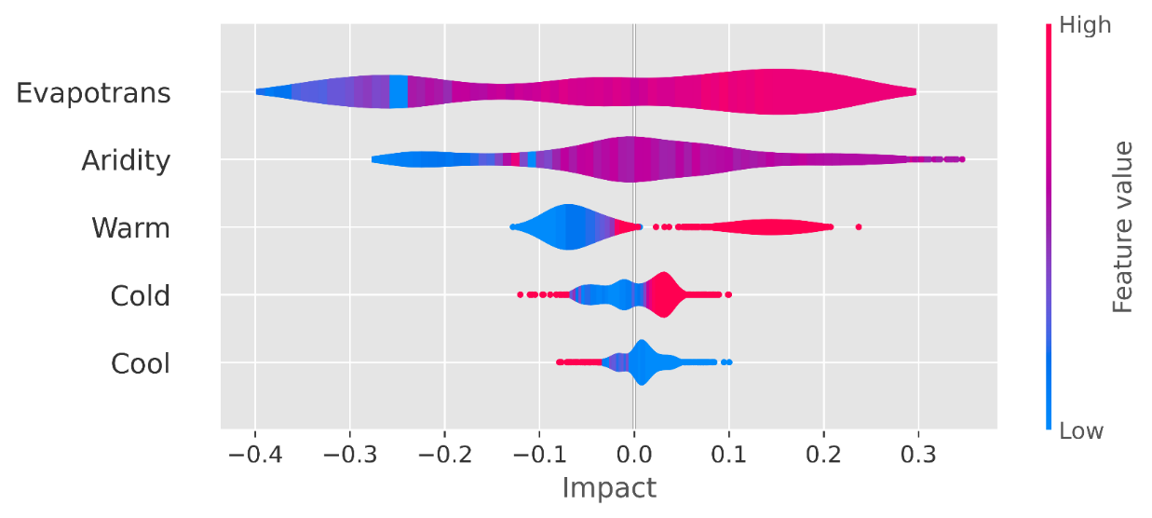
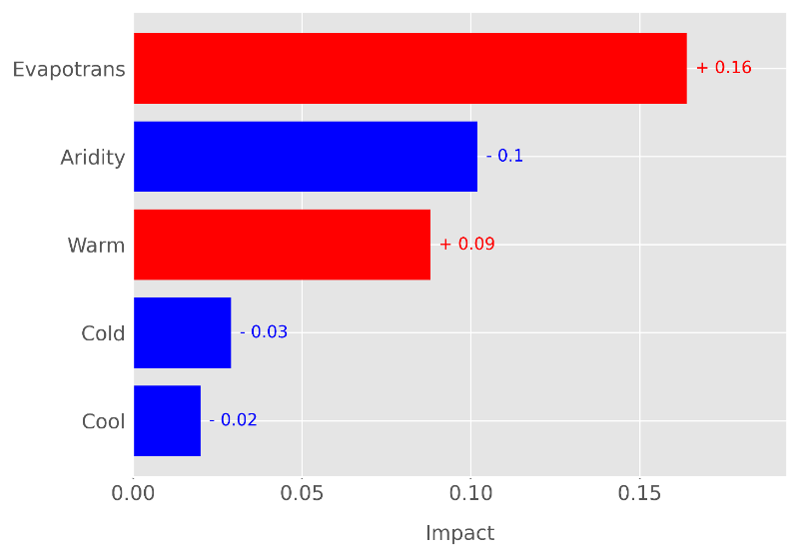
Results: global feature importance climatic models
Feature importance analysis in machine learning is a method for assessing and understanding the contribution of individual features (variables or attributes) in a predictive model. It helps answer the question: "Which features have the most influence on the model's predictions?“
Top: initiations with burned area > 100 ha
Bottom:initiations with burned area > 1000 ha

Slide 13
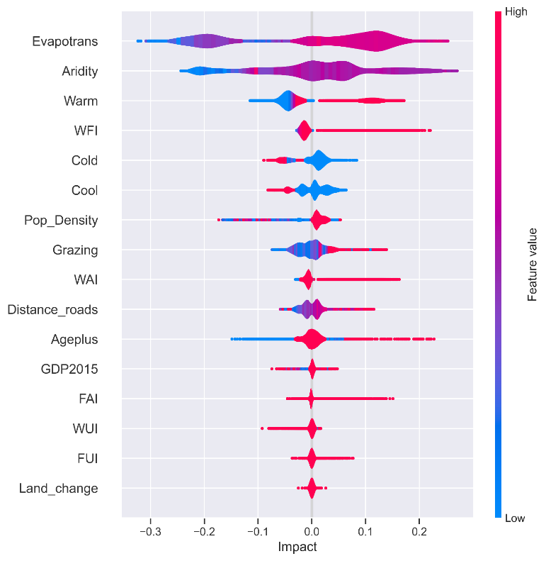
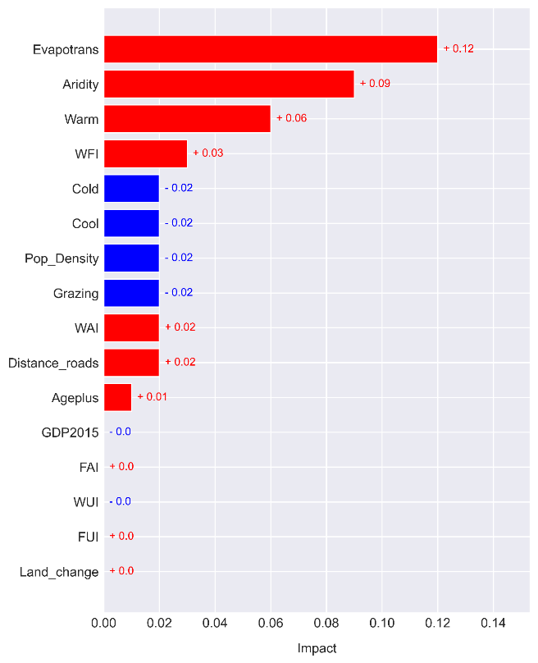
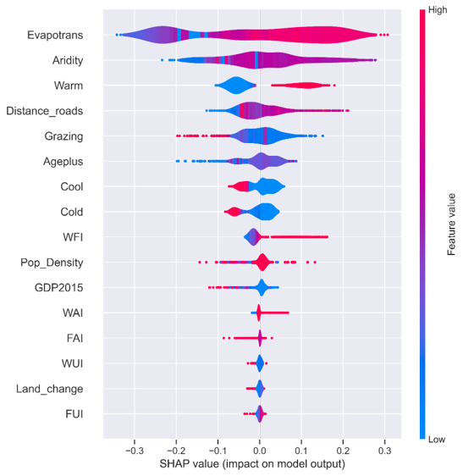
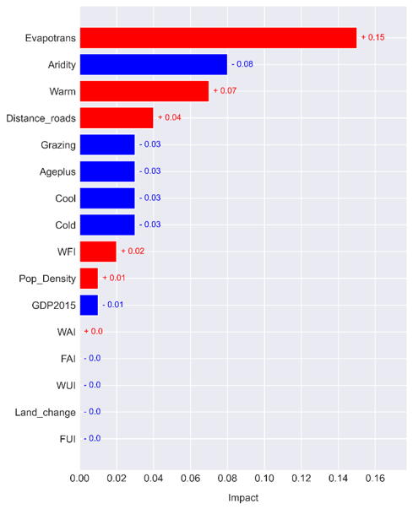
Results: global feature importance for mixed models
Top: initiations with burned area > 100 ha
Bottom:initiations with burned area > 1000 ha
Feature importance:
Mixed model: evapotranspiration, aridity, warm, Wildland-Forest Interface (WFI), cold, cool
Mixed 1000 model: evapotranspiration, aridity, warm, distance to roads, grazing, Ageplus.

Slide 14
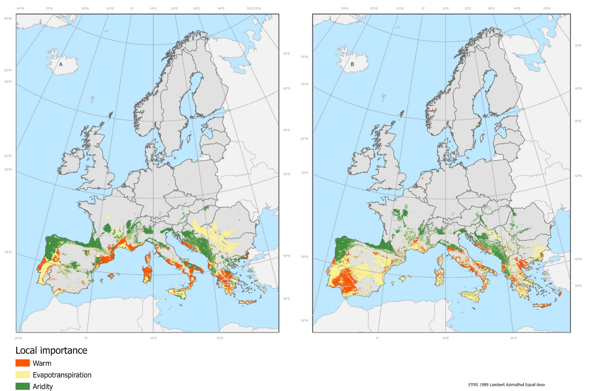
Results: local importance for climatic models
Left: predicted initiations with burned area > 100 ha
Right: predicted initiations with burned área > 1000 ha

Slide 15
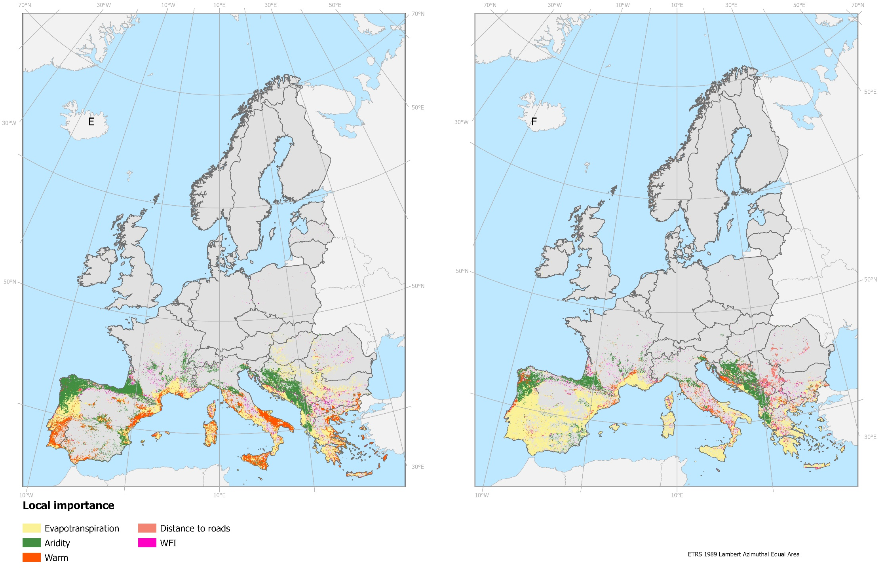
Results: local importance for mixed models
Left: predicted initiations with burned area > 100 ha
Right: predicted initiations with burned área > 1000 ha

Slide 16
Conclusions
Limitations:
Availability of updated and harmonized European databases.
Political implications:
Influence of human and climatic factors on initiations of large fires in Europe.
Human variables contribute to the prediction but can’t be used alone at this scale.
Human variables have more influence in the prediction of initiations with burned area > 1000 ha.
Strategies of fire management should focus on warm areas, with high evapotranspiration, medium values of aridity to develop policies that promote the repopulation of abandoned areas, create access to areas at high risk and promote natural woody pastures systems.
Clara Ochoa
mclara.ochoa@uah.es
Notes:
Climatic variables hace marked gradients across the study areas as opposed to human variables that depend entirely on the spatial distribution of humans across the continent.

Slide 17
Clara Ochoa
mclara.ochoa@uah.es

