Slide 1
Development medium-resolution BA at large scales using Google Earth Engine
Amin Khairoun, Emilio Chuvieco

Slide 2
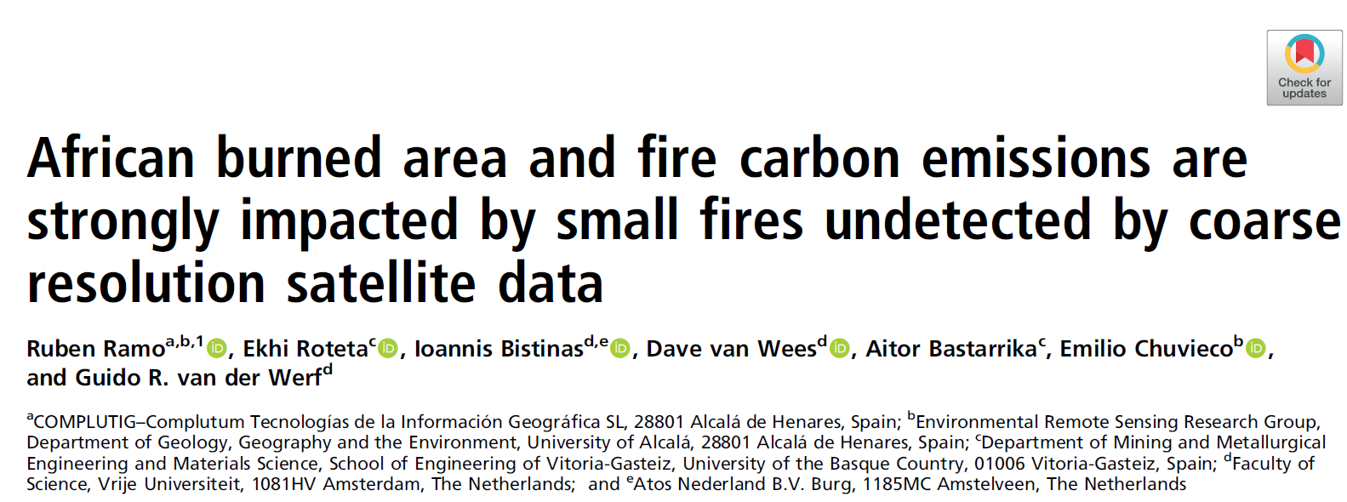
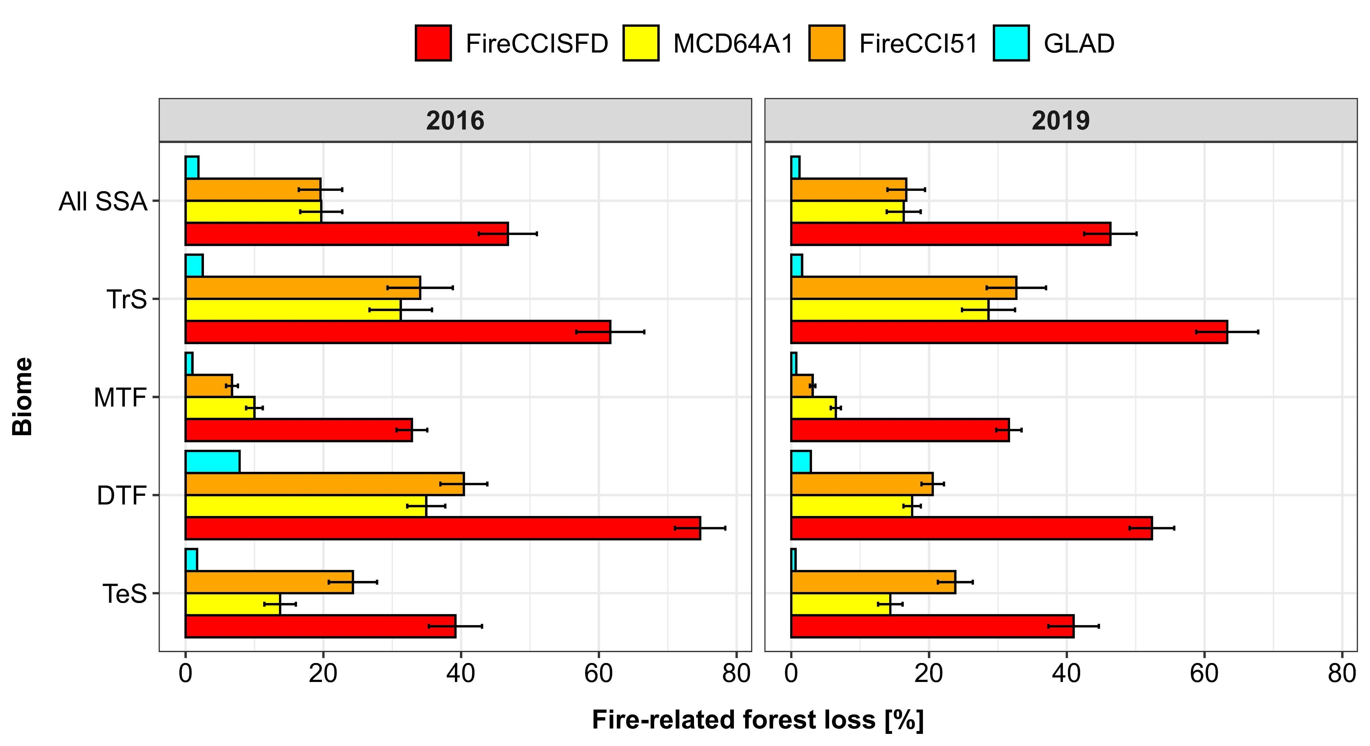
Relevance of medium-resolution data
Common BA products are derived from coarse-resolution sensors such as MODIS (>250 m) underestimates fire impacts (carbon emissions, forest loss, etc.)
Long-term and accurate medium-resolution products covering large-scales are still constrained by computational resources
Limited assessment of fire impacts in vulnerable and changing ecosystems (boreal, tropical, etc.)
Khairoun et all, In review
Notes:
BA is commonly analyzed based on global datasets such as MCD64A1 derived from coarse-resolution sensors such as MODIS, however, here the BA product we are using is called FireCCISFD, which covers BA detected over the Sub-Saharan region of the African continent, the most relevant region in terms of contributions to global BA and pyrogenic carbon emissions. BA detections were based on S-2A data and MODIS active fires in the first dataset of 2016, recently the new version of 2019 included data from S2B and VIIRS active fires, which ensures higher spatial and temporal reporting accuracy.

Slide 3
BAMT tool – BA cartography tool
BAMT tools are available at https://github.com/ekhiroteta/BAMT
Implemented in Google Earth Engine
Landsat and Sentinel2 images
Spatial resolution: 20 m (S2) and 30 m (Landsat)

Slide 4
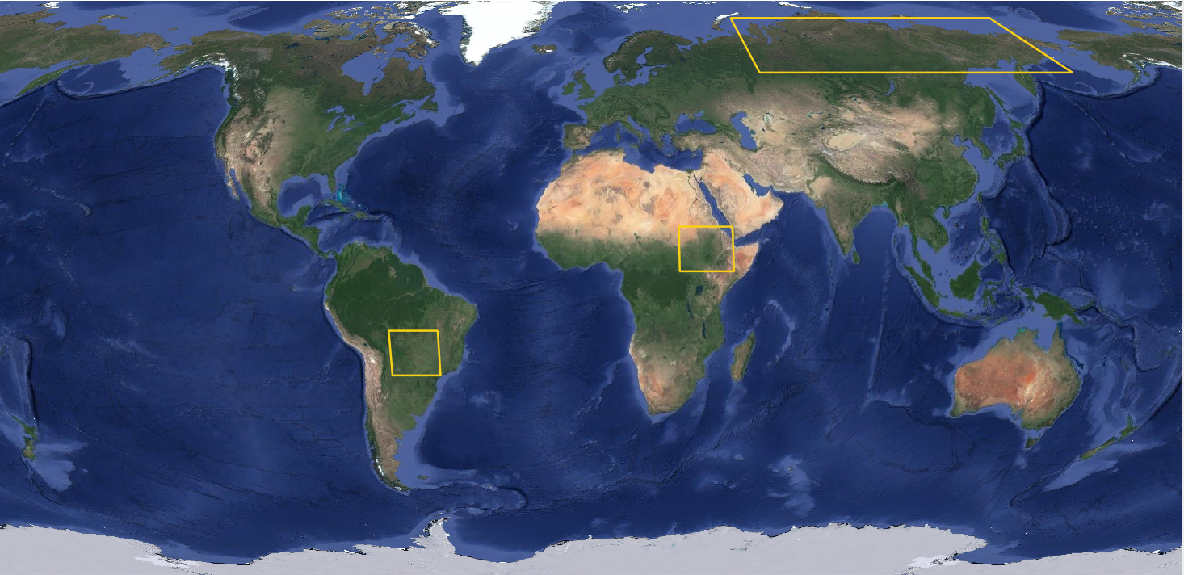
Target areas
Amazonia: tropical ecosystems (wetlands, tropical forests and savanna)
Sahel: tropical and temperate savanna and drylands
Siberia: peatlands and boreal forests
Siberia: 8.84 Mkm²
Amazonia: 2.10 Mkm²
Sahel: 2.39 Mkm²

Slide 5
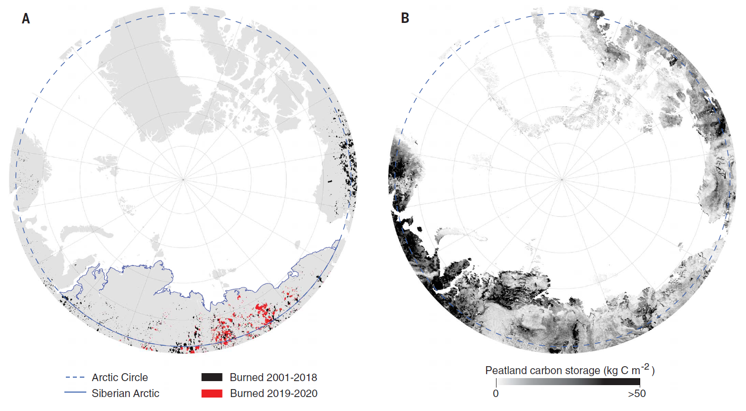
Siberia: West vs East

Slide 6
General approach
Two temporal times series (pre & post) of variables (initial bands + indices)
One temporal composite for period (minimizing the NBR)
nov/dec 2018
pre-composite nov/dec 2018

Slide 7
General approach
Two temporal times series (pre & post) of variables (initial bands + indices)
One temporal composite for period (minimizing the NBR)
jan/feb 2019
post-composite jan/feb 2019

Slide 8
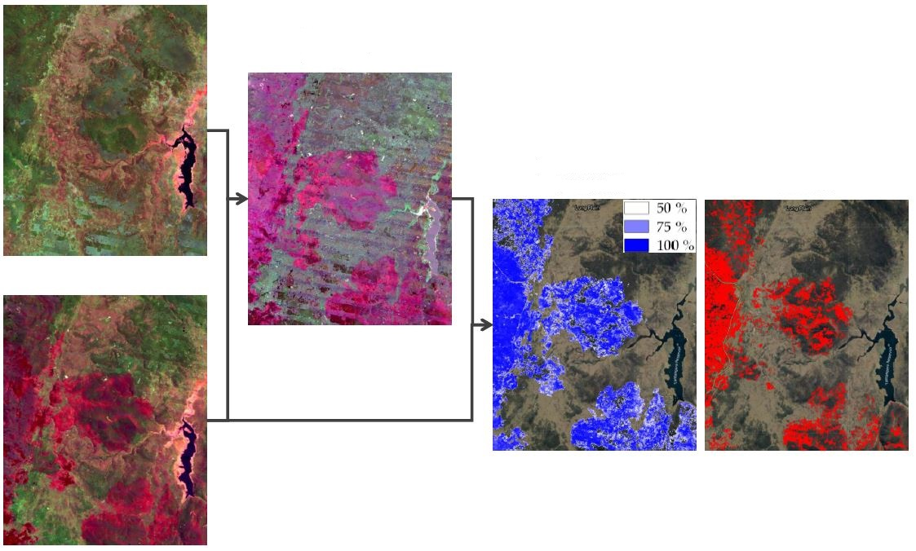
General approach
pre- and post- composite difference
pre-composite
probability of burning
seed pixels
result
post-composite

Slide 9
BAMT tool – Solved issues
The classification of each complete study area works well but exporting the final BA classification from the GEE takes a lot of time (hours or days).
Development of a pre-trained model:
Collection of extensive training data (2019)
Training and prediction based on by-period classification models
Modification of the expensive exporting functions:
Transformation of data types (float to int16 with x10000 multiplier)
Processing classification once and looping over grids (allowed in python not in GEE code editor).

Slide 10
BAMT tool – Solved issues
The selection of single date of burning for contiguous patches is inaccurate & computationally-demanding
Low signals in heterogeneous landscapes aren’t detected
Assignment of independent pixel dates:
The day of the highest signal using NBR index
Use of active fire dates
Application of growing regions:
Growing from initial confirmed seeds using relaxed thresholds

Slide 11
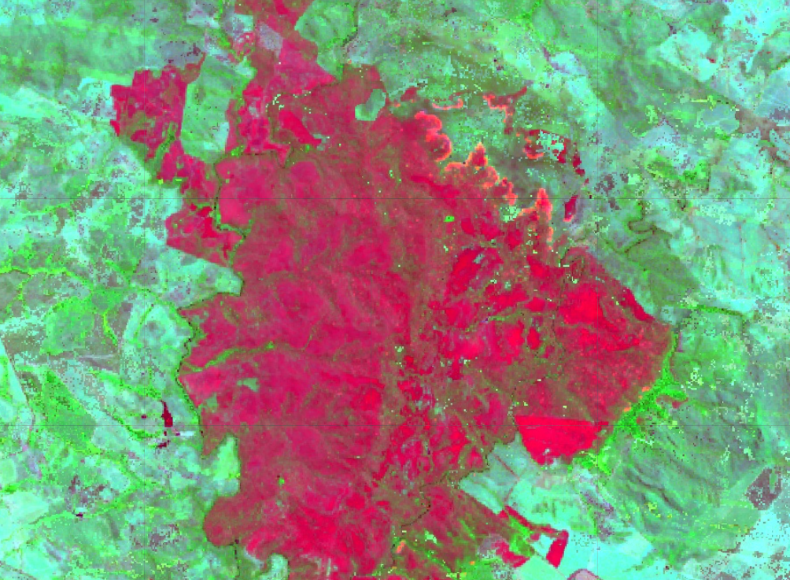
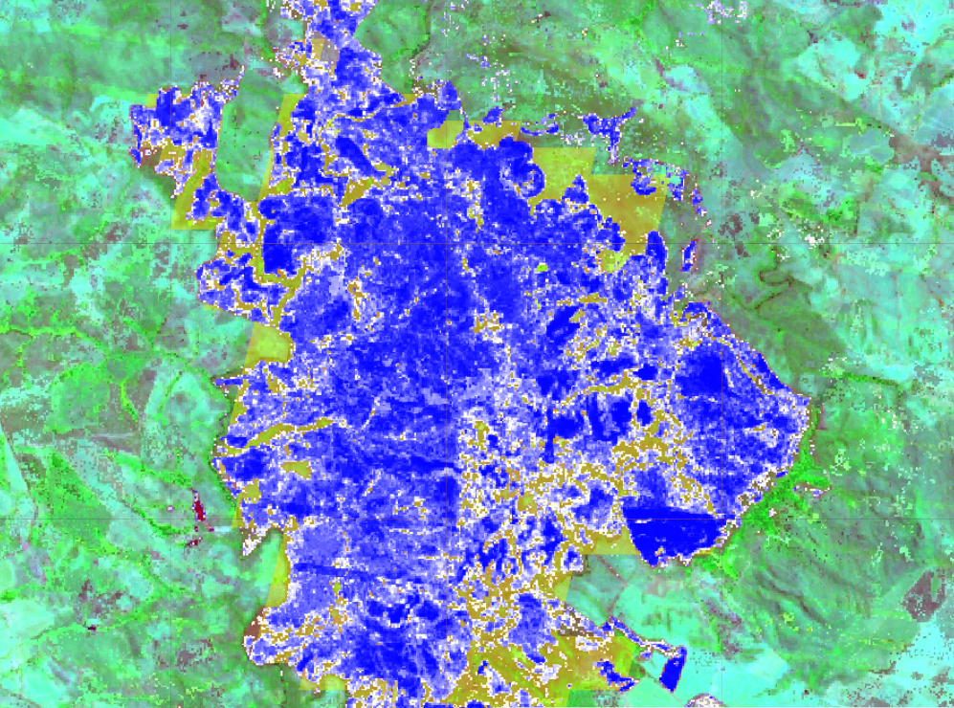
Low BA signal improvement
Post image composite (NBR2, NIR, Red)
Mapped BA against MCD64A1
Relaxed conditional growing region:
2 km around 3x3 seeds
Probability
Post NBR2 and
difference
Red and NIR differences (avoid crop harvest confusion)

Slide 12
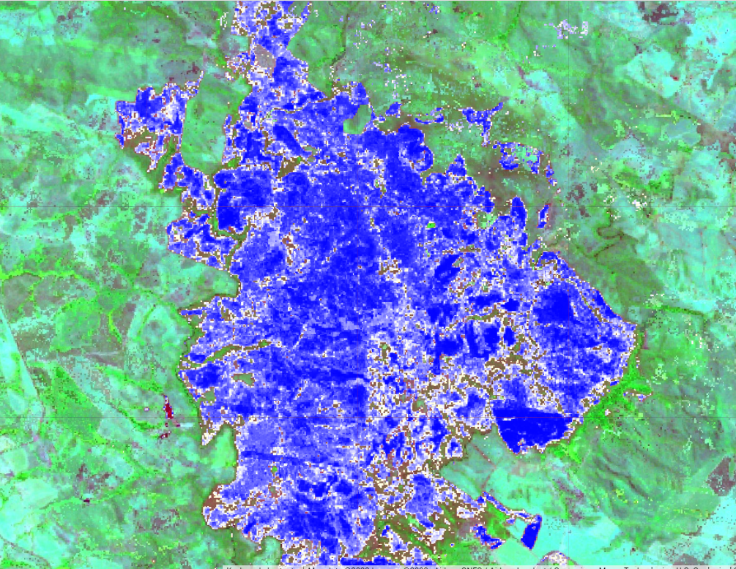
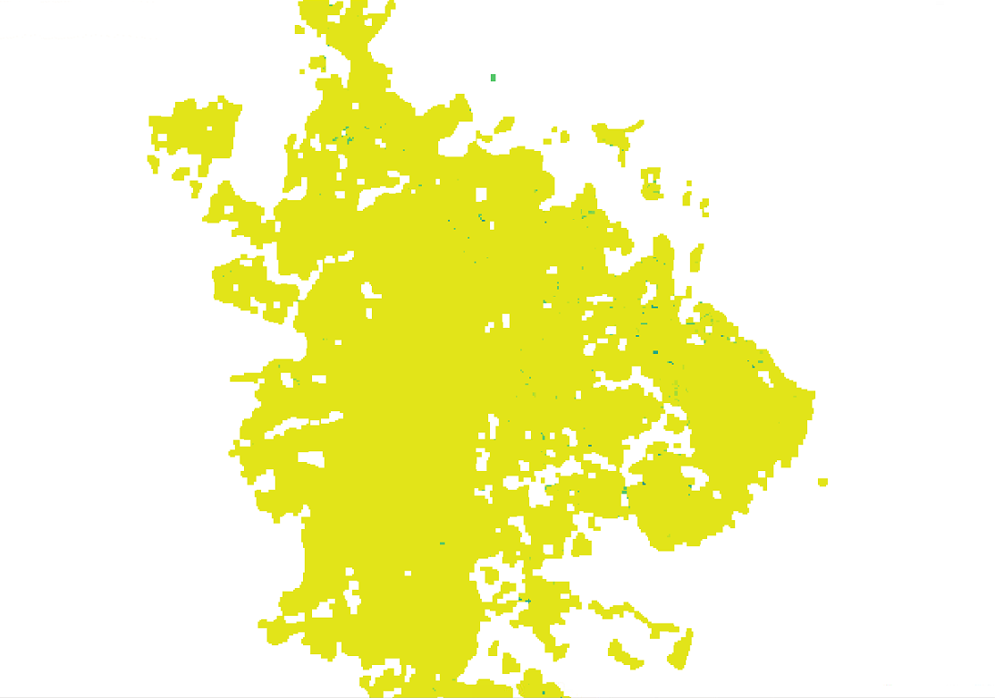
Low BA signal improvement
Filtered: No seed is inside + Morphological operations
Date (%Y% JD): 2019264
Morphological operations: Opening followed by closing with 3x3 kernel

Slide 13
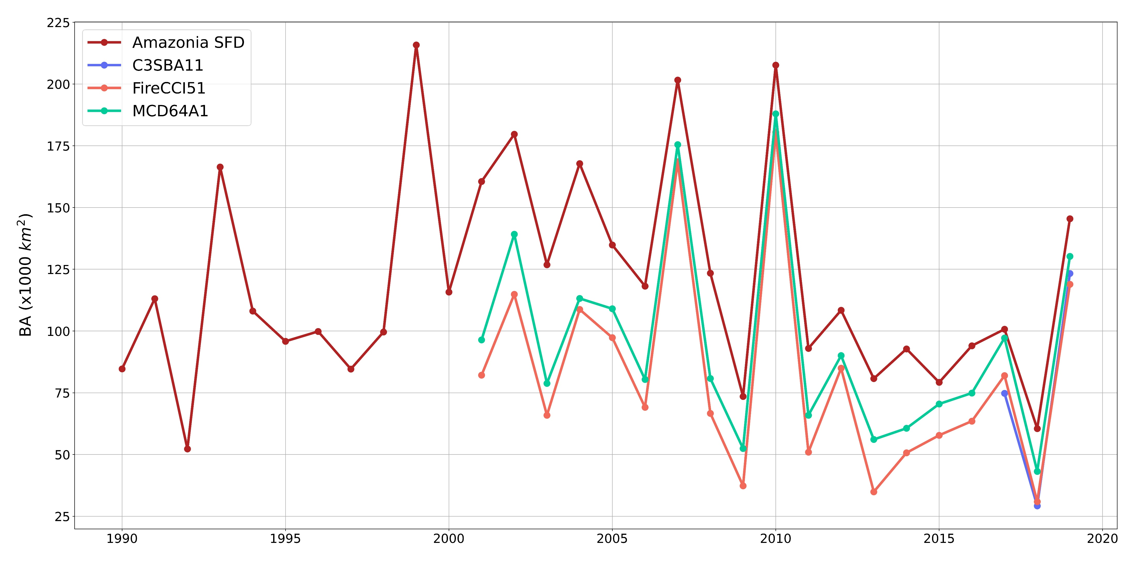
Preliminary results: Amazonia
On average (Only Landsat):
78% higher than FireCCI51
44% higher than MCD64A1

Slide 14
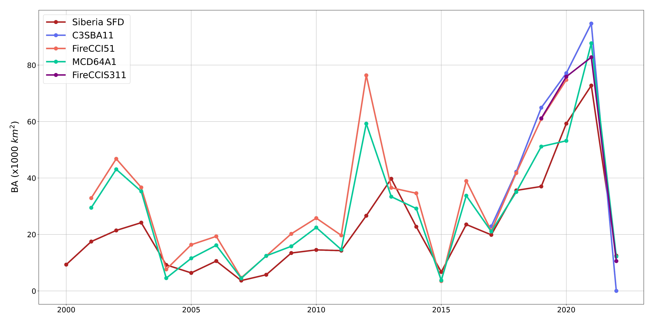
Preliminary results: Siberia
Significant increase in 2017-2021 and drop in 2022
Lower than global products: Small effect of small fires + balance between omission and commission errors

Slide 15
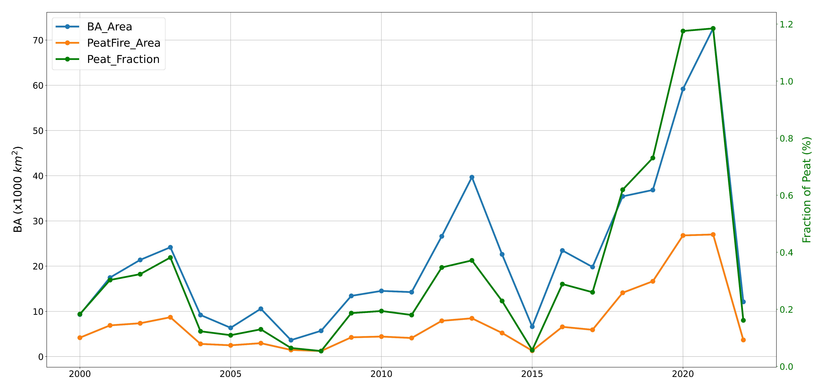
Preliminary results: Siberia
On average 33% of fires occur in peatlands
Significant increase in 2020-2021 affected more than 1% of peatland extent

Slide 16
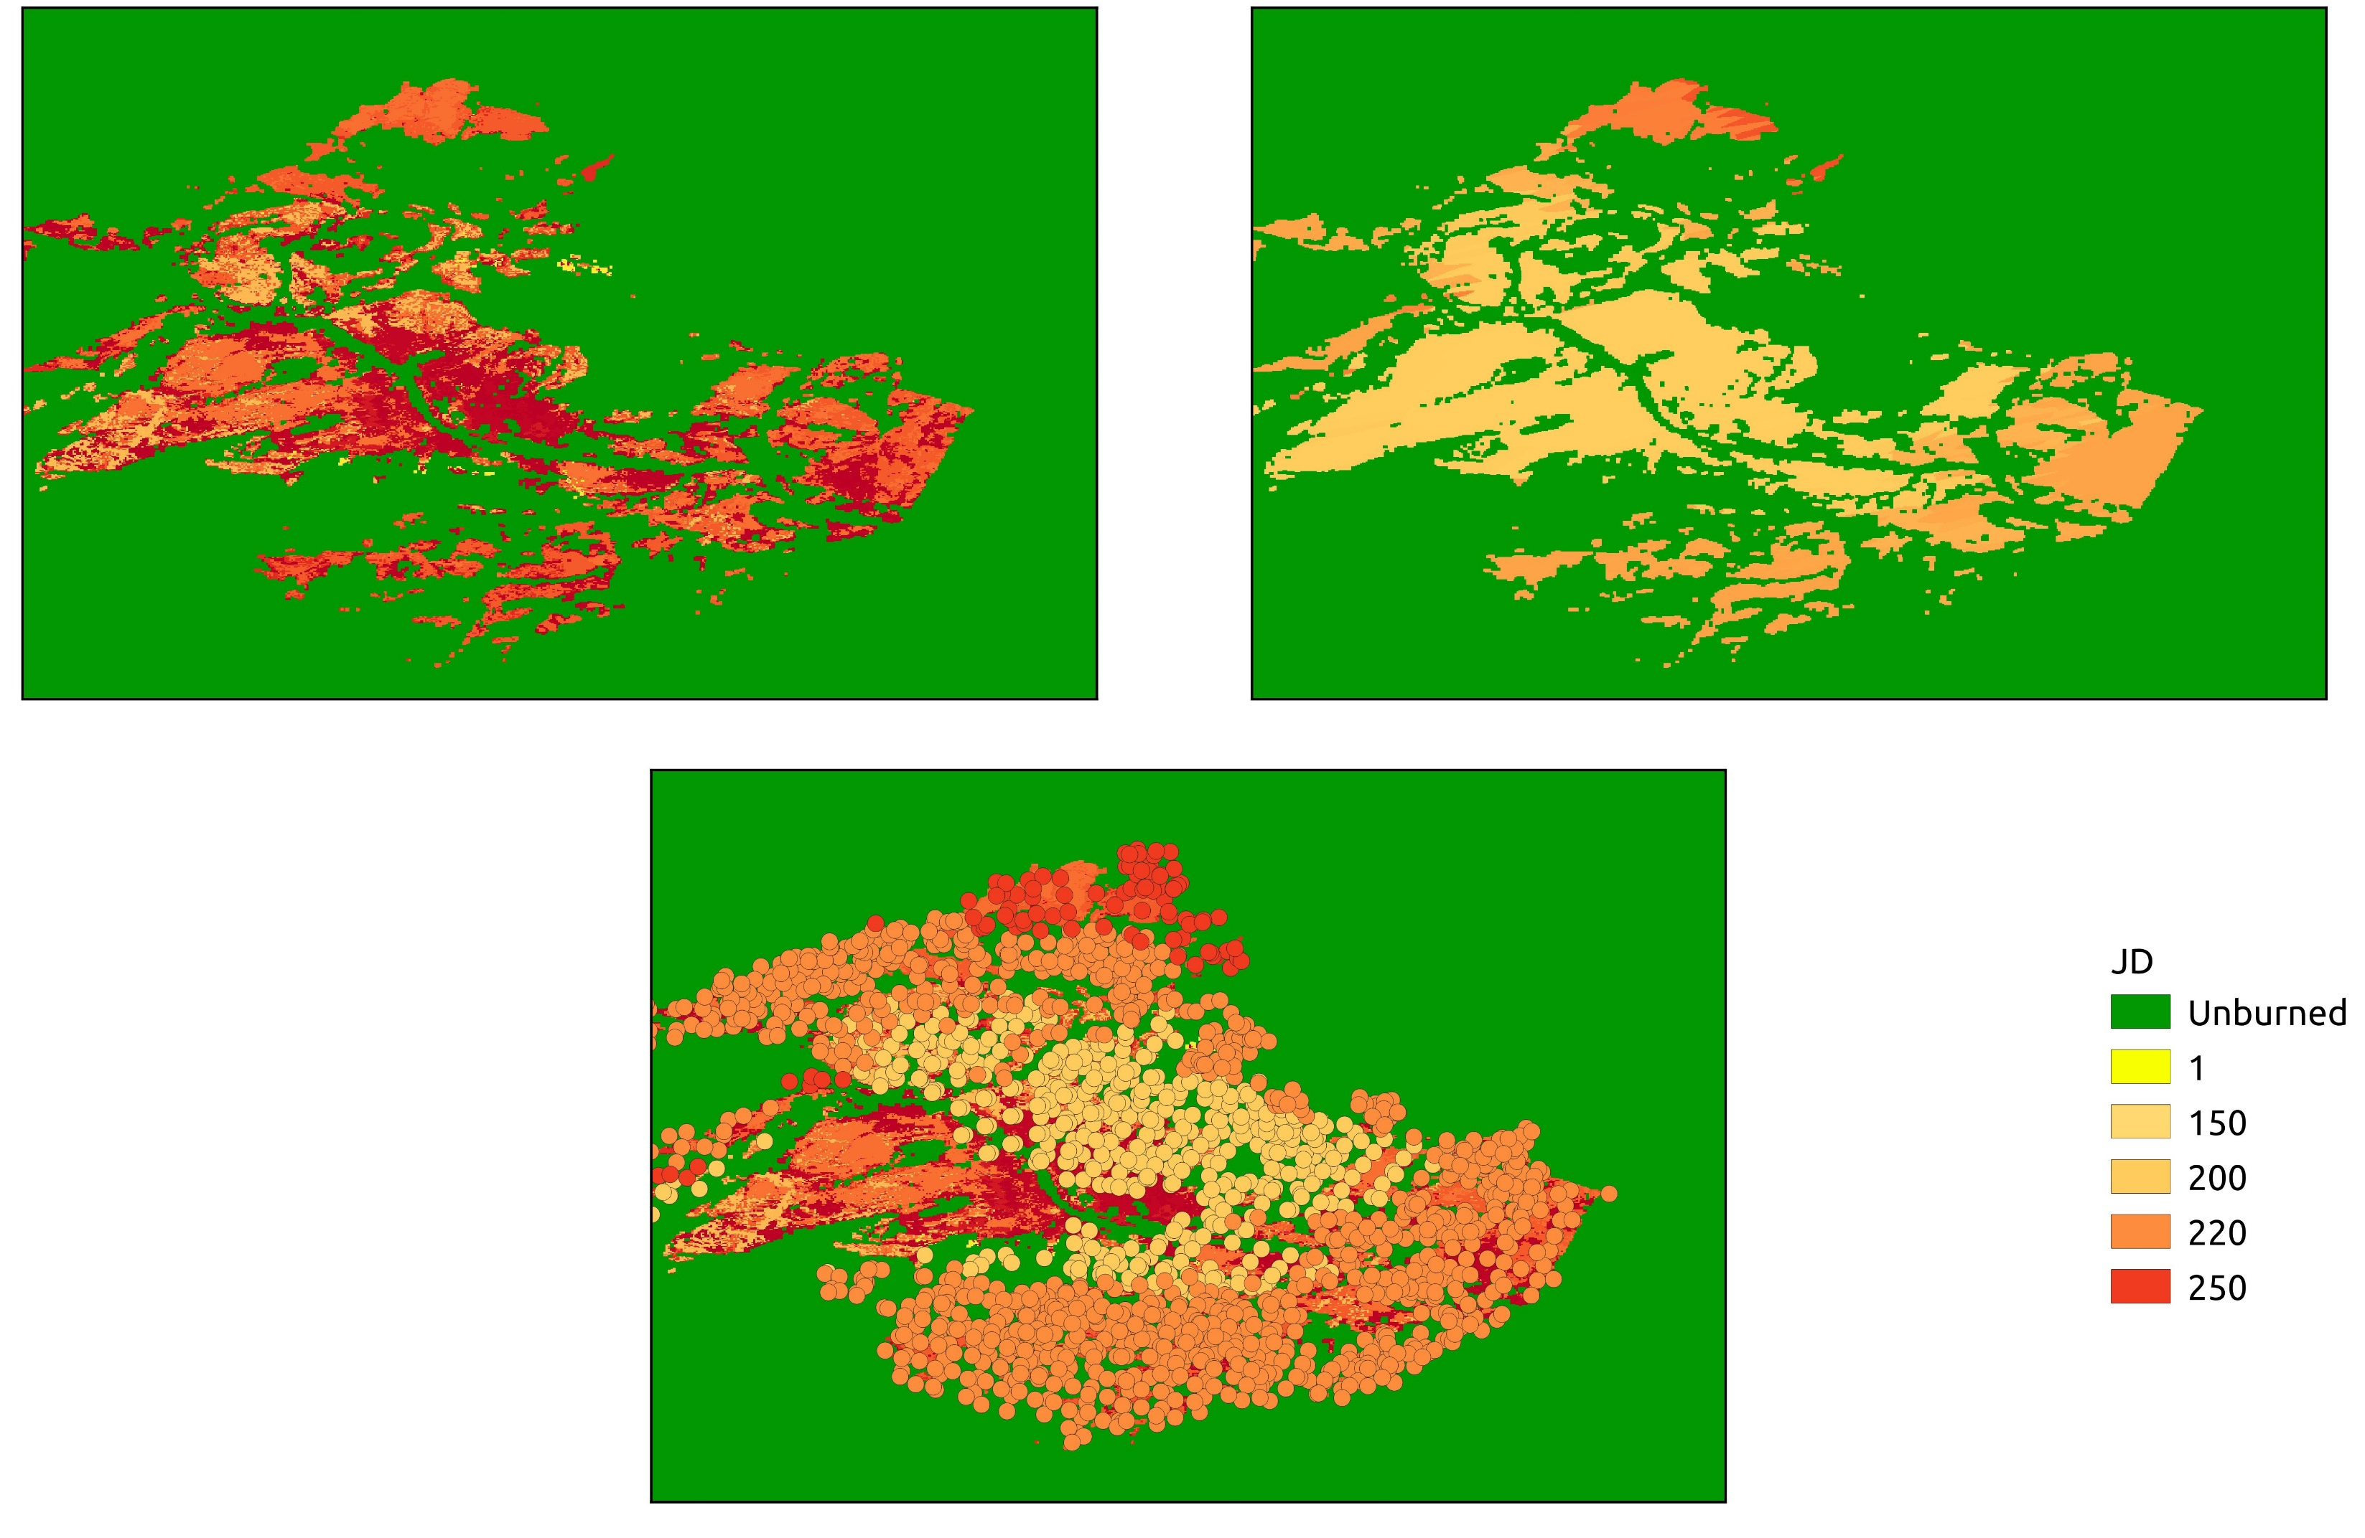
Fire date correction
Due to low number of observations, delayed fire detection is observed compared to active fires
➔ Date reassignment using active fires (Voronoi diagram)

Slide 17
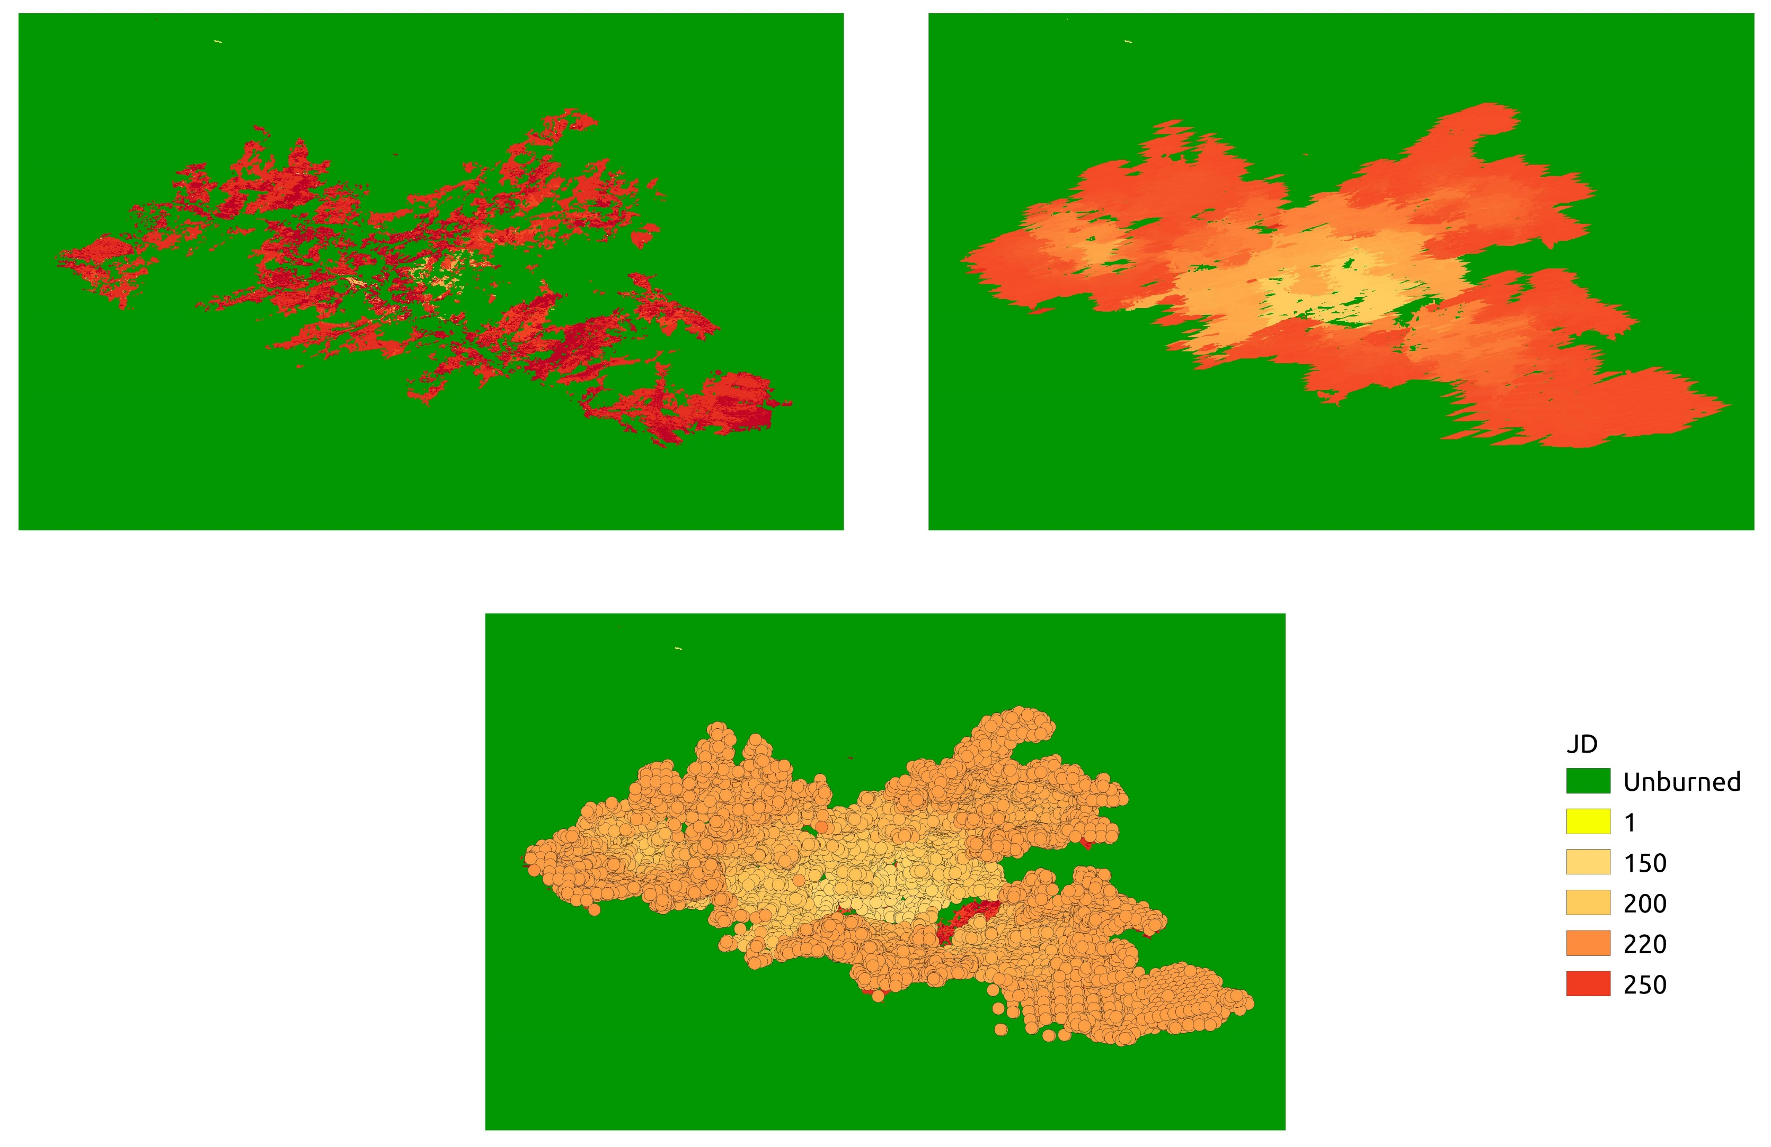
Complementation of fire patches
Due to low number of observations, some parts of fire patches are undetected (year 2012)
➔ Complementation using VIIRS or MODIS active fires using along scan and along track pixel dimensions

Slide 18
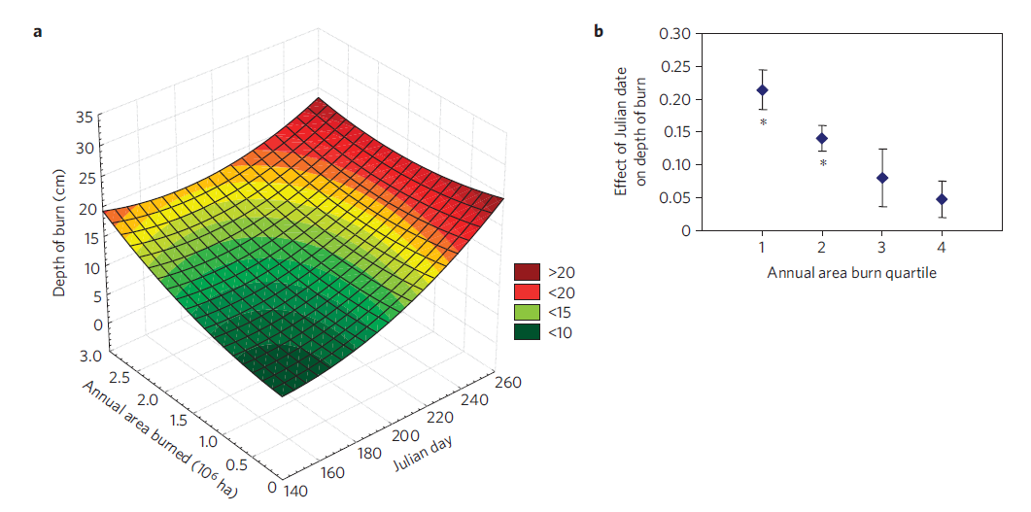
Future activities: Peatland Carbon modelling
Burning depth = f(JD, BA)
linear regression for each 25th percentile

Slide 19
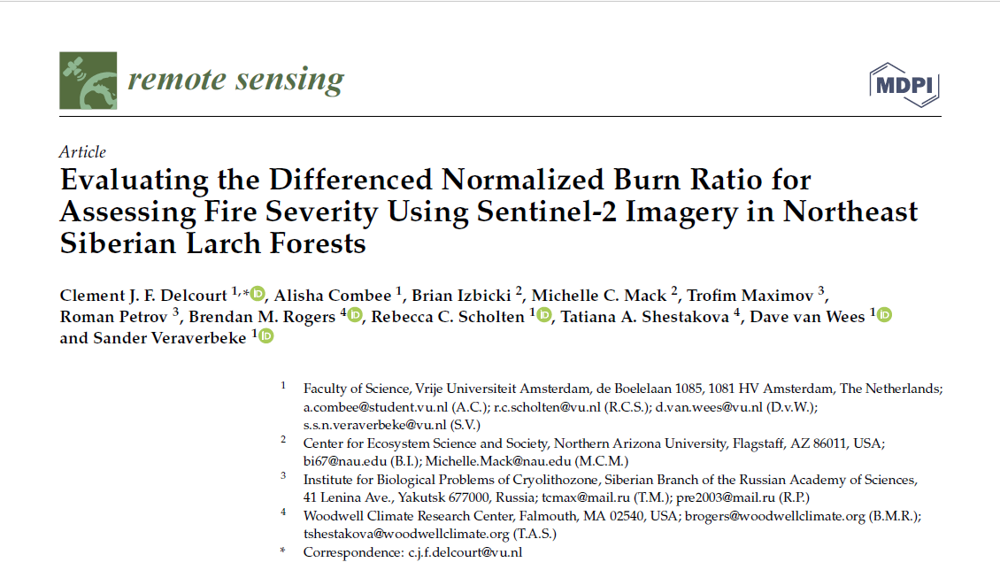
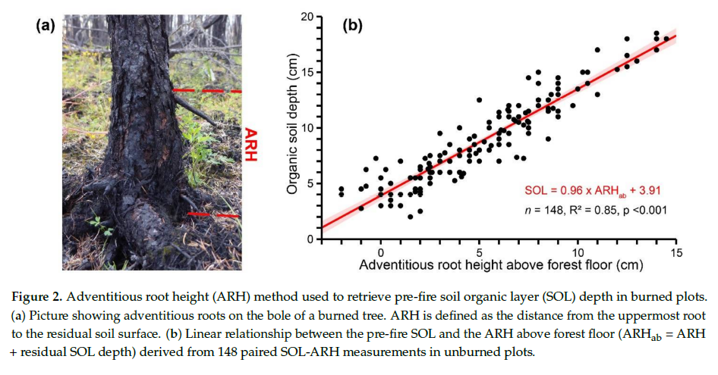
Future activities: Peatland Carbon modelling
Burning depth field data:
Collection of 53 plots (41 burned) in Northeast Siberian larch-dominated forests.
ARH is used to calculate the total pre-burning SOL, then subtracted from post-burning SOL to get burning depth.

Slide 20
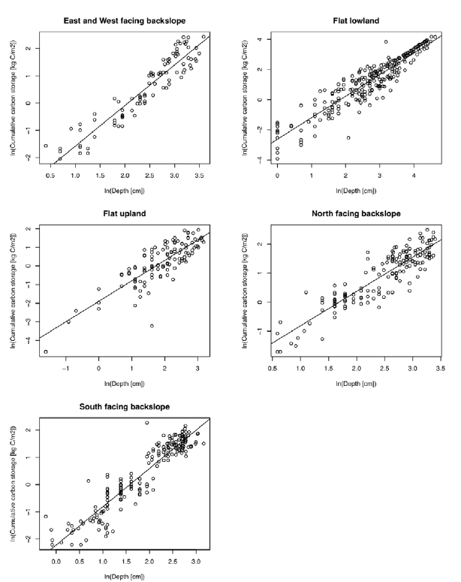
Future activities: Peatland Carbon modelling
Approach: Power law relationships between cumulative soil C storage and depth from unburned sites (near burned ones) in each landscape class
Estimation of carbon loss

Slide 21
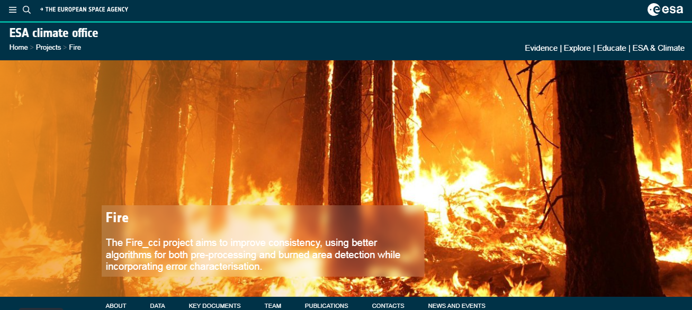
Future activities: Peatland Carbon modelling
https://climate.esa.int/en/projects/fire
amin.khairoun@uah.es
@AminKhairoun

