Slide 1
FUEL TYPE CLASSIFICATION USING MULTI-SEASONAL SENTINEL DATA, TOPOGRAPHY AND BIOPHYSICAL MODELS
Pegah Mohammadpour ^{1&2}, Domingos Xavier Viegas ¹, Emilio Chuvieco ², Alcides Pereira²
¹ Univ of Coimbra, ADAI, Department of Mechanical Engineering, Rua Luís Reis Santos, Pólo II, 3030-788 Coimbra, Portugal
² Universidad de Alcala, Environmental Remote Sensing Research Group, Department of Geology, Geography and Environment, Colegios 2, 28801 Alcalá de Henares, Spain
³ Univ Coimbra, Centre for Earth and Space Research of the University of Coimbra, Department of Earth Sciences, Portugal
V Simposio de Doctorandos de la UAH en Investigación con Tecnologías de la Información Geográfica (SITIG-UAH) 2023

Slide 2
Content
Introduction
Problem
Solution
Materials and Methodology
Study Area
Methodology & Data
Results
Band Selection
Height Estimation
Fuel Map & Occupied Area
Conclusion and Future Works
SITIG-UAH 2023
This Photo by Unknown Author is licensed under CC BY-SA

Slide 3
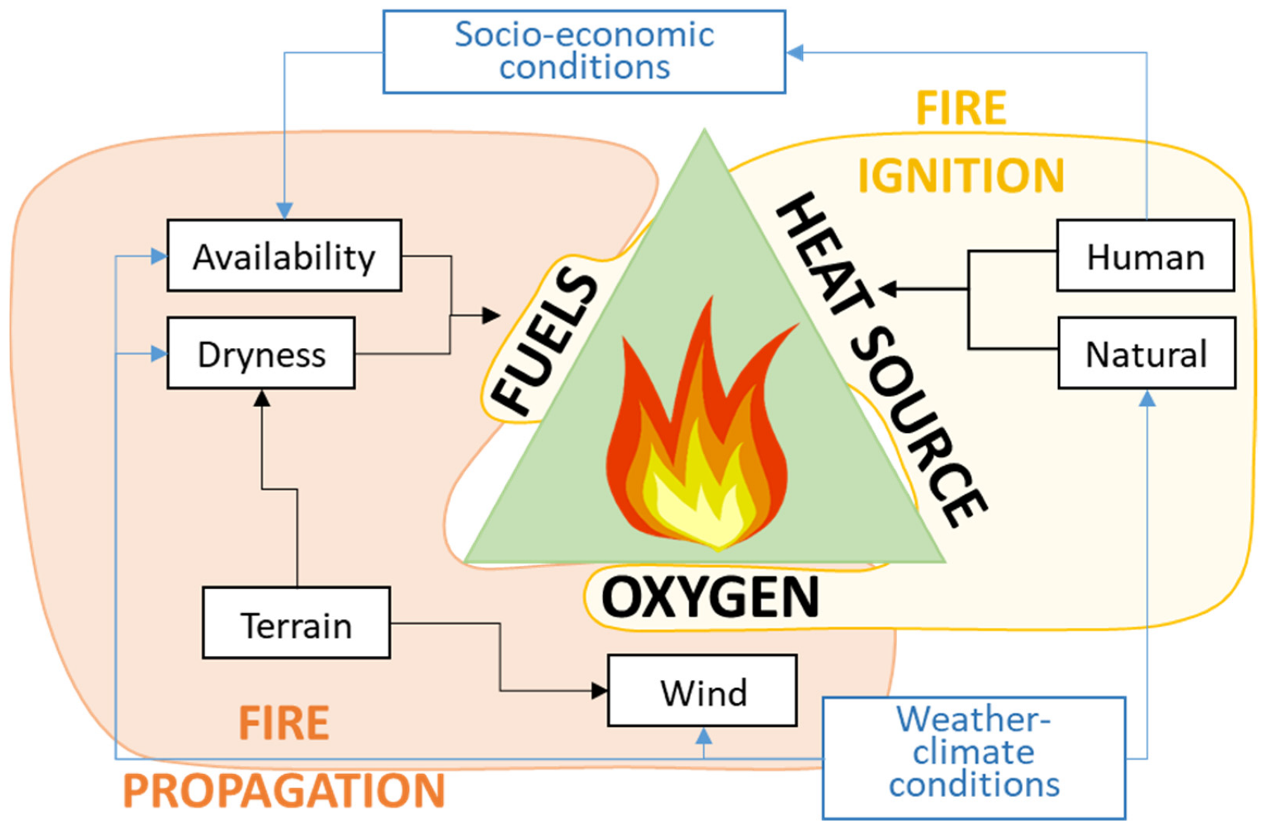
Introduction
Methodology & Data
Results
Conclusion and Future Works
SITIG-UAH 2023
Chuvieco, E.; Yebra, M.; Martino, S.; Thonicke, K.; Gómez-Giménez, M.; San-Miguel, J.; Oom, D.; Velea, R.; Mouillot, F.; Molina, J.R.; et al. Towards an Integrated Approach to Wildfire Risk Assessment: When, Where, What and How May the Landscapes Burn. Fire 2023, 6, 215. https://doi.org/10.3390/fire6050215

Slide 4
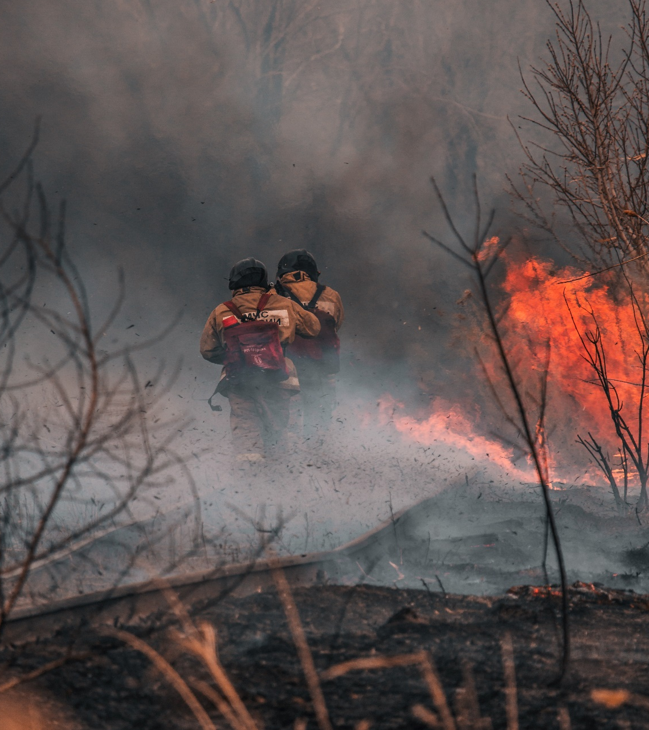
Introduction
Methodology & Data
Results
Conclusion and Future Works
Problem
Climate Change
More frequent and severe wildfires
Need to act on fire prevention
Need to do forest fuel management
SITIG-UAH 2023
Lack of detailed and quality data regarding vegetation cover
Lack of decision support tools to analyze available
remote sensing data

Slide 5
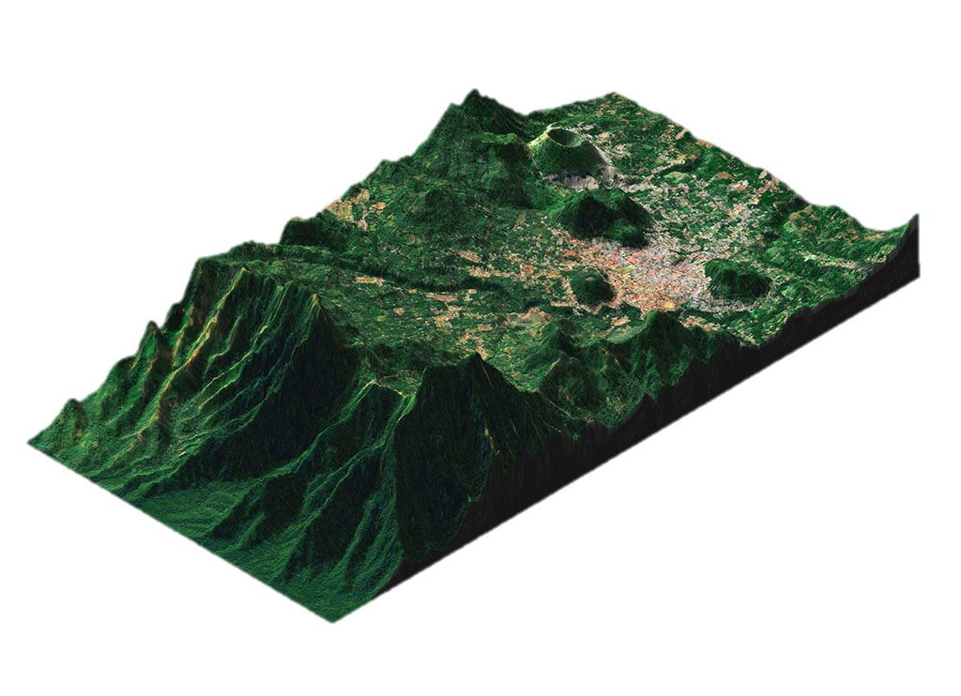
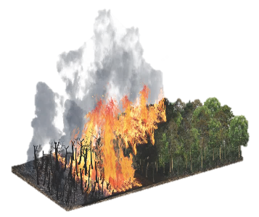
Introduction
Methodology & Data
Results
Conclusion and Future Works
Solution
Stage 1
Stage 2
Satellite data selection and acquisition
Data processing and fusion
Stage 3
Fuel classification and characterization
Stage 5
Fuel management plan based on multicriteria optimization
SITIG-UAH 2023
Integration to digital platform and validation
Stage 4

Slide 6
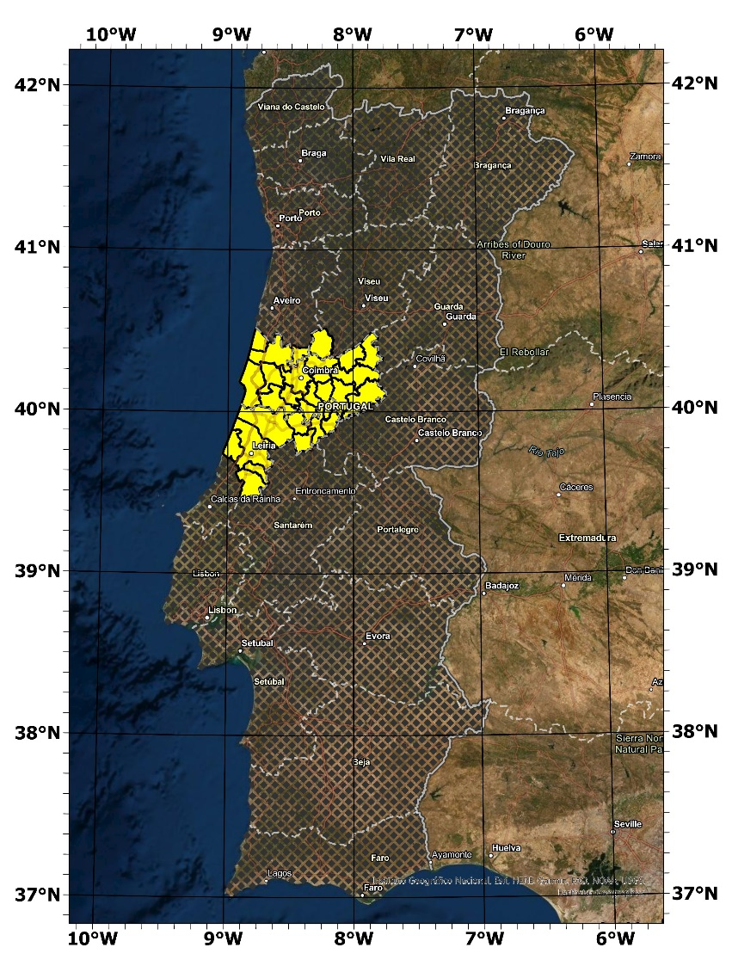
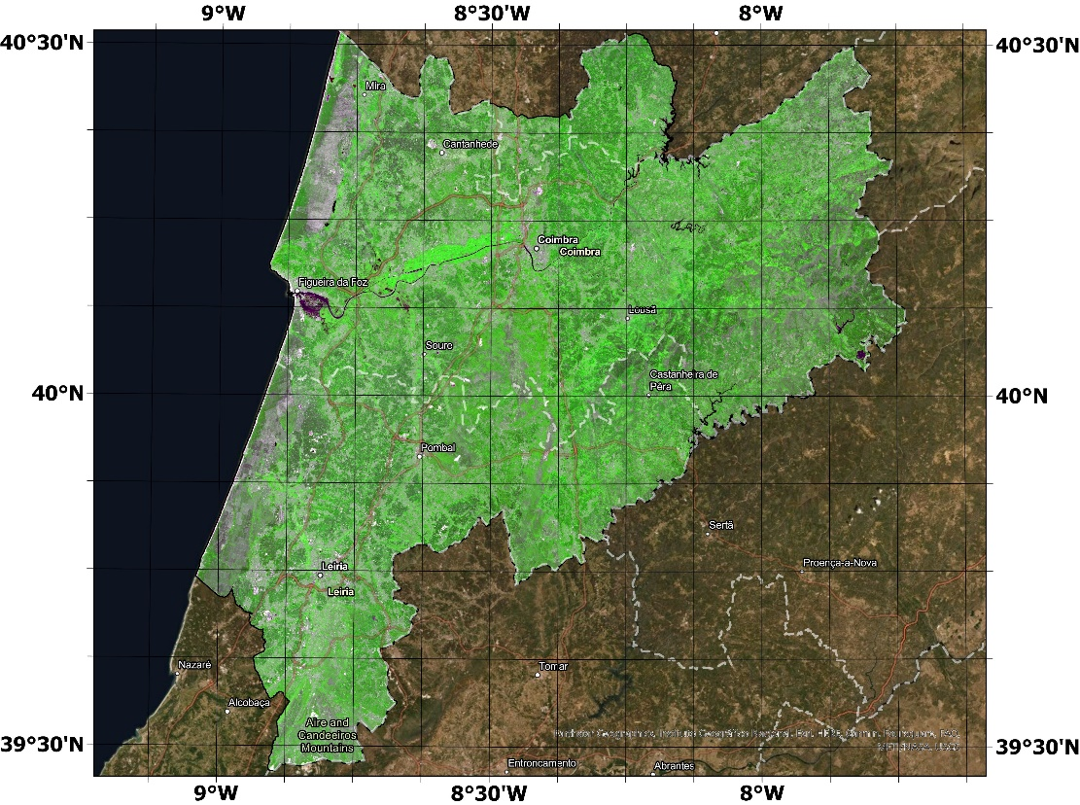
Introduction
Methodology & Data
Results
Conclusion and Future Works
Portuguese Pilot Site (PS3)
SITIG-UAH 2023

Slide 7
Introduction
Methodology & Data
Results
Conclusion and Future Works
First Level
Forest
Broadleaf
Needleleaf
Shrubland
Low
Wetland
Grassland
Low
Cropland
Herbaceous
Woody
Mixed
Evergreen
Evergreen
Deciduous
Deciduous
Open [15-70 %]
Closed [70-100 %]
Open [15-70 %]
Closed [70-100 %]
Open [15-70 %]
Closed [70-100 %]
Open [15-70 %]
Closed [70-100 %]
Open [15-70 %]
Closed [70-100 %]
Medium
High
Medium
High
Tree
Shrubland
Grassland
Urban
Non-Fuel
Continuous Fabric
Discontinuous Fabric
Hierarchical-multipurpose fuel classification system
Leaf Type
Deciduousness
SITIG-UAH 2023
Fractional Cover
Fuel Depth
Fuel Type
Aragoneses, E., García, M., Salis, M., Ribeiro, L. M., and Chuvieco, E.: Classification and mapping of European fuels using a hierarchical, multipurpose fuel classification system, Earth Syst. Sci. Data, 15, 1287–1315, https://doi.org/10.5194/essd-15-1287-2023, 2023.

Slide 8
Introduction
Methodology & Data
Results
Conclusion and Future Works
Primary Map
Samples
DEM
Sentinel-1
Sentinel-2
Preprocessing
Elevation, slope, Aspect
Preprocessing
Preprocessing
Test 30%
Train 70%
5 Months Images
5 Months images
Mosaic Images
Mosaic Images
SITIG-UAH 2023
Feature Extraction
Feature Extraction
Stack Images
1st Step
Statistical Accuracy
Feature Selection
Primary Fuel Map
Random Forest Classifier

Slide 9
Introduction
Methodology & Data
Results
Conclusion and Future Works
Final Map
Biophysical models
NDVI
Validation samples
Fuel Biomass
Precipitation
Fuel Depth
Primary Fuel Map
Final Fuel Map
Statistical Accuracy
Shrubland biomass (g m⁻²)= [0.856 (NDVI)+0.183] P_{r} , P_{r} = [P/P_{s}]^{k}
Shrub Height (m)= ((Shrubland biomass (g m⁻²)/1000)-0.708)/2.8
2nd Step
SITIG-UAH 2023
Grassland total biomass (kg/ha) = 3.11 + (25.11 * b5 + (-12.88*b8) + (9.46*NDVI))
Grass Depth (m) = (biomass (gm⁻²)-161.09) / 578
Marildo Guerini Filho, Tatiana Mora Kuplich & Fernando L. F. De Quadros (2020) Estimating natural grassland biomass by vegetation indices using Sentinel 2 remote sensing data, International Journal of Remote Sensing, 41:8, 2861-2876, DOI: 10.1080/01431161.2019.1697004
Maxim Shoshany & Lev Karnibad (2011) Mapping shrubland biomass along Mediterranean climatic gradients: The synergy of rainfall-based and NDVI-based models, International Journal of Remote Sensing, 32:24, 9497-9508, DOI: 10.1080/01431161.2011.562255
Zhang, H., Sun, Y., Chang, L., Qin, Y., Chen, J., Qin, Y., Du, J., Yi, S., and Wang, Y.: Estimation of grassland canopy height and aboveground biomass at the quadrat scale using unmanned aerial vehicle, Remote Sens., 10, 851, https://doi.org/10.3390/rs10060851, 2018.
Saglam, B., Küçük, Ö., Bilgili, E., and Durmaz, B. D.: Estimating Fuel Biomass of Some Shrub Species (Maquis) in Turkey, Turkish J. Agric. For., 32, 349–356, 2008

Slide 10
Introduction
Methodology & Data
Results
Conclusion and Future Works
Data
COS2018 & Cossim2020
IFN6-2015
National forest inventory- ICNF
Google Earth orthophoto maps
land use and occupation map-DGT
CLC2018
GLC2019
HRL2019
LUCAS2018
Copernicus global land cover map
pan-European Corine land cover
Pan-European high-resolution layers
Land cover/use statistics
Field Data 2021/2022
SITIG-UAH 2023

Slide 11
Introduction
Methodology & Data
Results
Conclusion and Future Works
Band Selection
Spectral bands
Band 11
Band 8A
Vegetation Indices
GNDVI
MSAVI
GLCM textures
Mean
Correlation
Variance
July & January
SAR band
VH
Topography
Elevation
TCW
Selection of 35 bands based on Recursive Feature Extraction (RFE) and Random Forest built-in feature importance measures
SITIG-UAH 2023

Slide 12
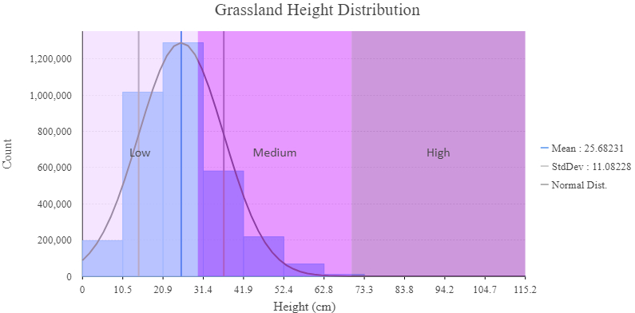
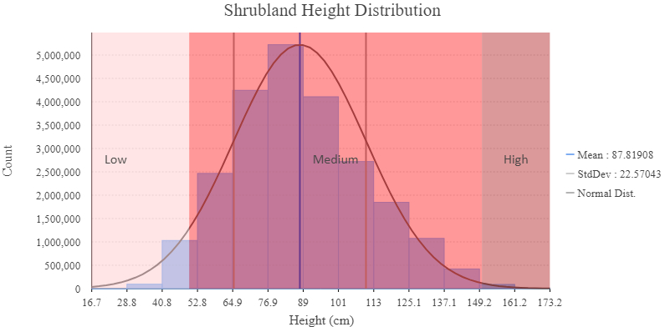
Introduction
Methodology & Data
Results
Conclusion and Future Works
Height Estimation
SITIG-UAH 2023

Slide 13
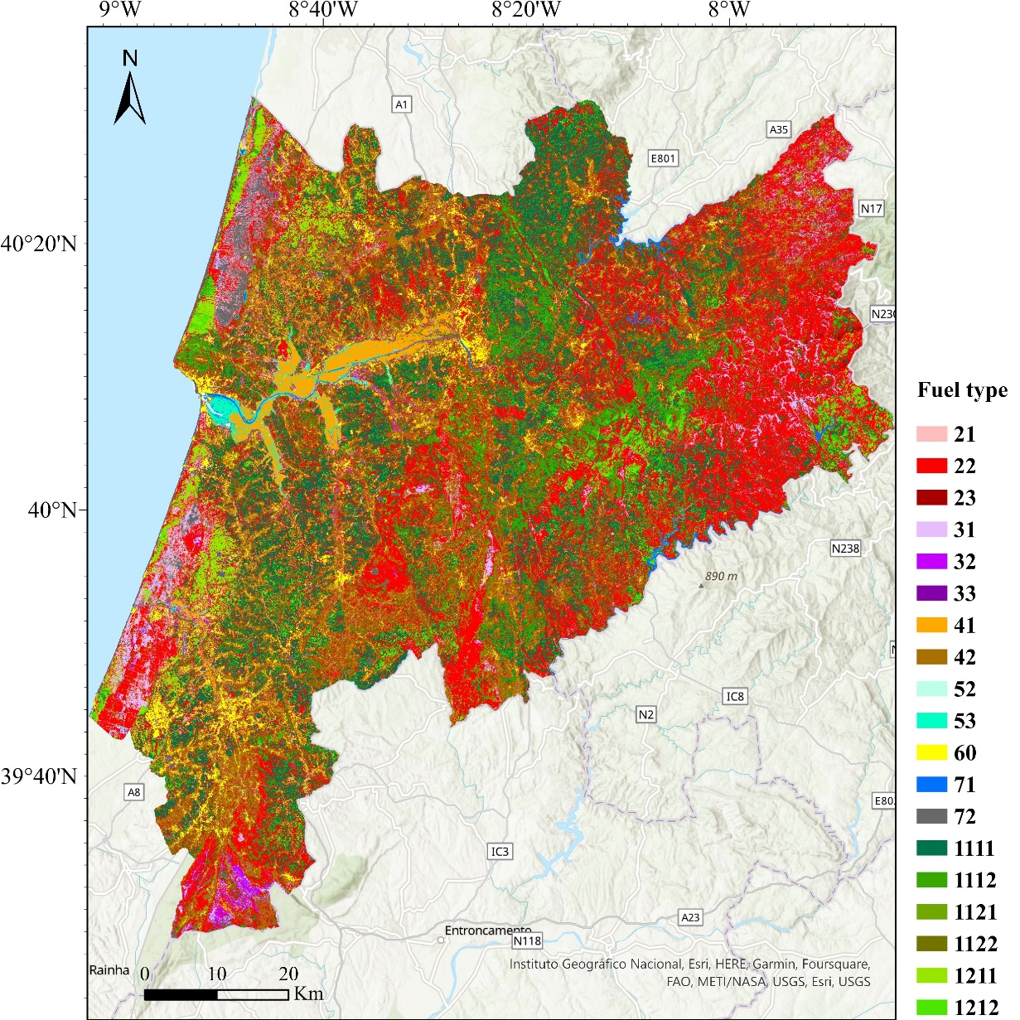
Introduction
Methodology & Data
Results
Conclusion and Future Works
Results
Primary map Final map
Overall Accuracy 88.94% ±1 83.62% ±1
Min Producer Accuracy 72.13% 64.51%
Min User Accuracy 60% 50%
Mean F1-score 87.65% 83.45%
SITIG-UAH 2023

Slide 14
Introduction
Methodology & Data
Results
Conclusion and Future Works
Confusion Matrix
Classification | Reference
 |  | 20 | 30 | 41 | 42 | 52 | 53 | 60 | 71 | 72 | 1111 | 1112 | 1121 | 1122 | 1211 | 1212 | PA (%) | F1-Score (%)
 | 20 | 100 | 5 | 0 | 0 | 0 | 0 | 1 | 0 | 0 | 2 | 0 | 6 | 0 | 3 | 0 | 85.5 | 86.6
 | 30 | 5 | 44 | 6 | 2 | 0 | 1 | 3 | 0 | 0 | 0 | 0 | 0 | 0 | 0 | 0 | 72.1 | 77.9
 | 41 | 0 | 3 | 87 | 6 | 0 | 1 | 0 | 0 | 0 | 0 | 0 | 0 | 0 | 0 | 0 | 89.7 | 87.9
 | 42 | 5 | 0 | 8 | 105 | 0 | 0 | 0 | 0 | 0 | 0 | 0 | 0 | 0 | 0 | 0 | 89.0 | 90.9
 | 52 | 0 | 0 | 0 | 0 | 27 | 0 | 0 | 0 | 0 | 0 | 0 | 0 | 0 | 0 | 0 | 100.0 | 77.1
 | 53 | 0 | 0 | 0 | 0 | 13 | 55 | 0 | 0 | 0 | 0 | 0 | 0 | 0 | 0 | 0 | 80.9 | 85.3
 | 60 | 0 | 0 | 0 | 0 | 0 | 0 | 87 | 0 | 2 | 0 | 0 | 0 | 0 | 0 | 0 | 97.8 | 92.1
 | 71 | 0 | 0 | 0 | 0 | 0 | 0 | 0 | 53 | 0 | 0 | 0 | 0 | 0 | 0 | 0 | 100.0 | 100.0
 | 72 | 0 | 0 | 0 | 0 | 0 | 0 | 9 | 0 | 79 | 0 | 0 | 0 | 0 | 0 | 0 | 89.8 | 93.5
 | 1111 | 0 | 0 | 0 | 0 | 0 | 0 | 0 | 0 | 0 | 55 | 13 | 0 | 0 | 0 | 1 | 79.7 | 85.3
 | 1112 | 0 | 0 | 0 | 0 | 0 | 0 | 0 | 0 | 0 | 1 | 50 | 0 | 0 | 0 | 0 | 98.0 | 87.7
 | 1121 | 0 | 0 | 0 | 0 | 0 | 0 | 0 | 0 | 0 | 0 | 0 | 12 | 1 | 0 | 0 | 92.3 | 72.7
 | 1122 | 0 | 0 | 0 | 0 | 3 | 4 | 0 | 0 | 0 | 0 | 0 | 2 | 43 | 0 | 0 | 82.7 | 89.6
 | 1211 | 0 | 0 | 0 | 0 | 0 | 0 | 0 | 0 | 0 | 2 | 0 | 0 | 0 | 75 | 0 | 97.4 | 94.9
 | 1212 | 4 | 0 | 0 | 0 | 0 | 0 | 0 | 0 | 0 | 0 | 0 | 0 | 0 | 3 | 43 | 86.0 | 91.5
 | UA (%) | 87.7 | 84.6 | 86.1 | 92.9 | 62.8 | 90.2 | 87 | 100 | 97.5 | 91.7 | 79.4 | 60 | 97.7 | 92.6 | 97.7
 | OA (%) | 88.94
SITIG-UAH 2023

Slide 15
Introduction
Methodology & Data
Results
Conclusion and Future Works
Occupied Area
Causes
Lack of up-to-date
Wildfires and burnt area
Cutting tree and new plantation
Complex and heterogeneous
Fragmented species distribution
Resolution and class differences
Tree age differences
SITIG-UAH 2023

Slide 16
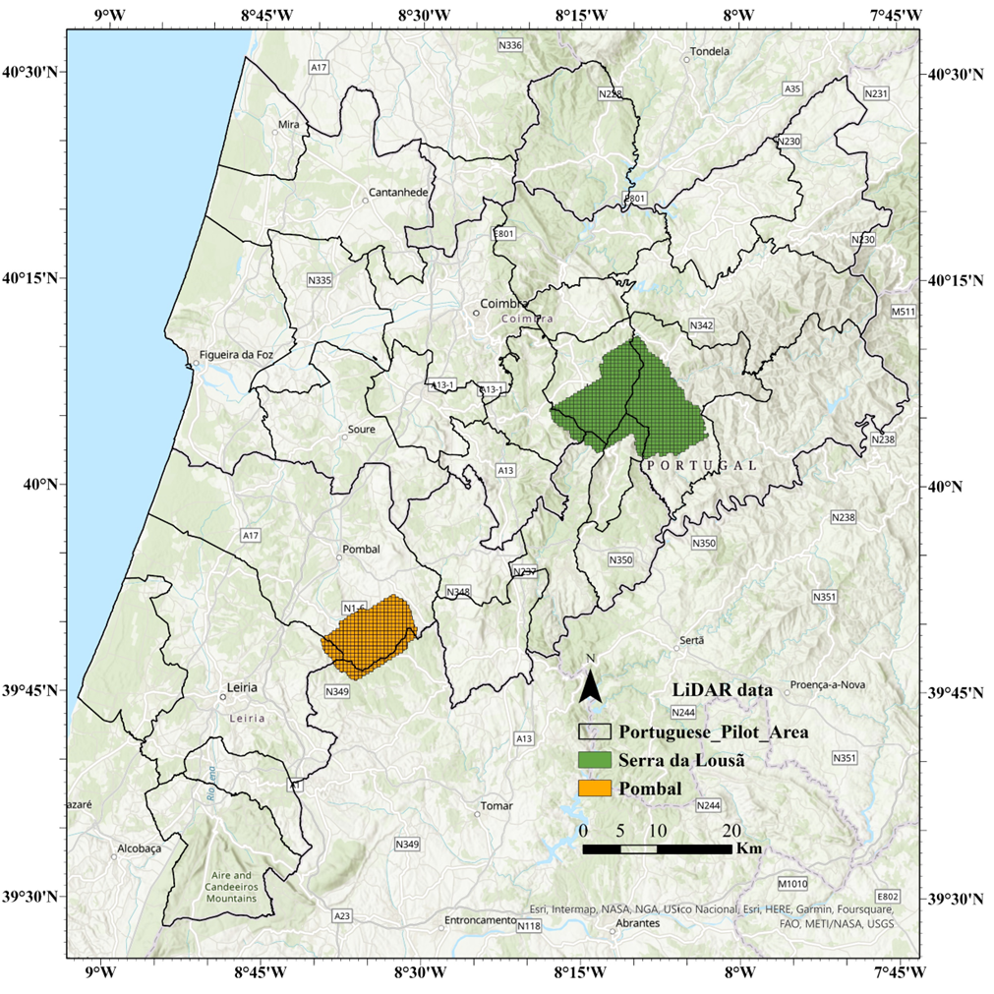
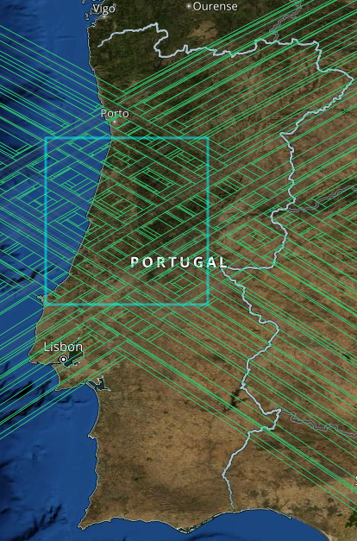
Introduction
Methodology & Data
Results
Conclusion and Future Works
High potential of multitemporal medium resolution Sentinel data for rapid and precise fuel type classification
Future Works
Using GEDI data for fuel parametrization
Calibrating GEDI with airborne LiDAR
Expanding the study area to mainland Portugal
89% accuracy for primary map and 84% accuracy for detailed fuel types classification by considering fuel depth
Importance of texture features and elevation, and fusion of Sentinel data by increasing the inter-class separability and OA
Conclusion
Effectiveness of biophysical model based on NDVI and precipitation for height estimation
SITIG-UAH 2023
Pegah Mohammadpour
pegah.mohammadpour@edu.uah.es

Slide 17
pegah.mohammadpour@edu.uah.es
This work is financed by national funds through FCT - Foundation for Science and Technology, under grant agreement 2021.05971.BD attributed to the 1st author.

